Slide 1
Hash-based signatures LMS, XMSS, Sphincs+ Gabriel ZAID, PEPR PQ-TLS, 12/03/2025

Slide 2



ITSEF
Evaluation
Goal : Obtain a security certification provided by ANSSI (CC / CSPN / EMVCo …)
1
Develop a crypto-lib implementing hash-based signatures
2
Conduct the security assessment of the crypto-lib
Thales ITSEF
3
Provides a certificate to the developer
Developer
ANSSI

Slide 3
Background

Slide 4

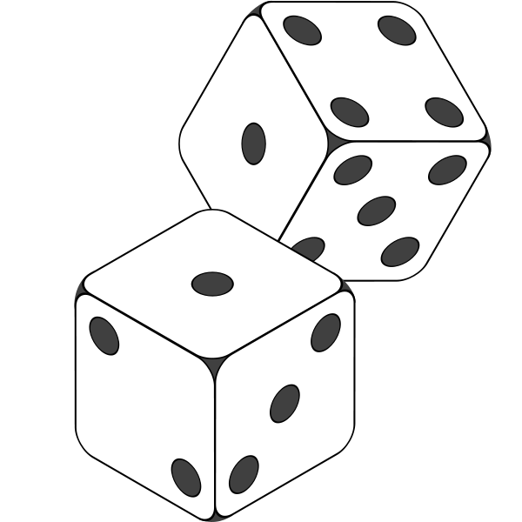





Background
Winternitz OTS
WOTS is a One-Time Signature scheme proposed by Merkle based on an idea by Winternitz [Mer89].
$$n$$
KeyGen
$$H$$
$$H( )$$
$$H$$
$$H\left(H\left( \right)\right)$$
…
$$H$$
$$H^{2^{w}−1}( )$$
SignGen
SignVerif
$$H$$
$$H$$
…
$$H$$
$$H^{\left(2^{w}−1\right)−2}\left( \right)=H^{2^{w}−1}( )$$
$$H$$
$$H( )$$
$$H$$
$$H^{2}\left( \right)=$$
[Mer89] R. C. Merkle. A certified digital signature. CRYPTO 89

Slide 5
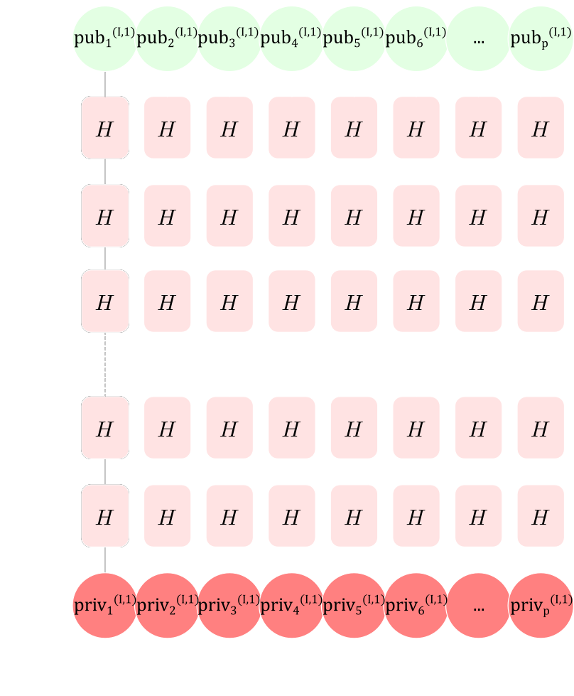















Background
Winternitz OTS
WOTS is a One-Time Signature scheme proposed by Merkle based on an idea by Winternitz [Mer89].
$$n$$
KeyGen
$$sign=\{ , , , , , , …, \}$$
SignGen
$$sign=\{ , , , , , , …, \}$$
SignVerif
?
?
?
?
?
?
?

Slide 6

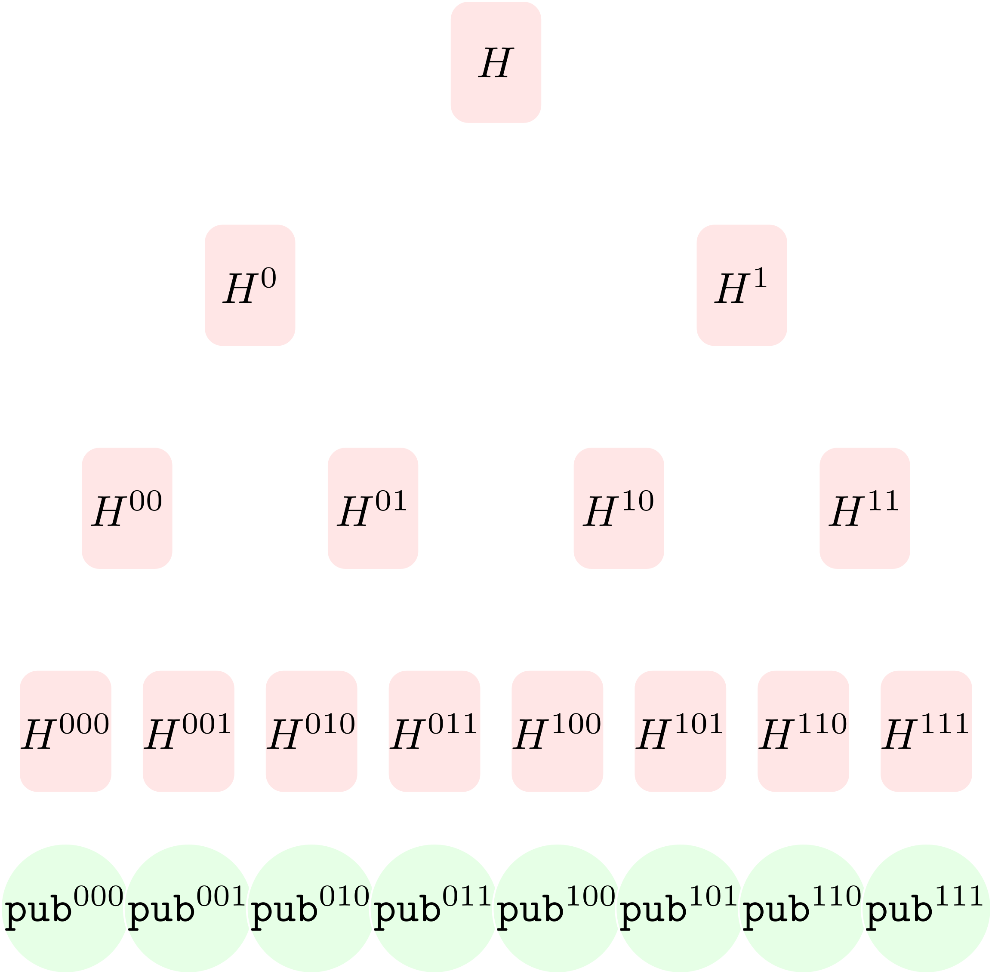








Background
Merkle tree
A public key construction tree which is based on hash functions.
$$n$$
KeyGen
$$H$$
Génération
clé publique
$$H$$
$$H$$
$$H$$
$$H$$
$$H$$
$$H$$
$$H$$
$$H$$
$$H$$
$$H$$
$$H$$
$$H$$
$$H$$
$$H$$

Slide 7
Hash-based Signatures*
* Simplifications were made to make the presentation more concise

Slide 8
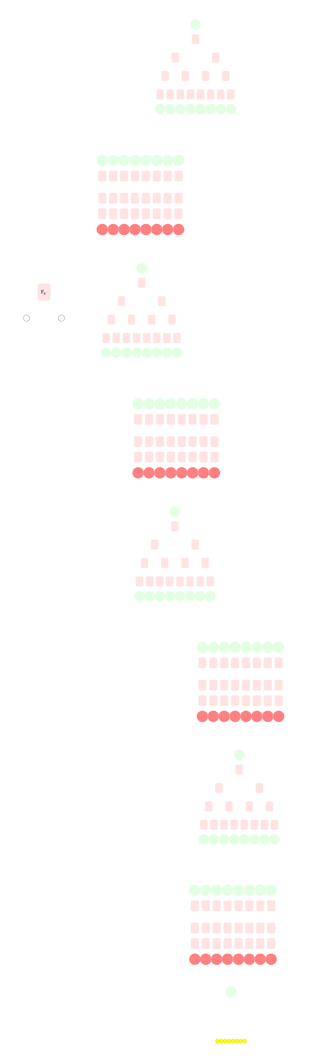
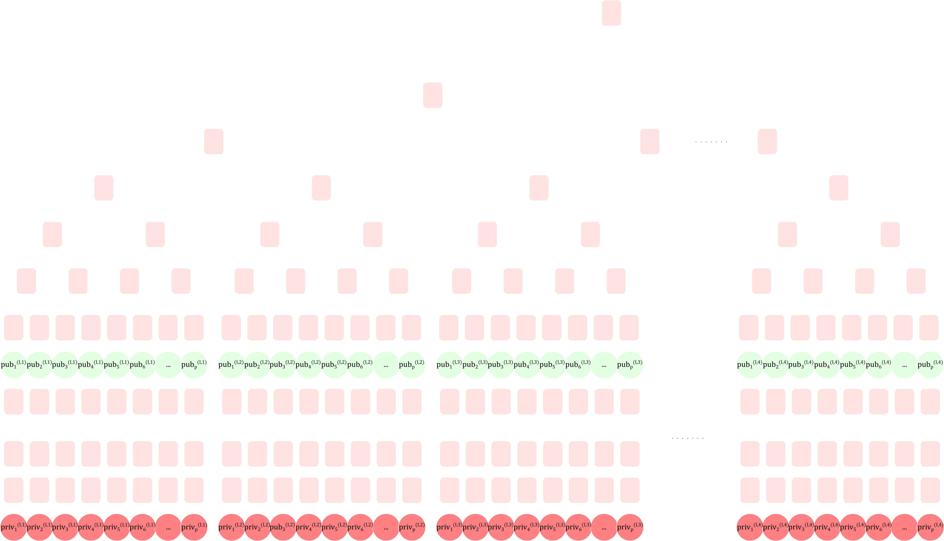
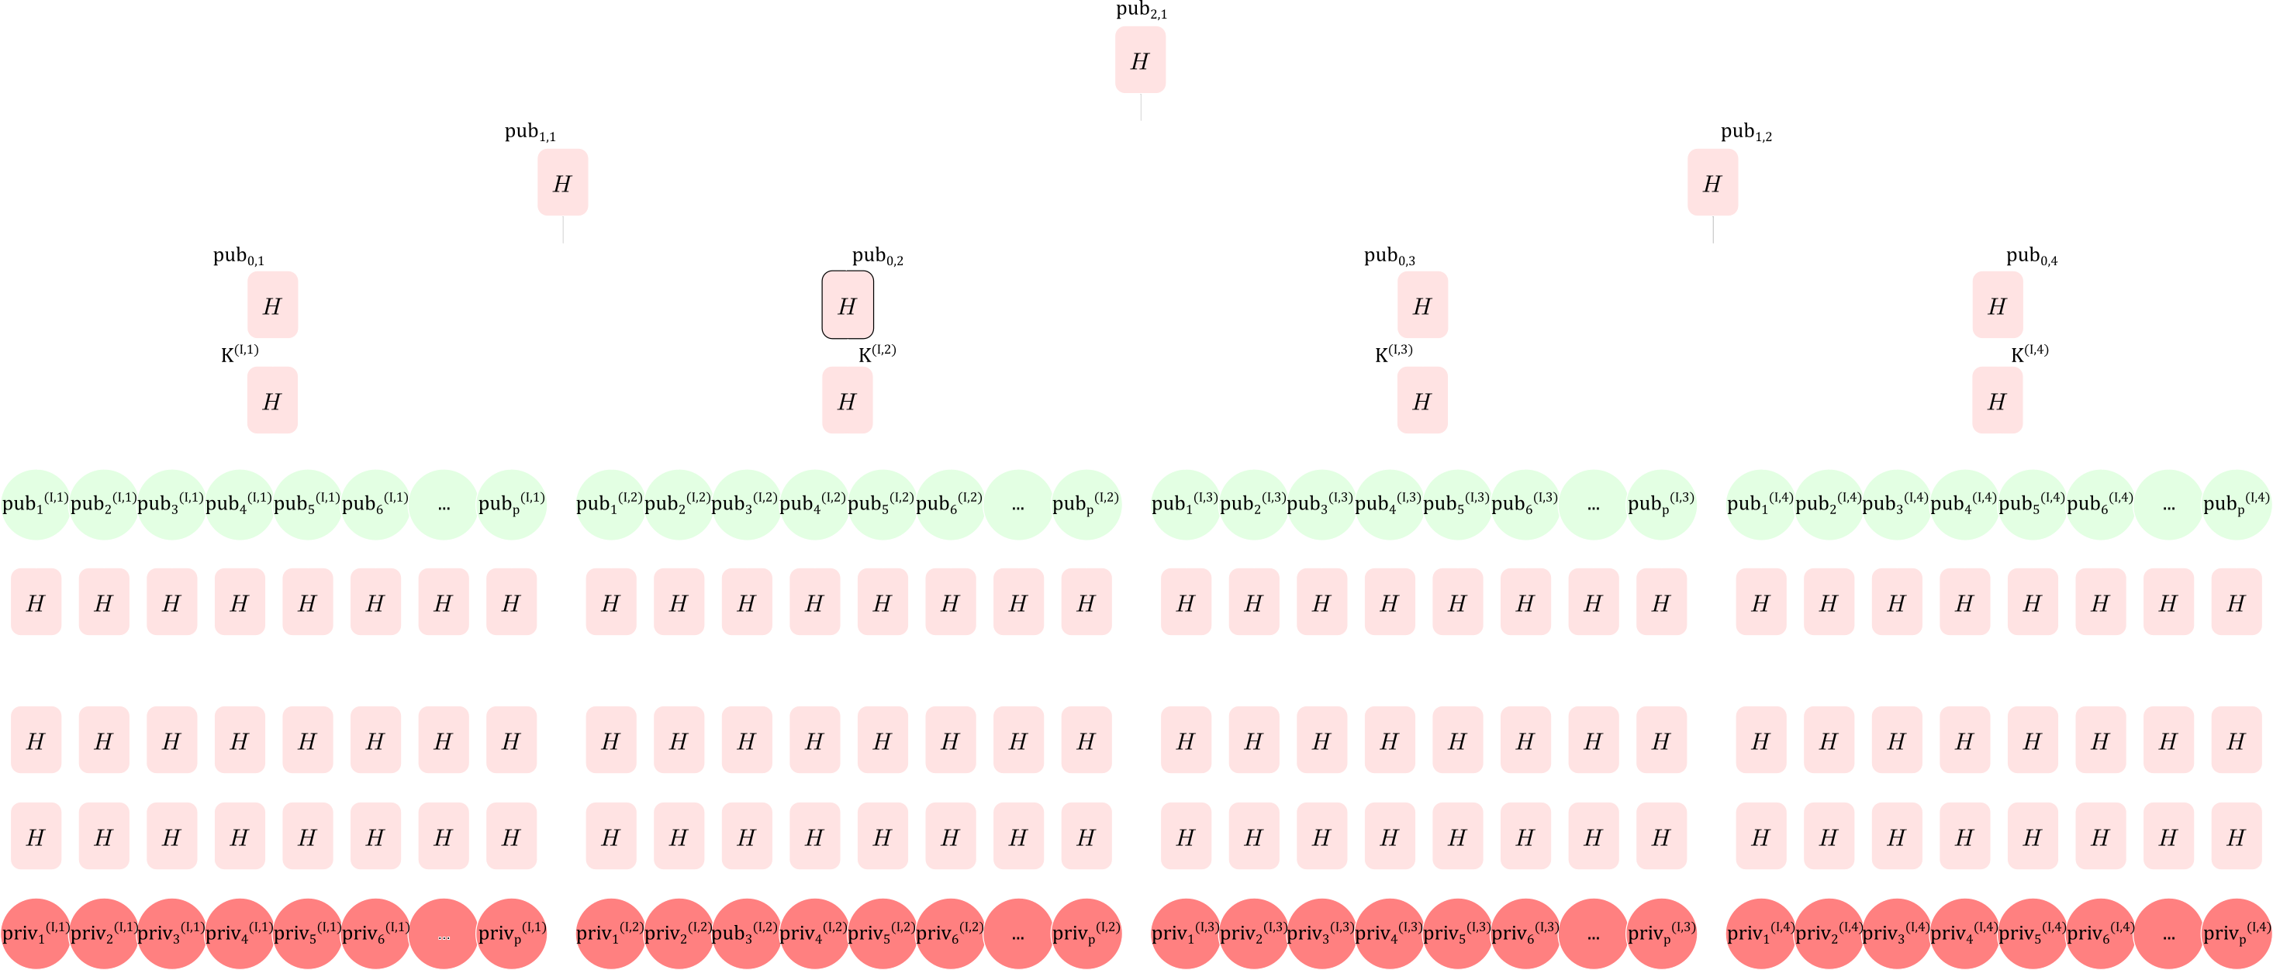
Hash-based signatures
LMS
XMSS
SPHINCS+

Slide 9
eXtended Merkle Signature Scheme (XMSS)

Slide 10
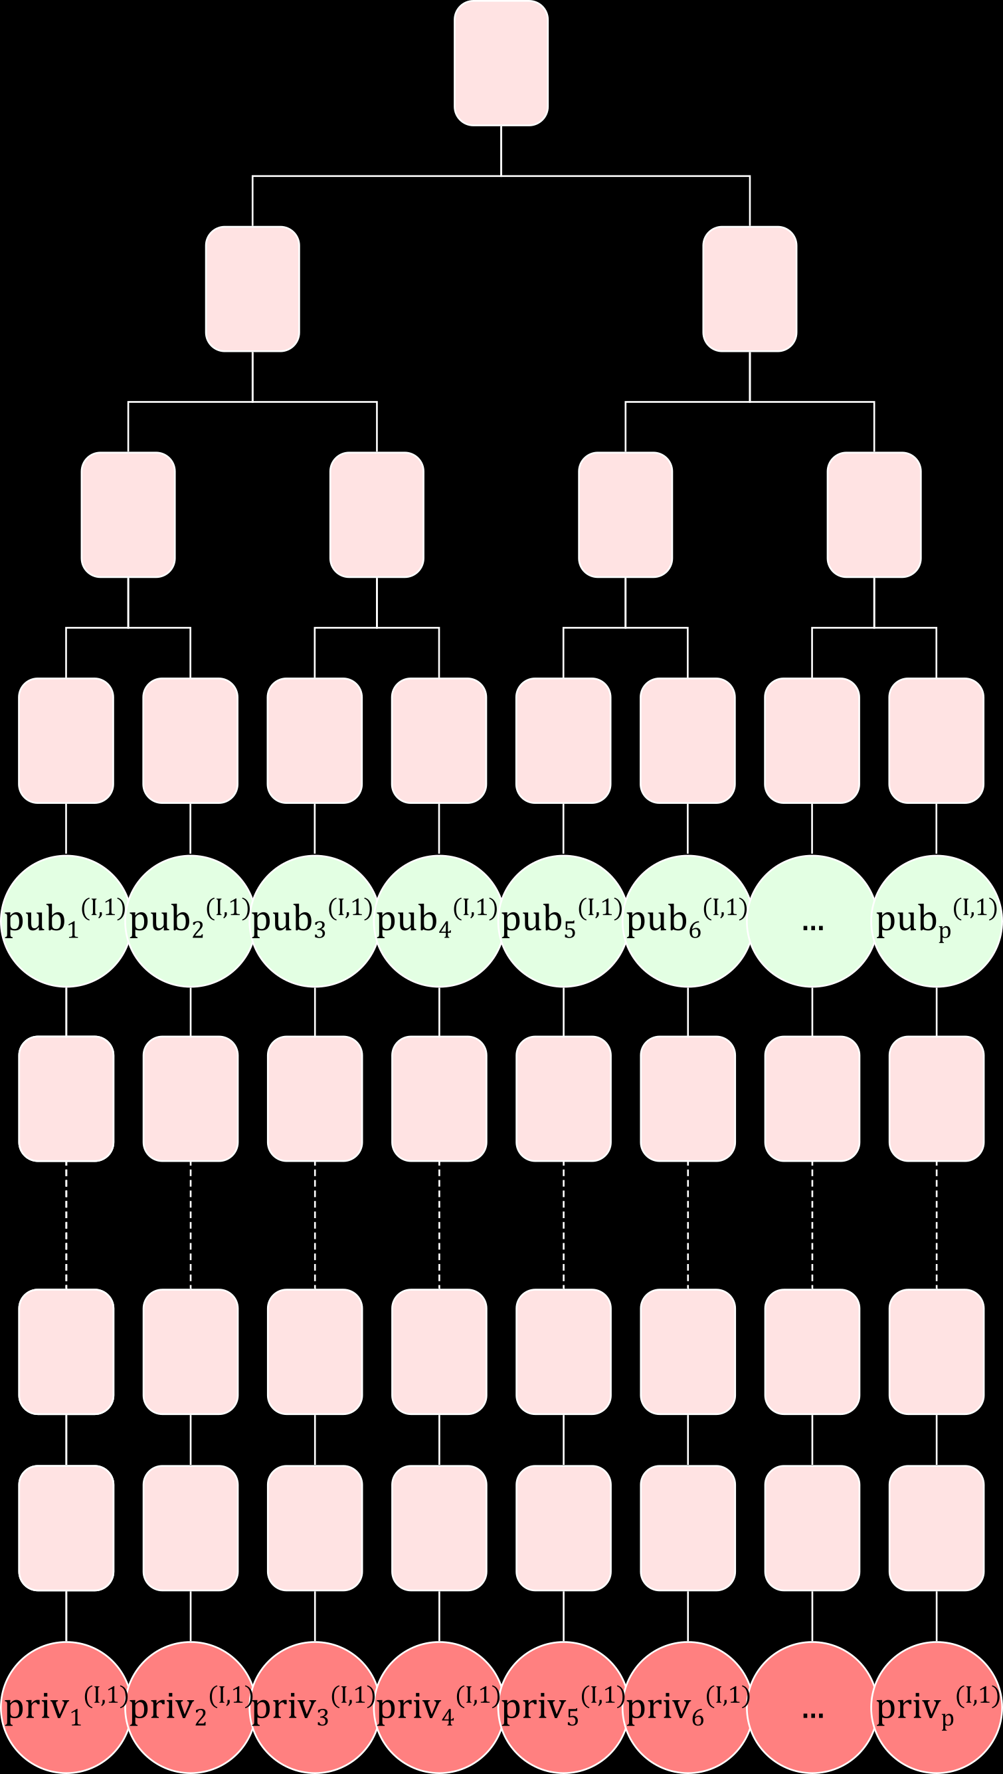
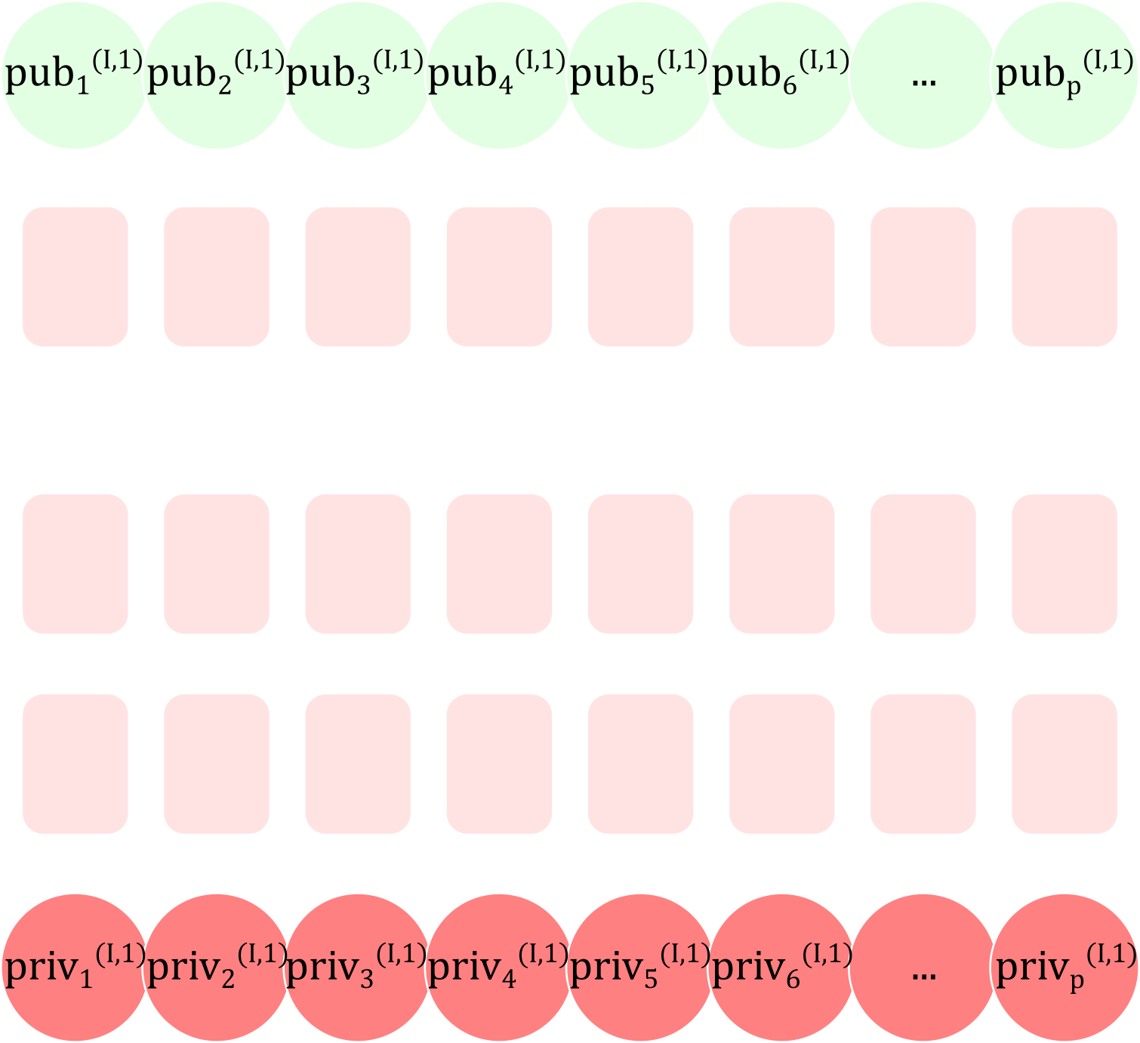
XMSS description
WOTS+
L-tree
XMSS

Slide 11



















WOTS+
$$F_{k′}$$
$$F_{k′}$$
$$F_{k′}$$
$$F_{k′}$$
$$F_{k′}$$
$$F_{k′}$$
$$F_{k′}$$
$$F_{k′}$$
KeyGen
…
…
…
…
…
$$8n$$
Similar to LM-OTS
Use of WOTS+ instead of WOTS
$$seed$$
…
…
…
$$F_{k′}$$
$$F_{k′}$$
$$F_{k′}$$
$$F_{k′}$$
$$F_{k′}$$
$$F_{k′}$$
$$F_{k′}$$
$$F_{k′}$$
$$F_{k′}$$
$$F_{k′}$$
$$F_{k′}$$
$$F_{k′}$$
$$F_{k′}$$
$$F_{k′}$$
$$F_{k′}$$
$$F_{k′}$$
$$H\left(k^{′}\right| )$$
$$seed$$
$$PRF$$
$$k′$$
$$mask^{′}$$
$$k′′$$
$$mask$$
$$mask$$
$$F_{k′}$$
$$F_{k′}$$
$$F_{k′}$$
$$F_{k′}$$
$$F_{k′}$$
$$F_{k′}$$
$$F_{k′}$$
$$F_{k′}$$
$$⊕$$
$$ADRS_{0}$$
$$ADRS_{0}^{′}$$
Key generation
1-bit difference
$$ADRS_{1}$$
$$ADRS_{1}^{′}$$
Mask generation

Slide 12




L-tree
$$F_{k′}$$
$$F_{k′}$$
$$F_{k′}$$
KeyGen
$$F_{k′}$$
$$F_{k′}$$
$$F_{k′}$$
$$F_{k′}$$
Once the WOTS+ is constructed, the public key is calculated.
Construction of an unbalanced Merkle tree to derive the public key
$$F_{k′}$$
$$F_{k′}$$
$$F_{k′}$$
$$F_{k′}$$
$$F_{k′}$$
$$F_{k′}$$
$$F_{k′}$$
$$F_{k′}$$

Slide 13





XMSS
$$F_{k′}$$
$$F_{k′}$$
KeyGen
$$F_{k′}$$
$$F_{k′}$$
$$F_{k′}$$
Construction of $l_{h}$ WOTS+
Construction of $l_{h}$ public keys
Construction of a binary Merkle tree to derive the XMSS public key
$$F_{k′}$$
$$F_{k′}$$
$$F_{k′}$$
…
$$F_{k′}$$
…
$$priv^{(I,q)}=\left( \right| \left|…\right| \left| \left|PRF\right|seed| \right)$$
$${pub}^{(I,q)}=\left(seed\right| )$$

Slide 14






XMSS
$$F_{k′}$$
$$F_{k′}$$
SignGen
$$F_{k′}$$
$$F_{k′}$$
$$F_{k′}$$
Compute a random $r$
Hash computation: concatenation of the message, 𝑟, the XMSS public key, 𝑖𝑑𝑥
Checksum computation from the hash value
Concatenation of the hashed value and the checksum to construct $\left(a_{1},a_{2},…, a_{p}\right)$
$$F_{k′}$$
$$F_{k′}$$
$$F_{k′}$$
…
$$F_{k′}$$
…
$$F_{k^{′}}$$
$$F_{k^{′}}$$
$$F_{k^{′}}$$
$$a_{1}$$
$$a_{2}$$
$$a_{3}$$
$$a_{4}$$
$$a_{5}$$
$$a_{6}$$
$$…$$
$$a_{p}$$
$$sign=\left(idx | r \right| \left| \right| \left| \right| \left| \right|…\left| \right| \left| \right| )$$
$idx=2$

Slide 15








XMSS
$$F_{k′}$$
$$?=$$
SignVerif
$$F_{k′}$$
$$F_{k^{′}}$$
$$F_{k^{′}}$$
$$F_{k^{′}}$$
$$\left(idx | r \right| \left| \right| \left| \right| \left| \right|…\left| \right| \left| \right| )← sign$$
$$F_{k′}$$
$$F_{k′}$$
$$F_{k′}$$
Retrieve index $idx$
Hash computation: concatenation of the message, 𝑟, the XMSS public key, 𝑖𝑑𝑥
Checksum computation from the hash value
Concatenation of the hashed value and the checksum to retrieve $\left(a_{1}^{′},a_{2}^{′},…, a_{p}^{′}\right)$
$$F_{k′}$$
$$F_{k′}$$
$$F_{k′}$$
…
$$F_{k′}$$
…
$$a_{1}^{′}$$
$$a_{2}^{′}$$
$$a_{3}^{′}$$
$$a_{4}^{′}$$
$$a_{5}^{′}$$
$$a_{6}^{′}$$
$$…$$
$$a_{p}^{′}$$
$idx=2$

Slide 16








XMSS: Security Analysis
KeyGen
SignGen
Hash function 𝐻: SCA attack to retrieve the manipulated private key
$PRNG:$seed generation function (fault attack, SCA, statistical tests)
$PRF$: function for generating WOTS private keys, hash keys, and masks (fault attack, SCA, statistical tests)
$$H\left(k^{′}\right| )$$
$$mask$$
$$⊕$$
Variable assignment 𝑡𝑚𝑝: fault attack, SCA to retrieve stored / manipulated sensitive data
Operation ⊕: SCA attack to retrieve stored/manipulated sensitive data because 𝑚𝑎𝑠𝑘 is public (single trace attack)
$$seed$$
$$ADRS_{0}$$
$$PRF$$
Selection of 𝑖𝑑𝑥: choice of WOTS+ from the Merkle tree.
If two WOTS+ keys share the same values → two-message attack [GBH18]
Fault attack during the increment of 𝑖𝑑𝑥 → a WOTS private key will not be initialized
$$ADRS_{1}$$
[GBH18] L.G. Bruinderink, A. Hülsing. “oops, i did it again” – security of one-time signatures under two-message attacks. SAC 2017,

Slide 17

XMSS: Security Analysis
SignGen
Computation of $\left(a_{1},a_{2},a_{3},…,a_{p}\right)$: fault attack during the computation of $\left(a_{1},a_{2},a_{3},…,a_{p}\right)$ → useful for an attacker to efficiently retrieve the private keys used by WOTS+
Computation of checksum: fault attack during the checksum calculation to set its signature to 0 [WWO+23] → allows an attacker to forge a checksum signature from the faulted signature
[WWO+23) A.Wagner, V.Wesselkamp, F. Oberhansl, M. Schink, E. Strieder. Faulting winternitz one-time signatures to forge LMS, XMSS, or Sphincs signatures. PQCrypto 2023

Slide 18
XMSS: Security Analysis
SignVerif
Computation of checksum: fault attack during the checksum calculation to set its signature to 0 [WWO+23] → allows an attacker to forge a checksum signature from the faulted signature
Verification of the candidate public key: fault attack during the verification → allows an attacker to bypass the signature verification
[WWO+23) A.Wagner, V.Wesselkamp, F. Oberhansl, M. Schink, E. Strieder. Faulting winternitz one-time signatures to forge LMS, XMSS, or Sphincs signatures. PQCrypto 2023

Slide 19
SPHINCS+

Slide 20
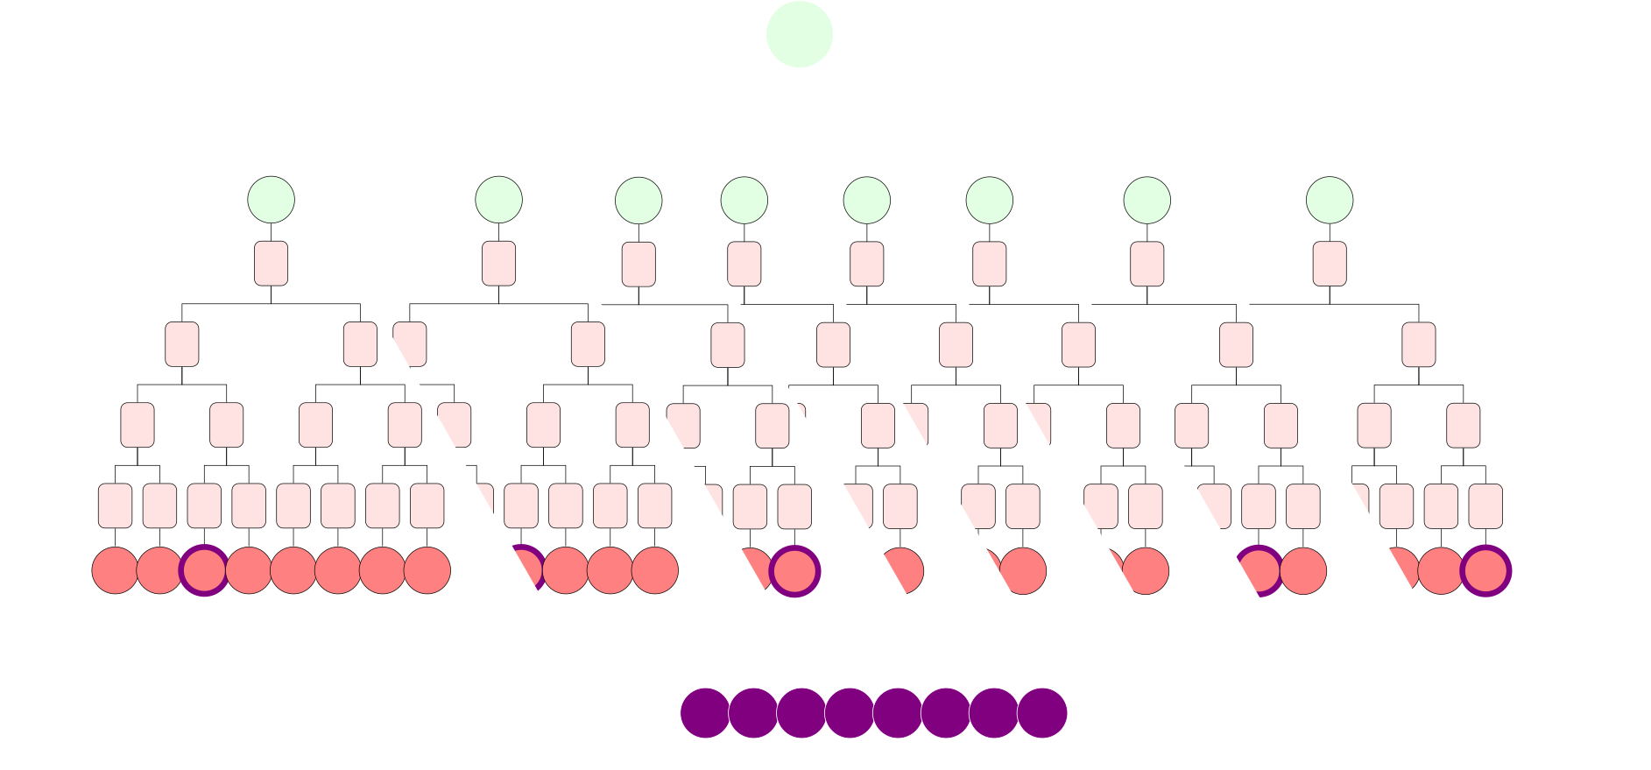
Sphincs+ (FIPS 205)
FORS
WOTS+
XMSS-tree
Sphincs+
"Use of a Few-Time Signature (FTS) scheme → Forest Of Random Subsets (FORS)
Stateless property → the same secret key can be reused multiple times

Slide 21


Conclusion
XMSS
Sphincs+
A private key cannot be used more than once → stateful hash-based signature (similar to LMS)
XMSS cannot signed more than $2^{l_{h}}$ messages
The signature scheme is stateless → the same private key can be used multiple times
The number of hash function calls is significantly higher than for LMS and XMSS
Security issues
Hash function 𝐻
Computation of $\left(a_{1},a_{2},a_{3},…,a_{p}\right)$
$$PRNG$$
Computation of checksum
$$PRF$$
Variable assignment 𝑡𝑚𝑝
Grafting tree attack
[XMSS] Choice of the leaf from the Merkle tree.
If two WOTS+ keys share the same values → two-message attack [GBH18]
Fault attack during the increment of 𝑖𝑑𝑥 → a WOTS private key will not be initialized
Verification of the candidate public key
Sensitive erasure process

Slide 22

Thank you ☺ Contact: gabriel.zaid@thalesgroup.com

