Slide 1
Towards the certification of AI Systems
Example of a physical attack
Gabriel ZAID

Slide 2




Who am I?
2018
Master in computer science
2021
Thesis in Deep Learning for SCA
2021-2025
Security evaluator
From 2025-…
Research engineer

Slide 3
Agenda
Context
Physical attacks & Side-channel attacks
Attack on AI systems
Q&A

Slide 4
Context

Slide 5





Context
Available on the
market
Develops
Company
Critical devices
Examples

Slide 6

Context
Available on the
market
Develops
Follows regulations
Company
Examples
Today

Slide 7


Context
Common Criteria for Information Technology Security Evaluation (or CC*)
  International standard (ISO/IEC 15408) for computer security certification
  Framework which helps developer for defining
    The Target of Evaluation (TOE)
    The security assets to protect (e.g. secret keys)
    The secure functions related to the TOE (e.g. secure communication, authentication process)
    The level of security assurance (EAL, Evaluation Assurance Level)
  Different security levels
    EAL 1: This is the most basic level, focusing on functional testing to ensure the product performs as specified.
    EAL 2: This level involves more in-depth testing, including structural analysis of the product's components.
    EAL 3: It adds a methodical approach to testing and checking the product's security features.
    EAL 4: This level requires a more rigorous design process, along with thorough testing and review of the product's security.
    EAL 5: It introduces semi-formal methods for design and testing, increasing the level of assurance.
    EAL 6: This level builds upon EAL5 with more formal verification techniques.
    EAL 7: It is the highest level of assurance, requiring formal verification of the product's design and security features.
Functional testing and
structural verifications
+ security testing
(software attacks)
+ physical attacks
+ formal verifications
Who is responsible for making the evaluation process?
*https://www.commoncriteriaportal.org/index.cfm

Slide 8



Evaluation process
    Security assets
    Threats
    Security function
    Hypothesis
    Evaluation Security Level
Security target
Certifies
ANSSI
Evaluation
Analysis
    Documentary analysis
    Cryptographic analysis
    Audit code
Company
Thales ITSEF
    Weaknesses: physical/logical attacks
    Criticity level for each weakness
Identification
    Test plan
    Exploitation of one or most weaknesses
    Verdict
Exploitation

Slide 9
Physical attacks & Side-channel attacks

Slide 10
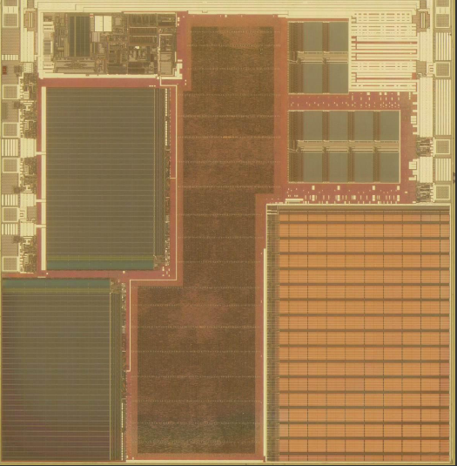










Physical attacks
Reverse engineering /
FIB probing routing
Invasive attacks
Evaluates
Temporarily / Permanently perturbations
(fault attacks)
Thales ITSEF
Semi-Invasive attacks
Today
Side-channel attacks
Non-Invasive attacks

Slide 11
Side-channel attacks
Surveillance and Exploitation of an INVOLUNTARY leak from the system
  Related to the communication protocol
  Related to the implementation
  Related to the underlying hardware and physics
Common channels (not exhaustive)
  Errors returned [SW]
  Computation time (duration, cache access time, etc.) [SW]
  Instantaneous current consumption (transistor switching) [HW]
    1 -> 1 or 0 -> 0 consumes less than 1 -> 0 or 0 -> 1
  Electromagnetic radiation [HW]
  Photon emissions, temperature, noise, etc. [HW]
Objective
  Allows attacks on cryptographic algorithms (RSA, ECC, AES, DES, HASH...) to retrieve secret information (key, message)
  Allows attacks on AI embedded systems to retrieve NN architecture, weight value.
  Also helps to understand how the code works (reverse engineering)

Slide 12
Attack on AI systems

Slide 13
Attack on AI systems
AI Act*, kesako ?
  Creation of regulations ranging from CE marking to a marketing ban on AI systems and models placed on the market.
AI Act, who is affected?
  All suppliers, developers and distributors of AI systems whose head office is in the EU or who market solutions in the EU.
AI Act, which systems are affected?
  AI at unacceptable risk
  High-risk AI
  Low-risk AI
  Minimal-risk AI
Ensure robustness, accuracy and resilience to cyber-attacks
* https://artificialintelligenceact.eu/the-act/

Slide 14

Physical Attacks against Neural Networks
Fidelity-based vs. Accuracy-based extraction attack

Slide 15





Fidelity-based vs. Accuracy-based extraction attack
Accuracy-based extraction: stealing the performance task ONLY
Fidelity-based extraction: stealing the performance task AND the IP of the model
Attack
Woman
Man
Accuracy-based extraction
Fidelity-based extraction
Woman
Man
Attack
Man
Woman
The fidelity-based extraction is beneficial to mount higher-level attacks against it, e.g., generation of adversarial examples in a white-box scenario

Slide 16
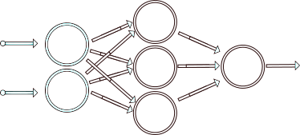






Fidelity-based extraction attack
Example “model extraction attack”
  Goal: Stealing IP of a model AND the performance of a model
    Better than accuracy-based extraction attack if we want to transfer attack (e.g. adversarial examples)
$$X_{1}$$
$$X_{1}$$
$$Y$$
$$Y$$
$$X_{2}$$
$$X_{2}$$
Hypotheses (ReLU activation function + knowledge of the architecture)
$$ReLU\left(x\right)=\max{(0,x)}$$
with $x$ a linear combination of $X_{1}$ et $X_{2}$
  ‘‘High accuracy and high fidelity extraction of neural networks’’, Jagielski et al. Usenix Security 20
  ‘‘Reverse-engineering deep ReLU networks’’, Rolnick et al. ICML 2020
  ‘‘Cryptanalytic extraction of neural network models’’, Carlini et al. Crypto 2020

Slide 17


Fidelity-based extraction attack
Example “model extraction attack”
  Goal: Stealing IP of a model AND the performance of a model
$$X_{1}$$
$$Y$$
$$X_{2}$$
$$X_{2}$$
$$Y=w_{1}^{1}⋅\max\left(0,w_{0,1}^{0}X_{1}+w_{0,2}^{0}X_{2}+b_{0}\right)$$
$$+w_{2}^{1}⋅\max\left(0,w_{1,1}^{0}X_{1}+w_{1,2}^{0}X_{2}+b_{1}\right)$$
$$+w_{3}^{1}⋅max⁡(0,w_{2,1}^{0}X_{1}+w_{2,2}^{0}X_{2}+b_{2})$$
Neurons are activated/deactivated depending on $X_{1}$ and $X_{2}$ → 8 possible linear combinations
$$X_{1}$$
  ‘‘High accuracy and high fidelity extraction of neural networks’’, Jagielski et al. Usenix Security 20
  ‘‘Reverse-engineering deep ReLU networks’’, Rolnick et al. ICML 2020
  ‘‘Cryptanalytic extraction of neural network models’’, Carlini et al. Crypto 2020

Slide 18
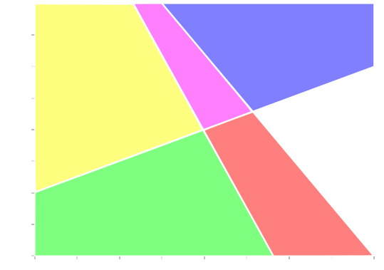





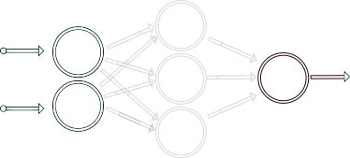
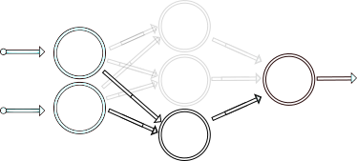
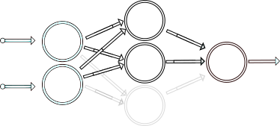
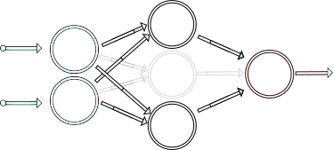

Fidelity-based extraction attack
Example “model extraction attack”
  Goal: Stealing IP of a model AND the performance of a model
$$X_{1}$$
$$Y$$
$$X_{2}$$
$$X_{2}$$
$$Y=w_{1}^{1}⋅\max\left(0,w_{0,1}^{0}X_{1}+w_{0,2}^{0}X_{2}+b_{0}\right)$$
$$+w_{2}^{1}⋅\max\left(0,w_{1,1}^{0}X_{1}+w_{1,2}^{0}X_{2}+b_{1}\right)$$
$$+w_{3}^{1}⋅max⁡(0,w_{2,1}^{0}X_{1}+w_{2,2}^{0}X_{2}+b_{2})$$
Neurons are activated/deactivated depending on $X_{1}$ and $X_{2}$ → 8 possible linear combinations
$$X_{1}$$
  ‘‘High accuracy and high fidelity extraction of neural networks’’, Jagielski et al. Usenix Security 20
  ‘‘Reverse-engineering deep ReLU networks’’, Rolnick et al. ICML 2020
  ‘‘Cryptanalytic extraction of neural network models’’, Carlini et al. Crypto 2020

Slide 19
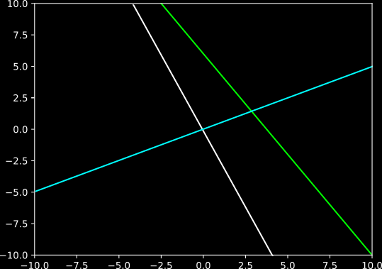

Fidelity-based extraction attack
Example “model extraction attack”
  Goal: Stealing IP of a model AND the performance of a model
$$X_{1}$$
$$Y$$
$$X_{2}$$
$$0$$
$$0=w_{2,1}^{0}X_{1}+w_{2,2}^{0}X_{2}+b_{2}$$
$$X_{2}$$
$$Y=w_{1}^{1}⋅\max\left(0,w_{0,1}^{0}X_{1}+w_{0,2}^{0}X_{2}+b_{0}\right)$$
$$+w_{2}^{1}⋅\max\left(0,w_{1,1}^{0}X_{1}+w_{1,2}^{0}X_{2}+b_{1}\right)$$
$$+w_{3}^{1}⋅max⁡(0,w_{2,1}^{0}X_{1}+w_{2,2}^{0}X_{2}+b_{2})$$
$$w_{2,1}^{0}X_{1}+w_{2,2}^{0}X_{2}+b_{2}$$
$$X_{2}=−\frac{w_{2,1}^{0}}{w_{2,2}^{0}}X_{1}−\frac{b_{2}}{w_{2,2}^{0}}$$
$$X_{1}$$
  ‘‘High accuracy and high fidelity extraction of neural networks’’, Jagielski et al. Usenix Security 20
  ‘‘Reverse-engineering deep ReLU networks’’, Rolnick et al. ICML 2020
  ‘‘Cryptanalytic extraction of neural network models’’, Carlini et al. Crypto 2020

Slide 20
Using side-channel attacks to extract the critical points
(Attack overview)

Slide 21










Fidelity-based extraction attack
Example “model extraction attack”
  Goal: Stealing IP of a model AND the performance of a model
$$X_{1}$$
$$Y$$
$$X_{2}$$
$$P_{0}$$
$$P_{2}$$
Algorithm
  1) Draw 2 points $\left(P_{0},P_{1}\right)$ and capture the physical signal $T(P_{0})$ and $T(P_{1})$
$$P$$
$$P_{1}$$
$$w_{0,1}^{0}X_{1}+w_{0,2}^{0}X_{2}+b_{0}$$
$$X_{2}$$
  2) From $T(P_{0})$ and $T(P_{1})$, use SCA to identify if $\left(P_{0},P_{1}\right)$ are in the same state
$$0$$
  3) If $state\left(P_{0}\right)==state\left(P_{1}\right)$, goto (1), else draw a point $P_{2}=\frac{\left(P_{0}+P_{1}\right)}{2}$ and capture the physical signal $T\left(P_{2}\right)$
  4) From $T(P_{2})$, $T\left(P_{1}\right)$ and $T(P_{0})$, use SCA to identify if $\left(P_{0}, P_{2}\right)$ or $\left(P_{1}, P_{2}\right)$ are in the same state
$$X_{1}$$
  5) For $\left(P_{i}, P_{2}\right)$ that are not in the same state, draw a point $P_{3}=\frac{\left(P_{2}+P_{i}\right)}{2}$
  6) …

Slide 22



Fidelity-based extraction attack
Example “model extraction attack”
  Goal: Stealing IP of a model AND the performance of a model
$$X_{1}$$
$$Y$$
$$X_{2}$$
$$X_{2}=−\frac{w_{0,1}^{0}}{w_{0,2}^{0}}X_{1}−\frac{b_{0}}{w_{0,2}^{0}}$$
$$X_{2}=−\frac{w_{1,1}^{0}}{w_{1,2}^{0}}X_{1}−\frac{b_{1}}{w_{1,2}^{0}}$$
$$X_{2}$$
$$X_{2}$$
$$X_{2}=−\frac{w_{2,1}^{0}}{w_{2,2}^{0}}X_{1}−\frac{b_{2}}{w_{2,2}^{0}}$$
$$X_{1}$$
$$X_{1}$$
Compute least-squares solution to equation $AX_{1}+b=X_{2}$

Slide 23
Using side-channel attacks to extract the critical points
(SCA Vulnerability)

Slide 24
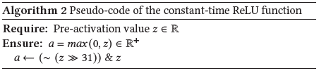
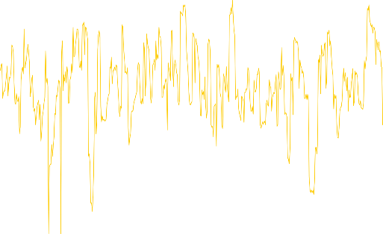
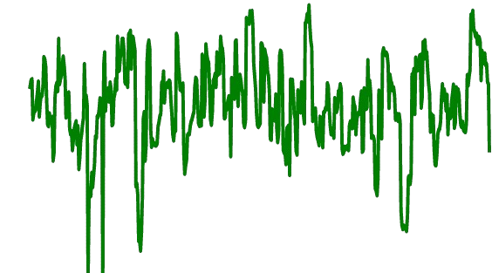


Fidelity-based extraction attack
Example “model extraction attack”
  Goal: Stealing IP of a model AND the performance of a model
$$X_{1}$$
$$Y$$
$$X_{2}$$
Algorithm
  1) Draw 2 points $\left(P_{0},P_{1}\right)$ and capture the physical signal $T(P_{0})$ and $T(P_{1})$
$$w_{0,1}^{0}X_{1}+w_{0,2}^{0}X_{2}+b_{0}$$
$$X_{2}$$
$$0$$
If $z<0$
If $z≥0$
0x00000000
0xFFFFFFFF
$$X_{1}$$

Slide 25
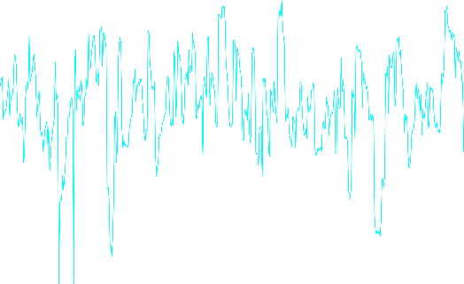
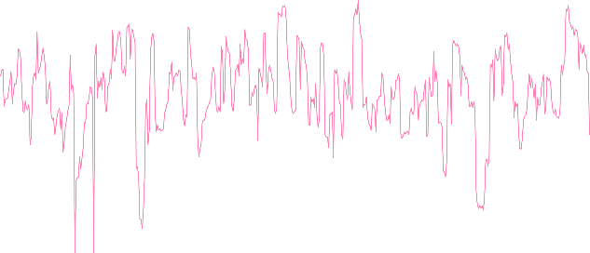
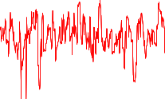






Fidelity-based extraction attack
Example “model extraction attack”
  Goal: Stealing IP of a model AND the performance of a model
$$X_{1}$$
$$Y$$
$$X_{2}$$
$$P_{0}$$
Algorithm
  1) Draw 2 points $\left(P_{0},P_{1}\right)$ and capture the physical signal $T(P_{0})$ and $T(P_{1})$
$$P_{1}$$
$$w_{0,1}^{0}X_{1}+w_{0,2}^{0}X_{2}+b_{0}$$
$$X_{2}$$
$$0$$
$T(P_{0})$
$T(P_{1})$
  2) From $T(P_{0})$ and $T(P_{1})$, use SCA to identify if $\left(P_{0},P_{1}\right)$ are in the same state
$$X_{1}$$
K-means

Slide 26

Fidelity-based extraction attack
Example “model extraction attack”
  Goal: Stealing IP of a model AND the performance of a model
$$X_{1}$$
$$Y$$
$$X_{2}$$
Algorithm
  1) Draw 2 points $\left(P_{0},P_{1}\right)$ and capture the physical signal $T(P_{0})$ and $T(P_{1})$
$$X_{2}$$
  2) From $T(P_{0})$ and $T(P_{1})$, use SCA to identify if $\left(P_{0},P_{1}\right)$ are in the same state
  3) If $state\left(P_{0}\right)==state\left(P_{1}\right)$, goto (1), else draw a point $P_{2}=\frac{\left(P_{0}+P_{1}\right)}{2}$ and capture the physical signal $T\left(P_{2}\right)$
  4) From $T(P_{2})$, $T\left(P_{1}\right)$ and $T(P_{0})$, use SCA to identify if $\left(P_{0}, P_{2}\right)$ or $\left(P_{1}, P_{2}\right)$ are in the same state
$$X_{1}$$
  5) For $\left(P_{i}, P_{2}\right)$ that are not in the same state, draw a point $P_{3}=\frac{\left(P_{2}+P_{i}\right)}{2}$
Final Step: Compute least-squares solution to equation $AX_{1}+b=X_{2}$
  6) …

Slide 27
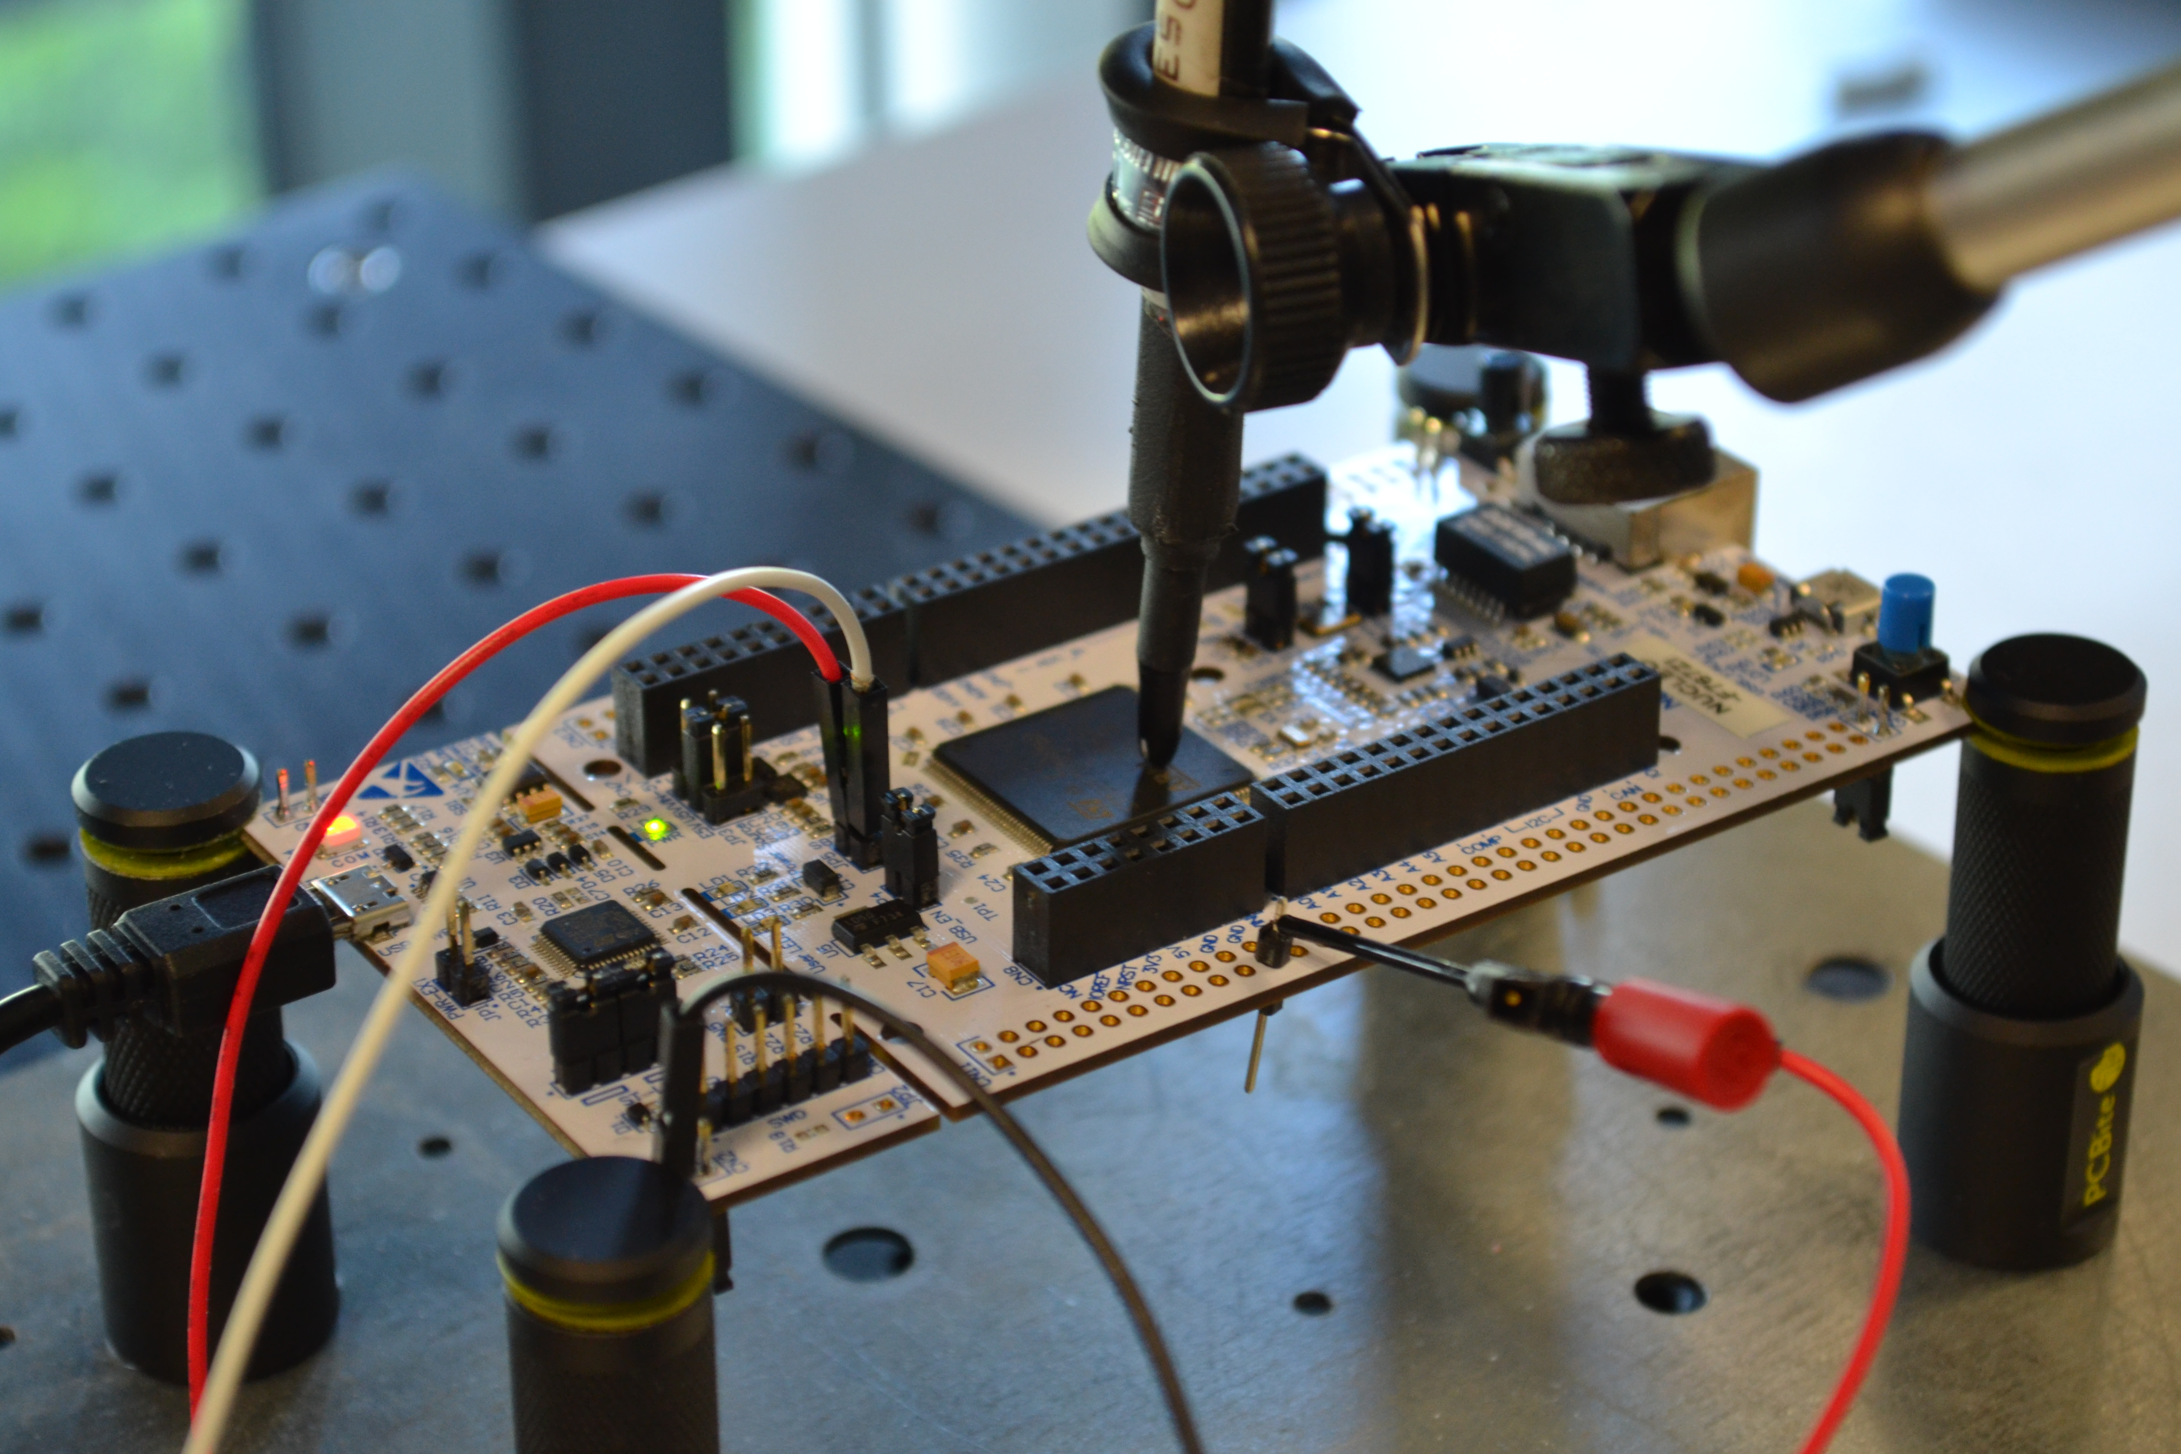
Fidelity-based extraction attack
  Device: ARM Cortex-M7 MCU on a STM32F767 board (216 MHz)
  Embedded AI: a 32-bit neural networks implemented with X-Cube-AI* tool
  Problem: Regression and Classification tasks
  Channel: Electromagnetic signal (EMV-Technik RF-U 2,5 probe)
Type of architectures | Nb of parameters | Nb of targets
Small MLP | < 200,000 | 7
MLP | 935,370 | 1
Large MLP | 1,721,802 | 1
MobileNetv1-short | 5,234 | 1
* X-CUBE-AI - AI expansion pack for STM32CubeMX - STMicroelectronics

Slide 28






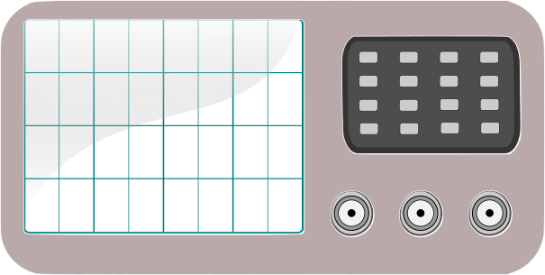


Fidelity-based extraction attack
  Acquisition step
Notes:
Corrèle le code de la fonction avec le rayonnement électromagnétique
Comme pour la crypto

Slide 29
Fidelity-based extraction attack
Experimental results
  Black-box scenario (the attacker has no knowledge on the targeted AI)
The targeted neuron
is activated !
The targeted neuron
is deactivated !
  K-means
  Logistic regression
Deep learning
We successfully identify the state of each neuron within 1 traces

Slide 30
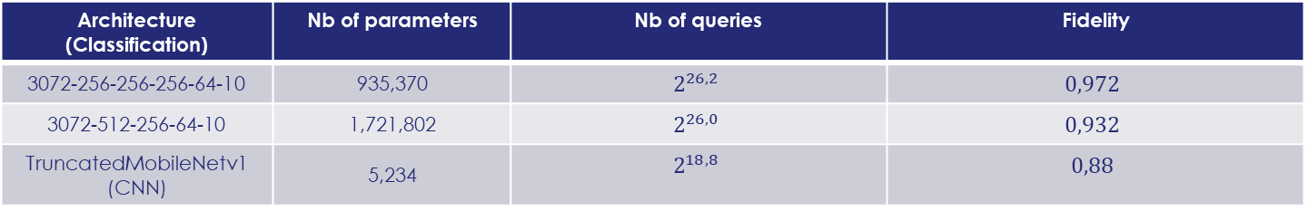

Fidelity-based extraction attack
(for classification task)
  How assessing the efficiency of fidelity-based extraction attacks (for classification task)?
  1) Number of queries required to extract all the neurons
  2) Fidelity metric = $Pr⁡\left[\underset{𝒴}{argmax}{f\left(X\right)}=\underset{𝒴}{argmax}{\hat{f}\left(X\right)}\right]$ s.t. $f\left(.\right)$ (resp. $\hat{f}(.)$) is the targeted model (resp. the copy)
  3) Weight difference = $\max_{i,j,k} {\left\|w_{j,k}^{i} −{\hat{w}}_{j,k}^{i}\right\|}_{1}$
  New targeted architectures
Architecture (Classification) | Nb of parameters | Nb of queries | Fidelity
3072-256-256-256-64-10 | 935,370 | $$2^{26,2}$$ | $$0,972$$
3072-512-256-64-10 | 1,721,802 | $$2^{26,0}$$ | $$0,932$$
TruncatedMobileNetv1 (CNN) | 5,234 | $$2^{18,8}$$ | $$0,88$$
First extraction of CNN using cryptanalytical-based extraction attacks by taking benefits of SCA !
  ‘‘Cryptanalytic extraction of neural network models’’, Carlini et al. Crypto 2020

Slide 31
Conclusion
Combining Software & Hardware attacks is beneficial to reduce adversary’s knowledge.
Side-channel attacks can be used to prevent some issues with software attacks.
  Performing fidelity-based extraction attacks on CNN architectures.
  Mitigating the effect of special case neurons.
Extends the security threats against embedded AI system.
Needs of finding adequate countermeasures which not alter the performance of embedded AI too much.
Need to work on a certification process for enhancing the security of AI systems

Slide 32
Personal recommendations
Machine-Learning
Side-channel attacks
Online courses
  Andrew NG’s course (Coursera): Machine Learning by Stanford University | Coursera, Deep Learning by deeplearning.ai | Coursera
Books
  Shai Shalev-Shwartz and Shai Ben-David. Understanding Machine Learning: From Theory to Algorithms.
  Christopher M. Bishop and Hugh Bishop. Deep Learning: Foundations and Concepts.
Open source Librairies:
  Tensorflow, PyTorch
International conferences
  NeurIPS, ICML, ECML-PKDD, CVPR, …
Online courses
  Amir Moradi’s course: https://www.youtube.com/@AmirMoradi_impsec/playlists
Books
  Embedded Cryptography 1 | Wiley
  Embedded Cryptography 2 | Wiley
  Embedded Cryptography 3 | Wiley
Public datasets:
  ASCAD, AES_HD, AES_RD, DPA contest, …
Open source Librairies:
  For side-channel attacks: SCALib – the Side-Channel Analysis Library: https://scalib.readthedocs.io/
  For deep learning: AISyLab’s framework - GitHub - AISY_Framework: Deep Learning-based Framework for Side-Channel Analysis
International conferences
  CHES, Cascade, Crypto, Eurocrypt, Asiacrypt, …

Slide 33

Merci

