Slide 1



Ranking Loss: Maximizing the Success Rate in Deep Learning Side-Channel Analysis
Gabriel ZAID, Lilian BOSSUET, François Dassance, Amaury HABRARD, Alexandre VENELLI
Univ Lyon, UJM-Saint-Etienne, CNRS Laboratoire Hubert Curien UMR 5516 F-42023, Saint-Etienne, France
Thales ITSEF, Toulouse, France
NXP Semiconductors, Toulouse, France
TCHES 2021 – Virtual Event

Slide 2
What is a Side-Channel Attack?

Slide 3





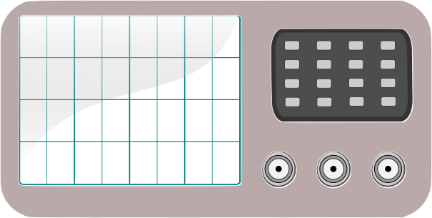
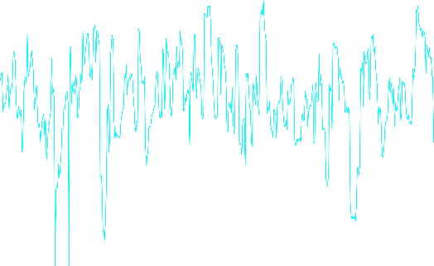
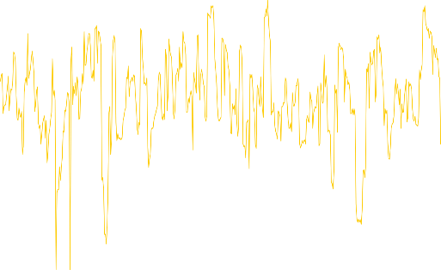


Plaintext = 0x17130198f8adb9ab
Secret Key = 0x25404f9d6bcc3c68
Plaintext = 0xda1294ddc28b466b
Secret Key = 0x89e8f11831b71a05

Slide 4




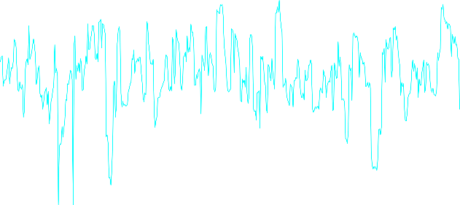



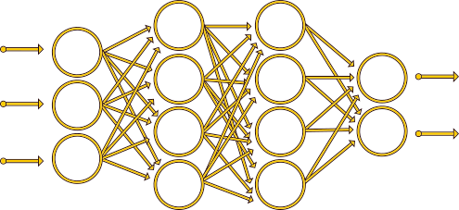
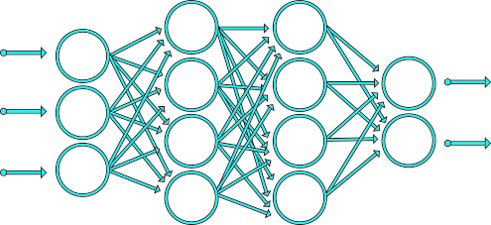
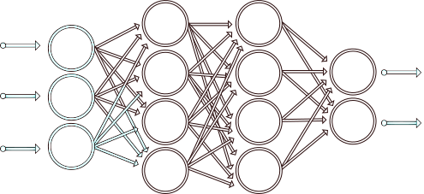
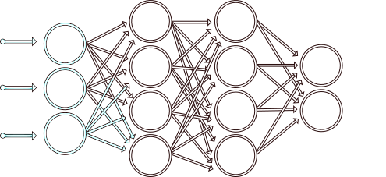
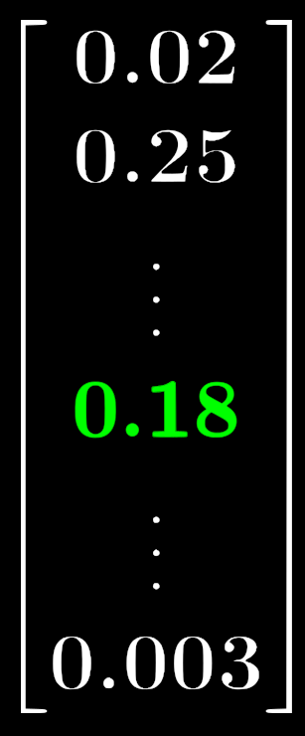



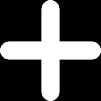
Profiling phase
Plaintext = 0x5e44a0b8cd0e4c5f
Secret Key =
Plaintext = 0x13c635b1ab74bab0
Secret Key = ?
Plaintext = 0x17130198f8adb9ab
Secret Key = 0x25404f9d6bcc3c68
Plaintext = 0x5e44a0b8cd0e4c5f
Secret Key = ?
Plaintext = 0xda1294ddc28b466b
Secret Key = 0x89e8f11831b71a05
Attack phase
Model Trained !

Slide 5
What is the classical learning metric used in DL-SCA?

Slide 6

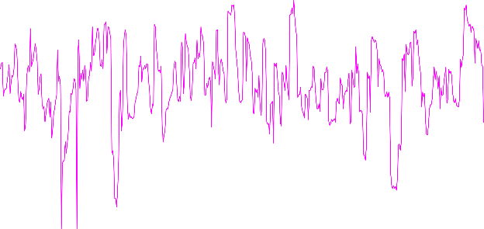
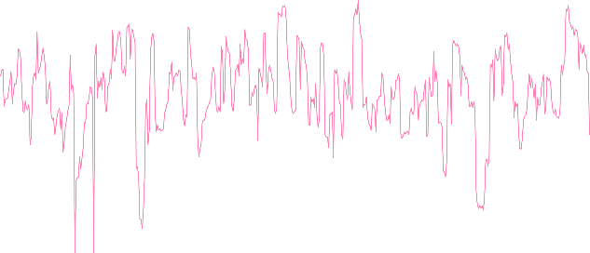

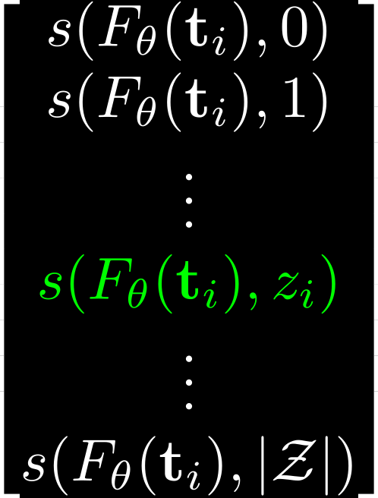
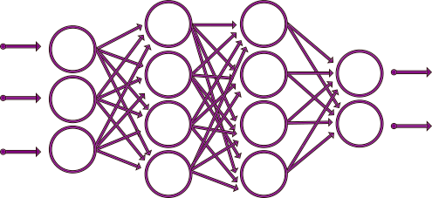
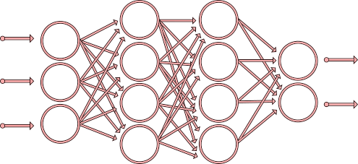



Plaintext = 0xff321a45327864c3
Secret Key = 0x89e8f11831b71a05
Plaintext = 0xac42d64ea1102567
Secret Key = 0x89e8f11831b71a05
Plaintext = 0x17130198f8adb9ab
Secret Key = 0x89e8f11831b71a05
Plaintext = 0xda1294ddc28b466b
Secret Key = 0x89e8f11831b71a05
Profiling phase
Cross-Entropy
Model Trained !
Softmax function

Slide 7
How should the loss function be minimized?

Slide 8
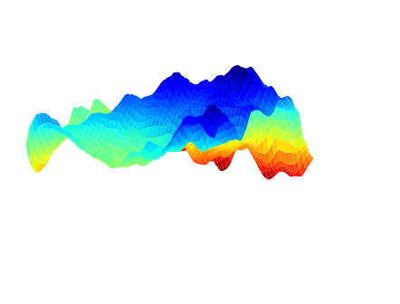




Gradient descent is an iterative minimization algorithm which consists in computing the gradient of the loss function in order to monitor the trainable parameters $θ$ such that $ℒ_{CCE}$ is minimized.
$$θ^{(i+1)}=θ^{\left(i\right)} −η⋅ ∇_{θ^{\left(i\right)}} LLLLLLLLLLLL$$
Local Minimum
Global Minimum
$$θ^{(0)}$$
$$θ^{(0)}$$
$$ℒ_{CCE}$$
$$ℒ_{CCE}$$
Optimization Error

Slide 9





Goal
Find a model $F_{θ}$ that maximizes the Success Rate for a minimum number of $N_{a}$ traces:
Gradient computation
$$−$$
The penalization induced by the CCE loss function does not perfectly reflect the SR behaviour

Slide 10








Cross-Entropy interpretation [MDP20]
Minimizing the cross-entropy is asymptotically equivalent to maximizing the perceived information [RSVC+11] :
Cross-Entropy Loss
Optimal Solution
Optimization Error
Estimation Error
Approximation Error
$$\hat{θ}≠θ$$
$$N_{p}<∞$$
$$F_{θ}→PI( , Z)$$
The optimization algorithm (eg. Stochastic Gradient Descent) converges towards the optimal solution $F^{∗}$
$$N_{p}→∞$$
$$F_{θ}→MI( , Z)$$

Slide 11
Ranking Loss: Maximizing the Success Rate

Slide 12
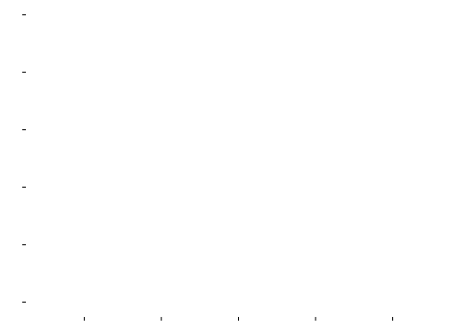
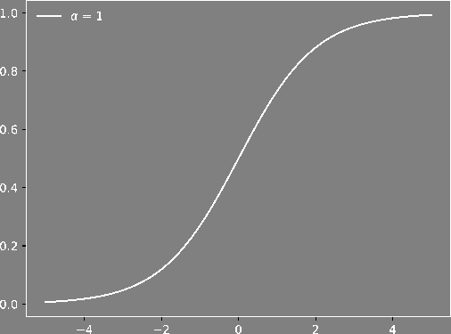

Goal
Find a model $F_{θ}$ that maximizes the Success Rate for a minimum number of $N_{a}$ traces:
Estimation [QLL10]

Slide 13




Ranking Loss
We want to penalize the learning process when $s_{N_{a}}(F_{θ}, k^{∗})⊳s_{N_{a}}(F_{θ}, k)$ is not respected:
Partial Ranking Loss
Given a profiling set of $N_{p}$ pairs ${\left(t_{i}, z_{i}\right)}_{0≤i<N_{p}}$, a model $F_{θ}$ and a number of attack traces $N_{a}$ such that $N_{a}|N_{p}$, we define the ranking loss function as follows:
where

Slide 14
Cross-Entropy vs. Ranking Loss

Slide 15









Goal
Find a model $F_{θ}$ that maximizes the Success Rate for a minimum number of $N_{a}$ traces:
Gradient computation
If $N_{a}=1$, $α=1$ | If $j=k^{∗}$ s.t. | If $j≠k^{∗}$ s.t.
$$−$$
Prevent the Approximation Error

Slide 16





Estimation of the Optimal Distinguisher Rule
Given a conditional probability distribution $Pr⁡[Z|T, θ]$, maximizing the success rate is equivalent to finding an estimation of the Optimal Distinguisher:
Ranking Loss
Mutual Information Estimation
$$θ$$
$$θ$$

Slide 17




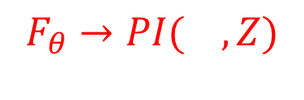






Error Analysis
Ranking Loss
Cross-Entropy Loss
Optimal Solution
Optimization Error
Estimation Error
Approximation Error
$$\hat{θ}≠θ$$
$$N_{p}<∞$$
$$F_{θ}→MI( , Z)$$
$$\hat{θ}≠θ$$
$$N_{p}<∞$$
$$F_{θ}→PI( , Z)$$
The optimization algorithm (eg. Stochastic Gradient Descent) converges towards the optimal solution $F^{∗}$
$$N_{p}→∞$$
$$F_{θ}→MI( , Z)$$
The Ranking Loss prevents the Approximation Error
17

Slide 18
Experimental Results

Slide 19
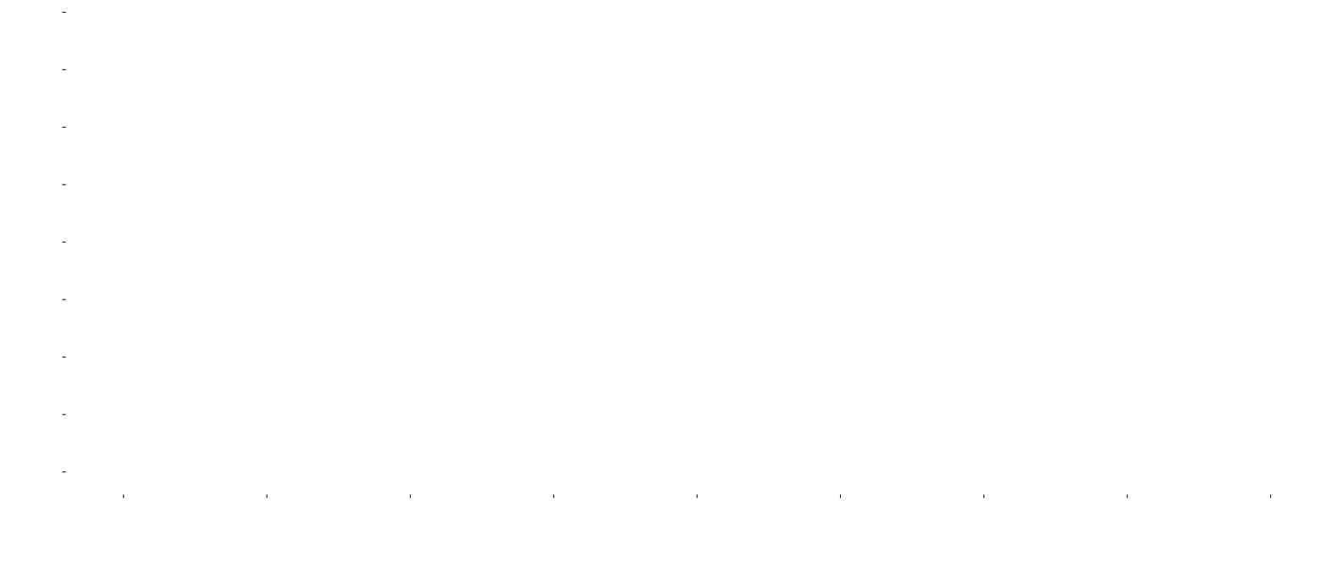



Datasets
ChipWhisperer* (AES-128)
  8-bit AVR microcontroller
  Sensitive variable:
  $$Z=Sbox\left[P_{0} ⊕ k^{∗}\right]$$
  Unprotected implementation
ASCAD-v1 (AES-128) [BPS+20]
  8-bit AVR microcontroller
  Sensitive variable:
  $$Z=Sbox[P_{3} ⊕ k^{∗}]$$
  - Countermeasure: Random delay + 1st order masking
*https://newae.com/tools/chipwhisperer/

Slide 20

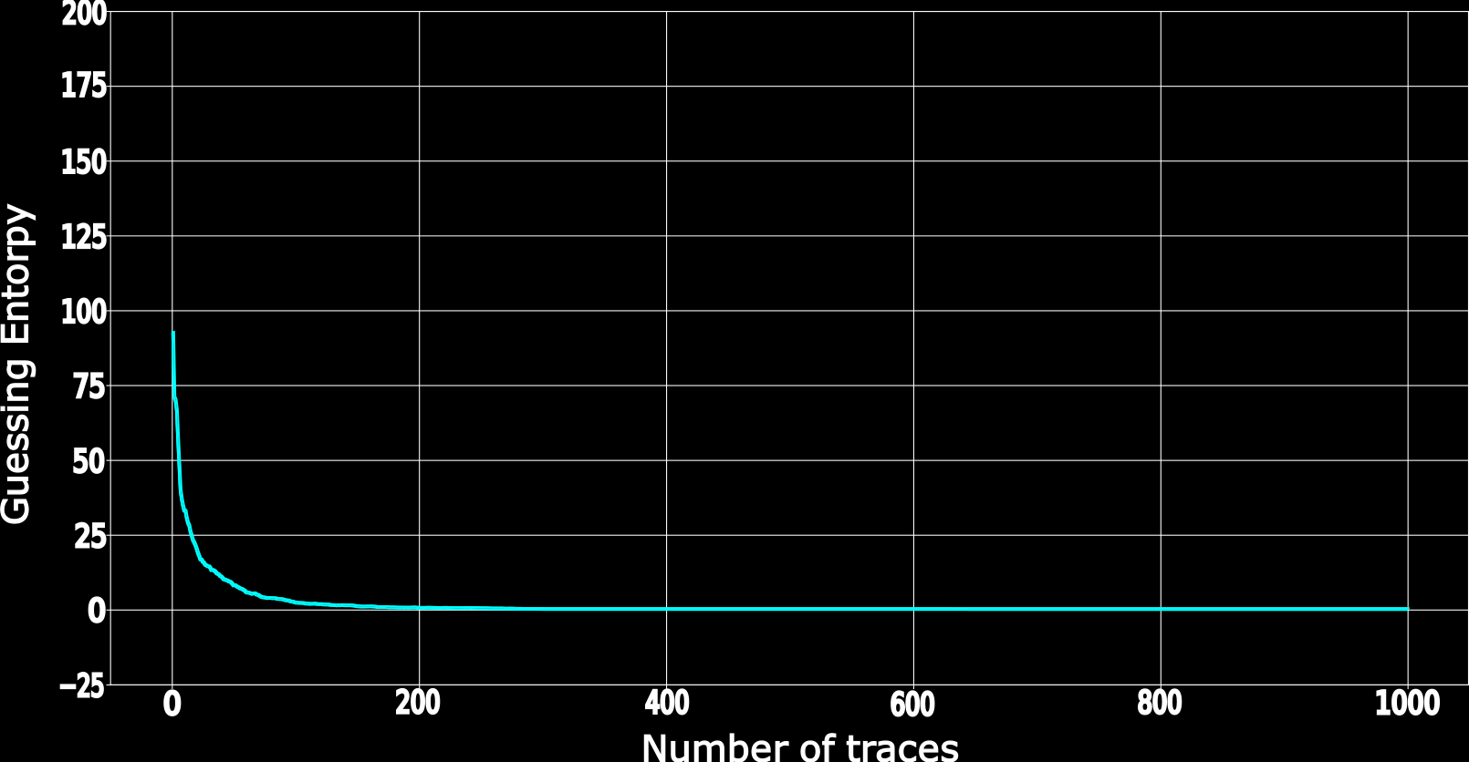

We compute ${Nt}_{GE}$ over 100 tests and denote the final result as ${\overline{Nt}}_{GE}$
$${\overline{Nt}}_{GE}$$

Slide 21
Chipwhisperer: A Partial Exploitation of the Leakages

Slide 22

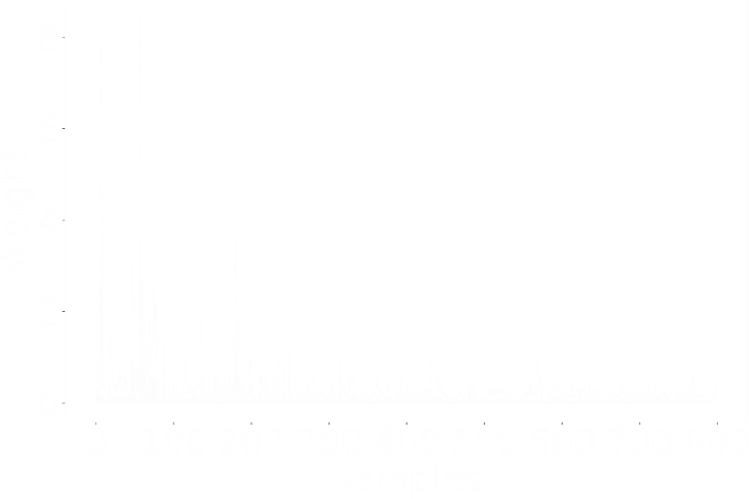
Profiling phase
Ranking Loss
Cross Entropy
Model Trained !

Slide 23



Partial Leakage Exploitation
Cross-Entropy
SNR on Chipwhisperer dataset
Approximation Error
Ranking Loss

Slide 24

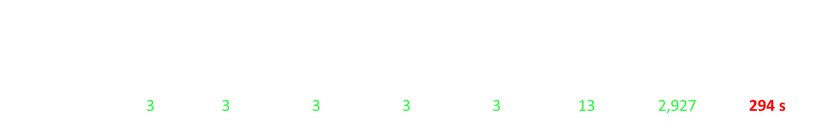
Cross-Entropy
Ranking Loss
$$σ$$ $$\overline{N}t_{GE}$$ | 0 | $$10^{−6}$$ | $$10^{−5}$$ | $$10^{−4}$$ | $$10^{−3}$$ | $$10^{−2}$$ | $$10^{−1}$$ | Training Time
Cross-Entropy | 4 | 4 | 6 | 6 | 7 | 21 | 3,958 | 81 s
Ranking Loss | 3 | 3 | 3 | 3 | 3 | 13 | 2,927 | 294 s

Slide 25
ASCAD: A Total Exploitation of the Leakages

Slide 26
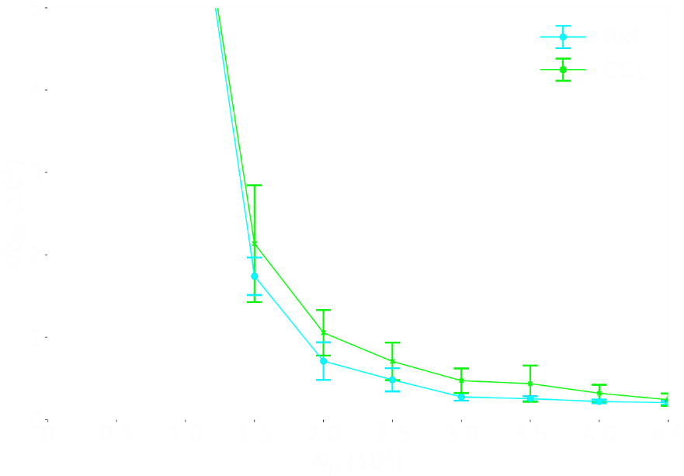
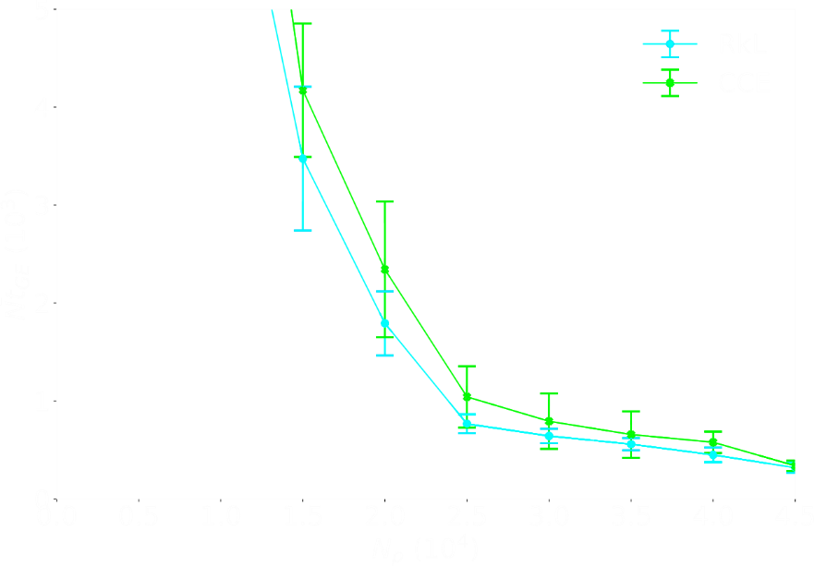
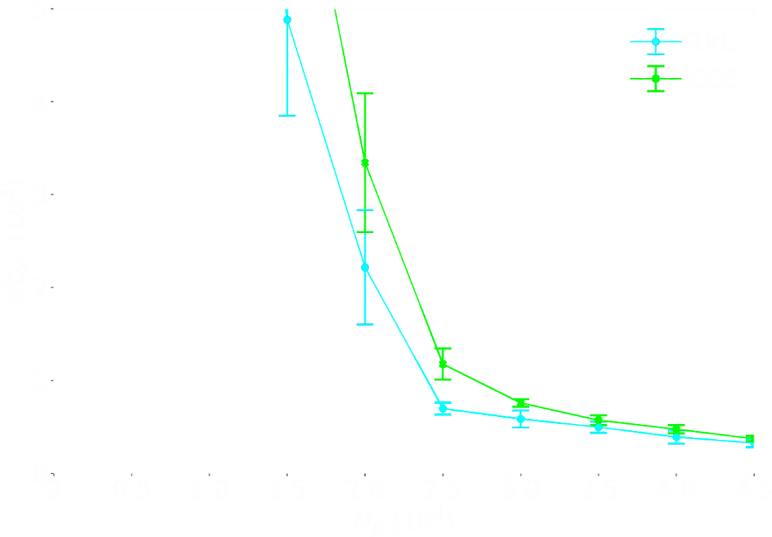
A Total Exploitation of the Leakages:
No Approximation Error
Remaining errors: Estimation Error and Optimization Error
ASCAD
(no desynchronization)
ASCAD
(desynchronization 50)
ASCAD
(desynchronization 100)
The Ranking Loss reduces the Estimation Error

Slide 27


MERCI !
Take-Away Messages
The Ranking loss tends to maximize the success rate for a given $N_{a}$ attack traces and converges towards the optimal model introduced in [BGH+17].
Through this new proposition, we are more concerned with the relative order between the secret key and each key hypothesis.
The Approximation Error is prevented when the Ranking Loss is considered.
Further investigations should be made on other “Learning To Rank” approaches.
Contact: gabriel.zaid@univ-st-etienne.fr
GitHub: https://github.com/gabzai/Ranking-Loss-SCA

Slide 28
Bibliography
[BGH+17] N. Bruneau, S. Guilley, A. Heuser, D. Marion, and O. Rioul. Optimal side-channel attacks for multivariate leakages and multiple models. J Cryptogr Eng 7, 331–341 (2017).
[BPS+20] R. Benadjila, E. Prouff, R. Strullu, E. Cagli, and C. Dumas. Deep learning for side-channel analysis and introduction to ASCAD database. J. Cryptogr. Eng., 10(2):163–188, 2020.
[MDP20] L. Masure, C. Dumas, and E. Prouff. A comprehensive study of deep learning for side-channel analysis. IACR Transactions on Cryptographic Hardware and Embedded Systems, 2020(1):348–375, Nov. 2019.
[QLL10] T. Qin, T-Y. Liu, and H. Li. A general approximation framework for direct optimization of information retrieval measures. Inf. Retr., 13(4):375–397, 2010.
[RSVC+11] M. Renauld, F-X. Standaert, N. Veyrat-Charvillon, D. Kamel, and D. Flandre. A formal study of power variability issues and sidechannel attacks for nanoscale devices. In K.G. Paterson, editor, Advances in Cryptology – EUROCRYPT 2011, pages 109–128, Berlin, Heidelberg, 2011. Springer Berlin Heidelberg.

