Slide 1



Efficiency through Diversity in Ensemble Models
- A case study on Public-Key Algorithms -
Gabriel ZAID, Lilian BOSSUET, Amaury HABRARD, Alexandre VENELLI
Univ Lyon, UJM-Saint-Etienne, CNRS Laboratoire Hubert Curien UMR 5516 F-42023, Saint-Etienne, France
Thales ITSEF, Toulouse, France
NXP Semiconductors, Toulouse, France
TCHES 2021 – Virtual Event

Slide 2
What is a Side-Channel Attack?

Slide 3








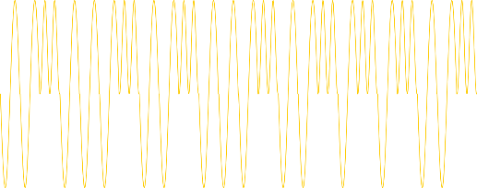

Signature = (Plaintext, Private Key)
Signature = (Plaintext, Private Key)

Slide 4


How can I identify the processing related to each bit?
Are some patterns dependent on the key bits?
Private Key=0100101001011101
YES !
0 ?
1 ?
1
0
0 1 0 0 1 0 1 0 0 1 0 1 1 1 0 1

Slide 5










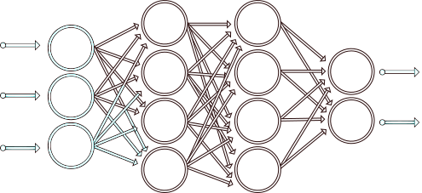
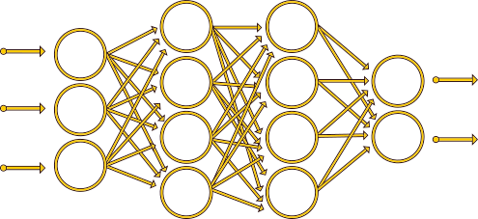
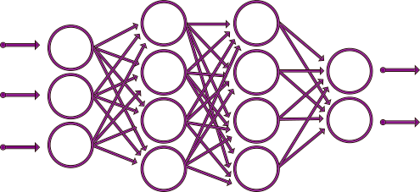
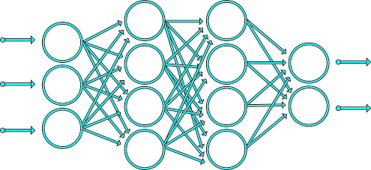



Profiling phase
Private Key=.……………
Private Key=10…………..
Private Key=1000100011011001
Private Key=1……………
Private Key=100010100101110.
Attack phase
Model Trained !
0
0
0
1
1

Slide 6



Guessed Private Key | True Private Key
1000100011011001 | 0100101001011101
Three Scenarios considered in our work:
1. If the Adversary does not know the position of uncertain bits
Degree n combination
Degree 1 combination
1
0
1
0
0
1
0
1
0
0
0
1
1
0
1
1
0
0
1
2. If the Adversary can detect the uncertain bits
1
0
0
0
1
0
0
0
1
1
0
1
1
0
0
1
3. If the Adversary has to deal with blinding scalar/exponent [SW14, SW17]
(RSA without CRT)

Slide 7
The Principle of Ensembling

Slide 8







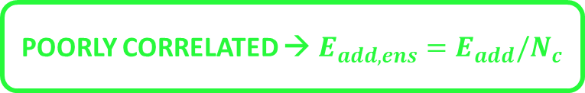



Let $E_{add}$ be the expected added error of $\{F_{0},F_{1},F_{2}, …, F_{N_{c}−1}\}$. The ensemble expected error can be defined as follows [TG96]: $$E_{add,ens}=\left(\frac{1+δ(N_{c} −1)}{N_{c}}\right)E_{add}$$
Ensemble Models reduce the Global Error
POORLY CORRELATED → $E_{add,ens}=E_{add}/N_{c}$
HIGHLY CORRELATED → $E_{add,ens}=E_{add}$
$$F_{0}$$
$$F_{1}$$
$$F_{2}$$
Definition (Diversity):
Given an ensemble model composed by $N_{c}$ committee members ${\left(F_{n}\right)}_{0≤n<N_{c}}$, the diversity is defined as the quantity measuring the difference in term of predictions among the members.

Slide 9
















Three types of diversity have been introduced in [LWC⁺19]:
$$F_{0}$$
$$F_{0}$$
$$F_{1}$$
$$F_{0}$$
1) Type I diversity characterizes the variety of committee members structure.
$$F_{6}$$
2) Given a pool of model, the Type II diversity selects a subset of members that minimize their error correlation.
$$F_{1}$$
$$F_{2}$$
$$F_{5}$$
$$F_{2}$$
3) Type III diversity forces the ensemble model to decorrelate the errors during the training process
$$F_{3}$$
$$F_{2}$$
OUR WORK
$$F_{4}$$
$$F_{1}$$

Slide 10
Mutual Information and Ensembling

Slide 11












Information Theory and Ensembling [Bro09, ZL10]
ENCODER + CHANNEL
DECODER
^
^
X
$$=g(X)$$
$$=$$
$$\frac{H\left( \right)−MI\left( ; \right)−1}{\log{(|} |)}≤\operatorname{Pr}\left[ ≠ \right]≤\frac{H\left( \right)−MI\left( ; \right)}{2}$$
$$\frac{H\left( \right)−MI\left( X ; \right)−1}{\log{(|} |)}≤\operatorname{Pr}\left[ g(X)≠ \right]≤\frac{H\left( \right)−MI\left( X ; \right)}{2}$$
To minimize $\operatorname{Pr}\left[ ≠ \right]$, the Adversary has to maximize $MI\left( ; \right)$

Slide 12


Definition (Mutual Information Ensemble Diversity) [Bro09, ZL10]:
Given an ensemble model $ℱ$ composed by $N_{c}$ committee members ${\left(F_{n}\right)}_{0≤n<N_{c}}$ and a target sensitive variable $Z$, the mutual information ensemble diversity is defined as:
$$MI\left(ℱ;Z\right)= \sum_{n=0}^{N_{c}−1}{MI(F_{n};Z)} − \sum_{n=1}^{N_{c}−1}{\sum_{ℱ_{n}⊆ℱ}{MI\left(\left\{ℱ_{n}\right\}\right)}}+\sum_{n=1}^{N_{c}−1}{\sum_{ℱ_{n}⊆ℱ}{MI\left(\left\{ℱ_{n}\right\}|Z\right)}}$$
$$≈ \sum_{n=0}^{N_{c}−1}{MI(F_{n};Z)} − \sum_{n=0}^{N_{c}−2}{\sum_{m=n+1}^{N_{c}−1}{MI\left(F_{n};F_{m}\right)}}+\sum_{n=0}^{N_{c}−2}{\sum_{m=n+1}^{N_{c}−1}{MI\left(F_{n};F_{m}|Z\right)}}$$
Pairwise Approximation
Conditional Redundancy
Relevance
Redundancy
How can I develop an ensemble model which maximizes the pairwise approximation?

Slide 13
Ensembling Loss: A Pairwise Ensemble Diversity Metric

Slide 14






Three strategies can be considered to conduct the learning process:
$$F_{0}$$
1) Independent Learning Strategy: There is no interaction between the committee members during the learning process.
2) Sequential Training: This strategy induces a set of parametric models such that the learning process is sequentially performed on each committee member.
$$F_{1}$$
3) Simultaneous Ensemble Learning: A set of committee members are trained interactively to promote uncorrelation and diversity during the learning process
$$F_{2}$$
OUR WORK

Slide 15
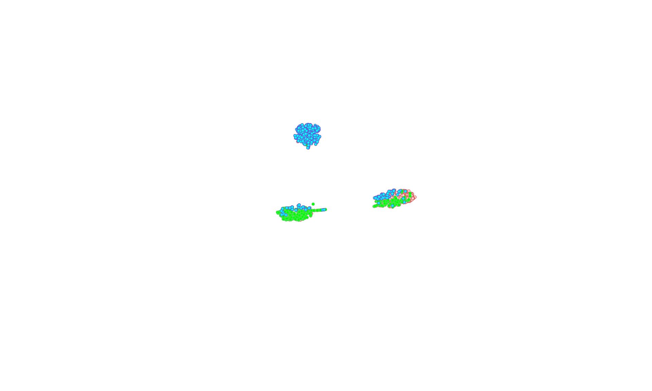
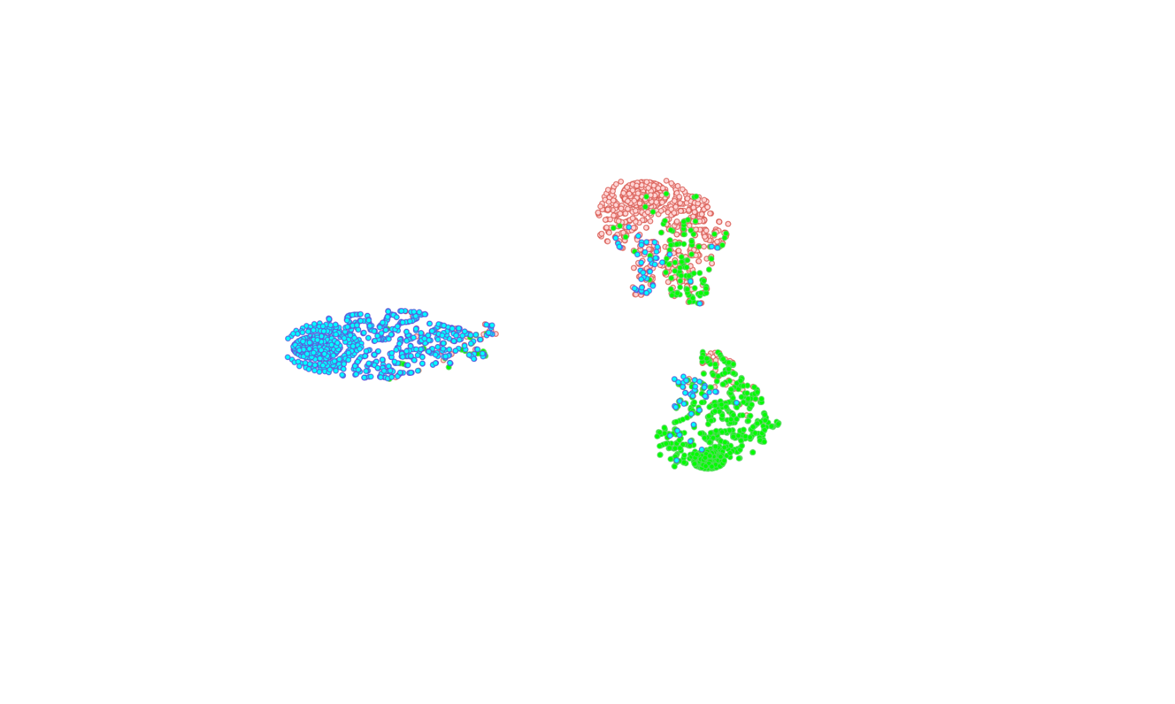
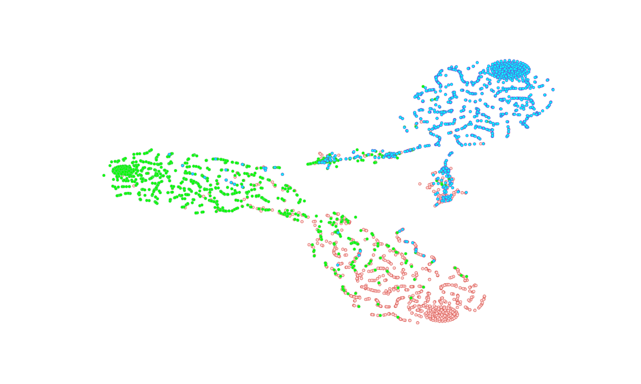
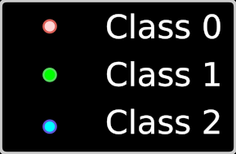










Definition (Ensembling Loss – Our main contribution):
Given a profiling set $𝒯$ of $N_{p}$ pairs ${\left(t_{i}, y_{i}\right)}_{1≤i<N_{p}}$, a set of parametric models $ℱ=\left\{F_{0}, F_{1}, …,F_{N_{c}−1}\right\}$ and a number of attack traces $N_{a}$ such that $N_{a}|N_{p}$, we define the ensembling loss as:
$$ℒ_{EL}\left(ℱ,𝒯,N_{a}\right)= \frac{1}{N_{c}}\sum_{n=0}^{N_{c}−1}{l_{rel}^{α}\left(F_{n},𝒯,N_{a}\right)}+ \frac{2μ}{N_{c}(N_{c}−1)}\sum_{n=0}^{N_{c}−2}{\sum_{m=n+1}^{N_{c}−1}{\left(l_{red}^{γ}\left(F_{n}, F_{m}, 𝒯, N_{a}\right)+l_{cond.red}^{β}\left(F_{n},F_{m},𝒯,N_{a}\right)\right)}}$$
$$F_{0}$$
Conditional Redundancy Loss aims at maximizing an approximation of $MI(F_{n},F_{m}|Y)$:
Redundancy Loss aims at minimizing an approximation of $MI(F_{n},F_{m})$:
Relevance Loss aims at maximizing an approximation of $MI(F_{n},Z)$:
What is the benefit of the EL compared to other losses?
$$l_{cond.red}^{β}\left(F_{n}, F_{m}, 𝒯, N_{a}\right)= \frac{N_{a}}{N_{p}}\sum_{i=1}^{N_{p}/N_{a}}{−\log_{2}\left(e^{−β\left|s_{N_{a},i}^{\left(n\right)}\left(k^{∗}\right)−s_{N_{a},i}^{\left(m\right)}\left(k^{∗}\right)\right|}\right)}$$
$$l_{red}^{γ}\left(F_{n}, F_{m}, 𝒯, N_{a}\right)= \frac{N_{a}}{N_{p}}\sum_{i=1}^{N_{p}/N_{a}}{\sum_{k=0}^{\left|𝒦\right|−1}{\sum_{k^{′}=0}^{\left|𝒦\right|−1}{{− log}_{2}\left(1−e^{−γ\left|s_{N_{a},i}^{\left(n\right)}\left(k\right)−s_{N_{a},i}^{\left(m\right)}\left(k^{′}\right)\right|}\right)}}}$$
$$l_{rel}^{α}\left(F_{n},𝒯,N_{a}\right)= \frac{N_{a}}{N_{p}}\sum_{i=1}^{N_{p}/N_{a}}{\sum_{\begin{aligned}k=0 \\ k≠k^{∗}\end{aligned}}^{\left|𝒦\right|−1}{\log_{2}\left(1+e^{−α\left(s_{N_{a},i}^{\left(n\right)}\left(k^{∗}\right)−s_{N_{a},i}^{\left(n\right)}\left(k\right)\right)}\right)}}$$
$$F_{1}$$
(This loss is identical to the ranking loss [ZBD⁺20])
$$F_{2}$$

Slide 16
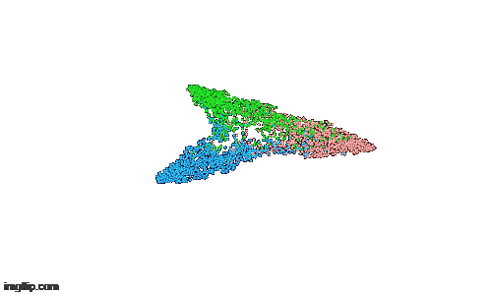
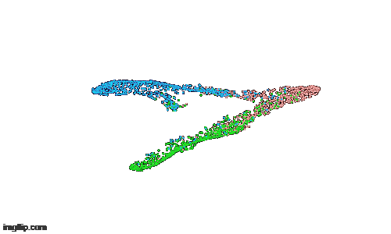
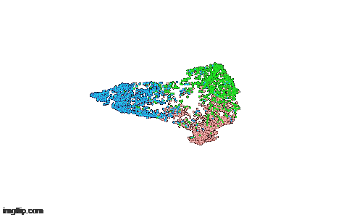

t-distributed Stochastic Neighbor Embedding (t-SNE) [vdMH08]
Cross-Entropy Loss
Ranking Loss
Ensembling Loss

Slide 17
Efficiency through Diversity in Ensemble Models

Slide 18



Secure RSA-1024 Implementation [CCC⁺19]
32-bit contact Smartcard IC
Countermeasures:
- Input randomization, Modulus randomization, Exponent randomization
$$m^{d} mod N=\left({\left(m+k_{1}⋅N\right)}^{d+k_{2}⋅φ\left(N\right)} mod \left(k_{0}⋅N\right)\right)mod N$$
with ${k_{0},k}_{1}, k_{2}$, three random values of bit-length 64
Targeted Operation: “Left-to-Right Square & Multiply Always” exponentiation algorithm
Targeted Variable: $seg_{free}$ address index in $\{0,1,2\}$
Multiclass classification problem has to be solved

Slide 19




If two consecutive iterations provides identical $seg_{free}$ value → the related blinded exponent bit equals 1, otherwise 0.
2
2
1
0
2
2
1
0
2
2
2
0
0
0
1
2
1
0
0
0
1
0
0
0
1
1
0
1
1
0
0
…
$$seg_{free}$$
Private Key Guessed
Performance metric
Given $Acc_{seg_{free}}$ obtained from a neural network, the Adversary can compute the related $Acc_{bit}$ and $ε_{bit}$.
Naive Complexity | $2^{b}$-Complexity | Alternate Attack Complexity
$$\log_{2}\left(\sum_{i=0}^{\left\lceil \left(n+r\right)×ε_{bit}\right\rceil }{\left({n+r \atop i}\right)} \right)$$ | $$⌈\left(n+r\right)×ε_{bit}⌉$$ | $$\log_{2}\left(N_{a}⋅2^{n−j+1}\sum_{i=0}^{\left\lceil \left(r+1\right)×ε_{bit}\right\rceil }{\left({r+1 \atop i}\right)} \right)$$

Slide 20


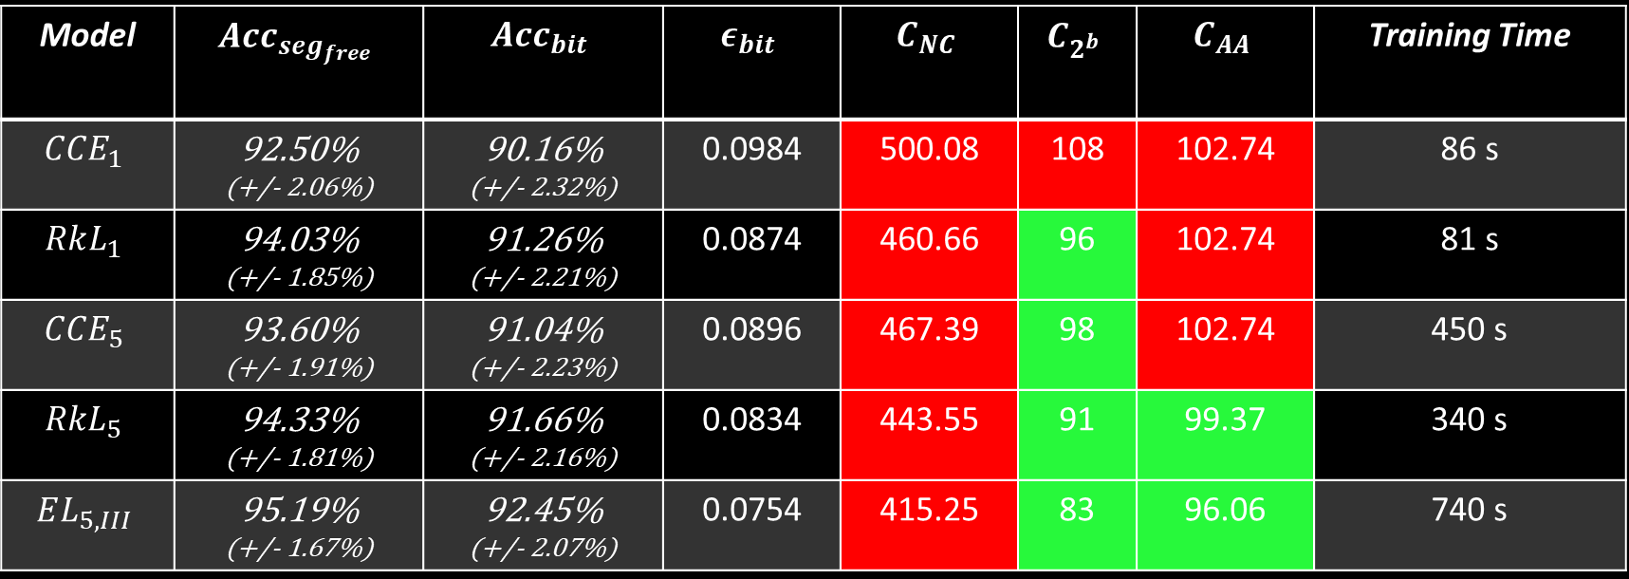



Benefit of Type III diversity
Model | $$Acc_{seg_{free}}$$ | $$Acc_{bit}$$ | $$ε_{bit}$$ | $$C_{NC}$$ | $$C_{2^{b}}$$ | $$C_{AA}$$ | Training Time
$$CCE_{1}$$ | 92.50% (+/- 2.06%) | 90.16% (+/- 2.32%) | 0.0984 | 500.08 | 108 | 102.74 | 86 s
$$RkL_{1}$$ | 94.03% (+/- 1.85%) | 91.26% (+/- 2.21%) | 0.0874 | 460.66 | 96 | 102.74 | 81 s
$$CCE_{5}$$ | 93.60% (+/- 1.91%) | 91.04% (+/- 2.23%) | 0.0896 | 467.39 | 98 | 102.74 | 450 s
$$RkL_{5}$$ | 94.33% (+/- 1.81%) | 91.66% (+/- 2.16%) | 0.0834 | 443.55 | 91 | 99.37 | 340 s
$$EL_{5,III}$$ | 95.19% (+/- 1.67%) | 92.45% (+/- 2.07%) | 0.0754 | 415.25 | 83 | 96.06 | 740 s
Model | $$Acc_{seg_{free}}$$ | $$Acc_{bit}$$ | $$ε_{bit}$$ | $$C_{NC}$$ | $$C_{2^{b}}$$ | $$C_{AA}$$ | Training Time
$$CCE_{1}$$ | 92.50% (+/- 2.06%) | 90.16% (+/- 2.32%) | 0.0984 | 500.08 | 108 | 102.74 | 86 s
$$RkL_{1}$$ | 94.03% (+/- 1.85%) | 91.26% (+/- 2.21%) | 0.0874 | 460.66 | 96 | 102.74 | 81 s
$$CCE_{5}$$ | 93.60% (+/- 1.91%) | 91.04% (+/- 2.23%) | 0.0896 | 467.39 | 98 | 102.74 | 450 s
$$RkL_{5}$$ | 94.33% (+/- 1.81%) | 91.66% (+/- 2.16%) | 0.0834 | 443.55 | 91 | 99.37 | 340 s
$$EL_{5,III}$$ | 95.19% (+/- 1.67%) | 92.45% (+/- 2.07%) | 0.0754 | 415.25 | 83 | 96.06 | 740 s
Following the European SOG-IS security guidances, a maximum brute-force
complexity of around $2^{100}$ is practicable (ie. $C_{\{NC, 2^{b},AA\}}≤100$)

Slide 21
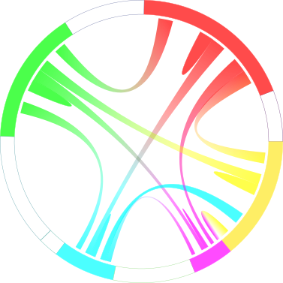













Benefit of Type I+II+III diversity
Type I+II+III diversity
$$F_{1}$$
Type I diversity
Type I+II diversity
$$F_{0}$$
$$F_{2}$$
Model | $$Acc_{seg_{free}}$$ | $$Acc_{bit}$$ | $$ε_{bit}$$ | $$C_{NC}$$ | $$C_{2^{b}}$$ | $$C_{AA}$$ | Training Time
$$CCE_{5,I+II}$$ | 96.23% (+/- 1.49%) | 94.66% (+/- 1.76%) | 0.0534 | 322.58 | 59 | 88.45 | 2,116 s
$$RkL_{5,I+II}$$ | 96.27% (+/- 1.48%) | 94.94% (+/- 1.71%) | 0.0506 | 310.01 | 56 | 88.45 | 1,092 s
$$CCE_{5,I+II+III}$$ | 97.33% (+/- 1.26%) | 96.96% (+/- 1.34%) | 0.0304 | 209.52 | 34 | 80.71 | 3,392 s
$$F_{9}$$
$$F_{3}$$
$$F_{8}$$
$$F_{4}$$
$$F_{5}$$
$$F_{7}$$
$$F_{6}$$

Slide 22


MERCI !
Take-Away Messages
The Ensemble methods are useful to defeat PKC implementations as a slight gain in accuracy provides a realistic improvement for a full attack scenario
Increasing the diversity between the committee members is beneficial to reduce the remaining attack complexity
The Ensembling Loss is beneficial to promote the interactions between committee members during the training process in order to enhance diversity
The application of the Ensembling Loss is not restricted to the PKC implementations (symmetric implementations, image classification, fraud detection, …)
Additionnal results are provided in our paper
Binary classification case-study on a Secure ECC implementation
Assessing the impact of the number of committee members
Comparison with classical ensembling methods (ie. Bagging, Boosting)
Multiple diversity metrics are used to assess the gain in diversity
Contact: gabriel.zaid@univ-st-etienne.fr
GitHub: https://github.com/gabzai/Ensembling-Loss-SCA

Slide 23
Bibliography
[Bro9] G. Brown. An information theoretic perspective on multiple classifier systems. In Jón Atli Benediktsson, Josef Kittler, and Fabio Roli, editors, Multiple Classifier Systems, pages 344–353, Berlin, Heidelberg, 2009. Springer Berlin Heidelberg.
[CCC⁺19] M. Carbone, V. Conin, M-A. Cornélie, F. Dassance, G. Dufresne, C. Dumas, E. Prouff, and A. Venelli. Deep learning to evaluate secure RSA implementations. IACR Transactions on Cryptographic Hardware and Embedded Systems, 2019(2):132–161, Feb. 2019.
[LWC⁺19] L. Liu, W. Wei, K. Chow, M. Loper, E. Gursoy, S. Truex, and Y. Wu. Deep neural network ensembles against deception: Ensemble diversity, accuracy and robustness. In 2019 IEEE 16th International Conference on Mobile Ad Hoc and Sensor Systems (MASS), pages 274–282, 2019.
[SW14] W. Schindler and A. Wiemers. Power attacks in the presence of exponent blinding. Journal of Cryptographic Engineering, 4, 06 2014.
[SW17] W. Schindler and A. Wiemers. Generic power attacks on RSA with CRT and exponent blinding: new results. Journal of Cryptographic Engineering, 7, 01 2017.
[TG96] Kagan Tumer and Joydeep Ghosh. Error correlation and error reduction in ensemble classifiers. Connection Science, 8(3-4):385–404, 1996.
[vdMH08] Laurens van der Maaten and Geoffrey Hinton. Visualizing data using t-SNE. Journal of Machine Learning Research, 9:2579–2605, 2008.
[ZL10] Z-H. Zhou and N. Li. Multi-information ensemble diversity. In N. El Gayar, J. Kittler, and F. Roli, editors, Multiple Classifier Systems, pages 134– 144, Berlin, Heidelberg, 2010. Springer Berlin Heidelberg.
[ZBD⁺20] G. Zaid, L. Bossuet, F. Dassance, A. Habrard, and A. Venelli. Ranking loss: Maximizing the success rate in deep learning side-channel analysis. IACR Transactions on Cryptographic Hardware and Embedded Systems, 2021(1):25–55, Dec. 2020.

