Slide 1




Conditional Variational AutoEncoder based on Stochastic Attack Gabriel ZAID⁽¹⁾, Lilian BOSSUET⁽²⁾, Mathieu CARBONE⁽¹⁾, Amaury HABRARD⁽²⁾, Alexandre VENELLI⁽³⁾
(1)
(2)
(3)

Slide 2


Side channel attacks?

Slide 3





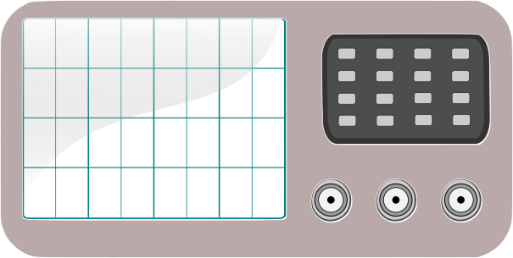
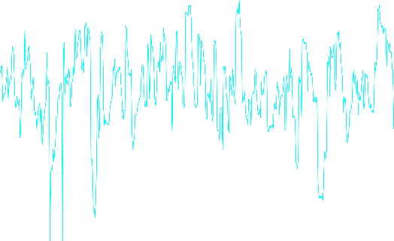
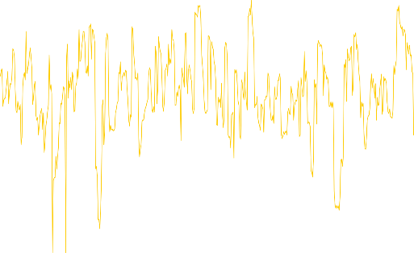


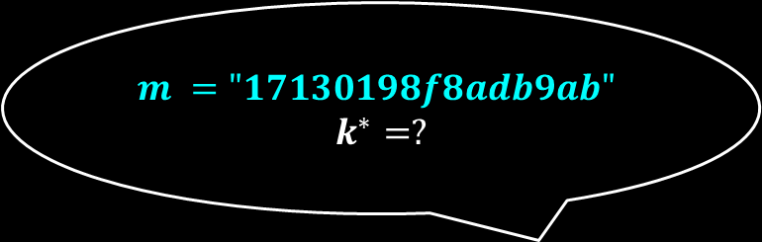

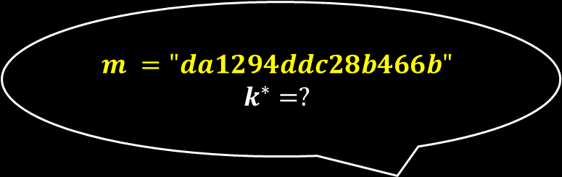

Side channel attacks
$$m ="da1294ddc28b466b"$$
$$k^{∗}=?$$
$m ="17130198f8adb9ab"$
$$k^{∗}=?$$
$$T=ψ\left(m, k^{∗}\right)+Z$$
$$T=ψ\left(m, k^{∗}\right)+Z$$

Slide 4
Adversary’s goal
Target a system to retrieve the secret information it contains
Evaluator’s goal
Target a system, in constraint time, to retrieve the secret information it contains using interpretable/explainable methods
How can we perform a deep learning-based side-channel attack following the Evaluator’s goal?

Slide 5
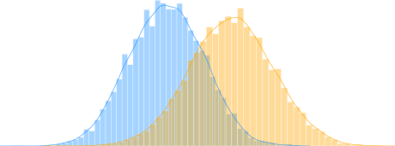
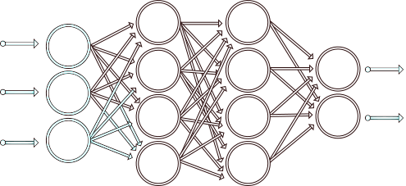
Side channel attacks
State-of-the-art solutions
Classical SCA
(Template, stochastic attack)
Deep learning-based SCA

Slide 6



Classical vs. Deep Learning-based SCA
Classical
DLSCA
No hypothesis on $ψ$ or $Z$
Mitigate the preprocessing phase
Interpretable / Explainable
Time to construct the statistical model

Slide 7






Recap’
Evaluator’s goal
Target a system, in constraint time, to retrieve the secret information it contains using interpretable/explainable methods
1 – Interpretable & Explainable
Optimal solution?
2 – Estimation of $\operatorname{Pr}\left[T | Y\right]$ without any assumption on $ψ$ and/or Z
DLSCA
Classical
3 – Preventing pre-processing phase
4 – Convergence towards the true unknown $\operatorname{Pr}\left[T | Y\right]$
5 – Minimizing the time required to construct an estimation of $\operatorname{Pr}\left[T | Y\right]$

Slide 8

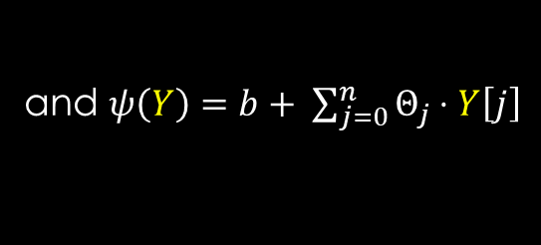


Towards a new DLSCA solution derived from [SLP05]
Leakage model $ψ$
A leakage model $ψ:𝔽_{2}^{n}→ℝ$ characterizes the impact of a sensitive variable $Y=f(m, k^{∗})$ on a physical trace $T$
$T=ψ\left(Y\right)+Z$ s.t. $Z\sim 𝒩\left(0, Σ\right)$
$$\hat{ψ}\left(Y\right)$$
and $ψ\left(Y\right)=b+ \sum_{j=0}^{n}{Θ_{j}⋅Y\left[j\right]}$
-
$$Z\sim 𝒩\left(0, Σ\right)$$
Attack scenario
1
Find the coefficients $Θ$ related to $ψ(Y)$ (least square method)
2
Estimate the distribution $Z$ from $\left\{T^{(l)}−\hat{ψ}\left(Y^{\left(l\right)}\right)|l≤N\right\}$
Werner Schindler, Kerstin Lemke, and Christof Paar. A stochastic model for differential side channel cryptanalysis. In Josyula Rao and Berk Sunar, editors, Cryptographic Hardware and Embedded Systems – CHES 2005, pages 30–46, Berlin, Heidelberg, 2005. Springer Berlin Heidelberg.

Slide 9
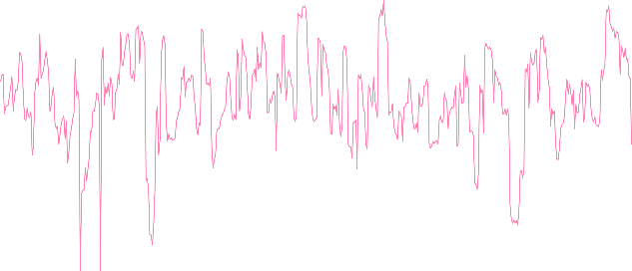
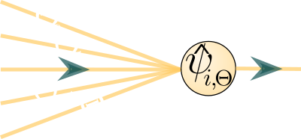








Towards a new DLSCA solution derived from [SLP05]
Contribution
$$μ_{v}$$
-
-
$$Z[i]$$
+
$$Σ_{v}$$
$$\begin{matrix}Y[0] \\ Y[1] \\ \begin{aligned}⋮ \\ Y[n−1] \\ Y[n]\end{aligned}\end{matrix}$$
$$\begin{matrix}Y[0] \\ Y[1] \\ \begin{aligned}⋮ \\ Y[n−1] \\ Y[n]\end{aligned}\end{matrix}$$
$$b+ \sum_{j=0}^{n}{Θ_{j}⋅Y\left[j\right]}$$
$$\hat{ψ}\left(Y\right)$$
$$\hat{ψ}′\left(Y\right)$$
Conditional Variational AutoEncoder based on Stochastic Attack
(cVAE-SA)

Slide 10

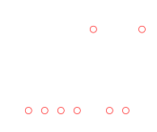
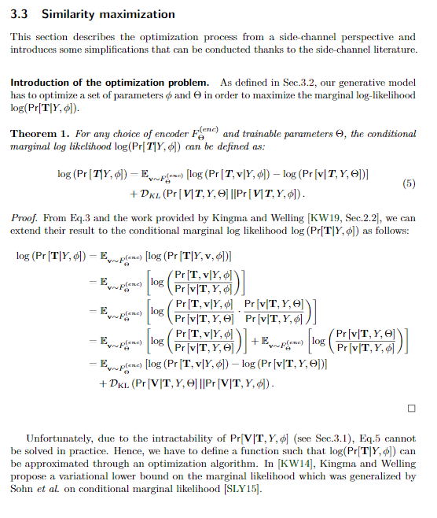












Towards a new DLSCA solution derived from [SLP05]
Additional results
$$μ_{v}$$
$$D$$
-
+
$$Σ_{v}$$
$$\begin{matrix}Y[0] \\ Y[1] \\ \begin{aligned}⋮ \\ Y[n−1] \\ Y[n]\end{aligned}\end{matrix}$$
$$\begin{matrix}Y[0] \\ Y[1] \\ \begin{aligned}⋮ \\ Y[n−1] \\ Y[n]\end{aligned}\end{matrix}$$
$$\hat{ψ}\left(Y\right)$$
$$\hat{ψ′}\left(Y\right)$$
Is our contribution the optimal solution?
$$Θ$$
$$Θ$$
* Training process
Approximation of the true unknown $\operatorname{Pr}\left[T|Y\right]$ through an adapted version of the ELBO loss
$$…$$
$$…$$
$$Y[0]$$
$$Y[0]$$
$$Y[7]$$
$$Y[7]$$
* Inference stage
Adapt this strategy to fit with the new architecture
Possibility to simultaneously target multiple sensitive variables
Technical details
in our paper
* Other results
Number of trainable parameters is a priori known $2D⋅\left(\left(D+1\right)+1+\sum_{i=0}^{d}{\left({n \atop i}\right)}\right)$
Visualization of the extracted leakage model

Slide 11

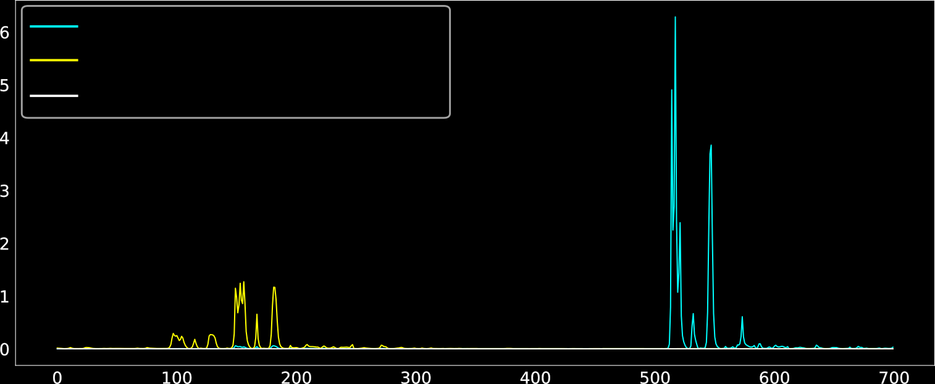








Towards a new DLSCA solution derived from [SLP05]
AES_HD*¹ (AES-128) [PHJ⁺18]
Xilinx Virtex-5 FPGA
Targeted variable:
$$Y=Sbox^{−1}\left[C\left[12\right]⊕k^{∗}\right]⊕C\left[8\right]$$
Unprotected implementation
$$SNR$$
$$Sample$$
ASCAD-v1*² (AES-128) [BPS+20]
AVR (8-bit) microcontroller
Targeted variable:
$$Y=Sbox[m\left[3\right]⊕ k^{∗}]$$
Countermeasure: 1st order boolean masking
Version 1 with fixed key
$$Sbox\left[m\left[3\right]⊕k^{∗}\right]⊕r[3]$$
$$r[3]$$
$$Sbox\left[m\left[3\right]⊕k^{∗}\right]$$
$$SNR$$
$$Sample$$
*¹ https://github.com/AESHD/AES_HD_Dataset
*² https://github.com/ANSSI-FR/ASCAD

Slide 12






Towards a new DLSCA solution derived from [SLP05]
AES_HD
ASCAD-v1
$$Rank$$
$Ran$k
$$Number of traces$$
$$Number of traces$$
 | Our contribution | State of the Art (SOTA)
 | cVAE-SA | CNN | MLP | ResNets
AES_HD | 300 | 831 [ZXF⁺19] | 350 [MDP19] | 2,100 [JZHY20]
ASCAD-V1 | 194 | 87 [PWP20] | 104 [PWP20] | 552 [JZHY20]

Slide 13



Limitations & perspectives
Evaluator’s goal
Target a system, in constraint time, to retrieve the secret information it contains using an interpretable/explainable methods
1 – Interpretable & Explainable
Optimal solution
2 – Estimation of $\operatorname{Pr}\left[T | Y\right]$ without any assumption on $ψ$
3 – Preventing pre-processing phase
4 – Convergence towards the true unknown $\operatorname{Pr}\left[T | Y\right]$
5 – Minimizing the time required to construct an estimation of $\operatorname{Pr}\left[T | Y\right]$

Slide 14


Limitations & perspectives
Evaluator’s goal
Target a system, in constraint time, to retrieve the secret information it contains using an interpretable/explainable methods
Estimation of $\operatorname{Pr}\left[T | Y\right]$ without any assumption on $ψ$ and $Z$
→ Find a generic structure for the latent space
Preventing pre-processing phase
→ Dimensionality reduction
→ Mitigate the desynchronization effect
Convergence towards the true unknown $\operatorname{Pr}\left[T | Y\right]$
→ Finding a solution to automatize the samples’ combination
→ What kind of non-linear functions are required
All those perspectives must keep the explainable / interpretable property of cVAE-SA

Slide 15

Thank You
Contact
Gabriel ZAID – gabriel.zaid@thalesgroup.com

Slide 16






Limitations: Estimation of $\operatorname{Pr}\left[T | Y\right]$ without any assumption on $ψ$
$$μ_{v}$$
-
+
$$Σ_{v}$$
$$\begin{matrix}Y[0] \\ Y[1] \\ \begin{aligned}⋮ \\ Y[n−1] \\ Y[n]\end{aligned}\end{matrix}$$
$$\begin{matrix}Y[0] \\ Y[1] \\ \begin{aligned}⋮ \\ Y[n−1] \\ Y[n]\end{aligned}\end{matrix}$$
$$\hat{ψ}\left(Y\right)$$
$$\hat{ψ}′\left(Y\right)$$
Perspectives
Find a generic structure for the latent space in order to reduce the assumption on the leakage model
Marissa Connor, Gregory Canal, Christopher Rozel. Variational Autoencoder with Learned Latent Structure. AISTATS 2021.
Jiacheng Xu, Greg Durrett. Spherical Latent Spaces for Stable Variational Autoencoders. EMNLP 2018.

Slide 17


Limitations: Preventing pre-processing phase
$$μ_{v}$$
-
+
$$Σ_{v}$$
$$\begin{matrix}Y[0] \\ Y[1] \\ \begin{aligned}⋮ \\ Y[n]\end{aligned}\end{matrix}$$
$$\begin{matrix}Y[0] \\ Y[1] \\ \begin{aligned}⋮ \\ Y[n]\end{aligned}\end{matrix}$$
$$\hat{ψ}\left(Y\right)$$
$$\hat{ψ}′\left(Y\right)$$
Perspectives
Dimensionality reduction & PoI selection → Link with PCA? LDA?
Elad Plaut. From Principal Subspaces to Principal Components with Linear Autoencoders. ArXiv 2018
Mitigate the desynchronization effect
Maximilian Ilse, Jakub M. Tomczak, Christos Louizos, and Max Welling. Diva: Domain invariant variational autoencoders. MIDL 2020

Slide 18
Limitations: Convergence towards the true unknown $\operatorname{Pr}\left[T | Y\right]$
$$μ_{v}$$
-
+
$$Σ_{v}$$
$$\begin{matrix}Y[0] \\ Y[1] \\ \begin{aligned}⋮ \\ Y[n]\end{aligned}\end{matrix}$$
$$\begin{matrix}Y[0] \\ Y[1] \\ \begin{aligned}⋮ \\ Y[n]\end{aligned}\end{matrix}$$
$$\hat{ψ}\left(Y\right)$$
$$\hat{ψ}′\left(Y\right)$$
Perspectives
1) Finding a solution to automatize the samples’ combination?
Kohei Miyaguchi, Takayuki Katsuki, Akira Koseki, Toshiya Iwamori. Variational Inference for Discriminative Learning with Generative Modeling of Feature Incompletion. ICLR 2022
Valence Cristiani, Maxime Lecomte, Philippe Maurine. Leakage Assessment Through Neural Estimation of the Mutual Information. ACNS Workshop 2020
2) Which implementations require a non-linear leakage model?

