Slide 1
Hack a SAT Hacking of an In-Orbit satellite Gabriel ZAID

Slide 2

Agenda
Context
What is OPS-SAT Space lab?
Hack Cysat
Experimenters’ side (The Good)
Attackers’ side (The Bad)
Post Exploitation (The Ugly)
Mitigation strategies

Slide 3
Context

Slide 4

Context
CYSAT
Event exclusively dedicated to cybersecurity for the space industry
Raising awareness about cybersecurity for space assets and data
Next event (2024 edition)
Location: Paris, Station F
Date: April 24-25th
Hack Cysat
CYSAT had launched a competition in 2022, inviting ethical hackers to comprehensively assess satellite vulnerabilities
Thales's offensive cybersecurity team took part in the Hack CYSAT 2023 challenge
Objective: identify vulnerabilities on-board OPS-SAT (ESA) that could enable malicious actors to disrupt satellite mission operations

Slide 5
Hack Cysat

Slide 6
Hack Cysat
Objective
Identify vulnerabilities on-board OPS-SAT that could enable malicious actors to disrupt satellite mission operations
The results of the challenge will be used to
Tighten satellite security and its on-board applications
Improve the cyber resilience of space systems
Support the long-term success of space programmes
Experiment context
ESA actively assisted the Thales team to perform the security assessment of OPS-SAT
The satellite has been designed with the idea of an evil experimenter in mind. For example, the bus is constantly monitoring the behavior of the system and can shut it down if necessary

Slide 7


The Team
In alphabetic order:
Arnaud Gatignol: Reverse Engineer @ Thalium
Brian Jouannic: Cyber Security Evaluator @ Thales ITSEF
Quentin Minster: Reverse Engineer @ ex-Thalium
Guillaume Tessier: Reverse Engineer @ ex-Thalium
Thalium
Thales laboratory dedicated to cyberdefense, offensive security, vulnerabilities assessment and Red Team activities
Thales ITSEF
Thales’ Information Technology Security Evaluation Facility, specialized in independent security evaluation of components and embedded systems

Slide 8
What is OPS-SAT Space lab?

Slide 9

An OPS-SAT?

Slide 10
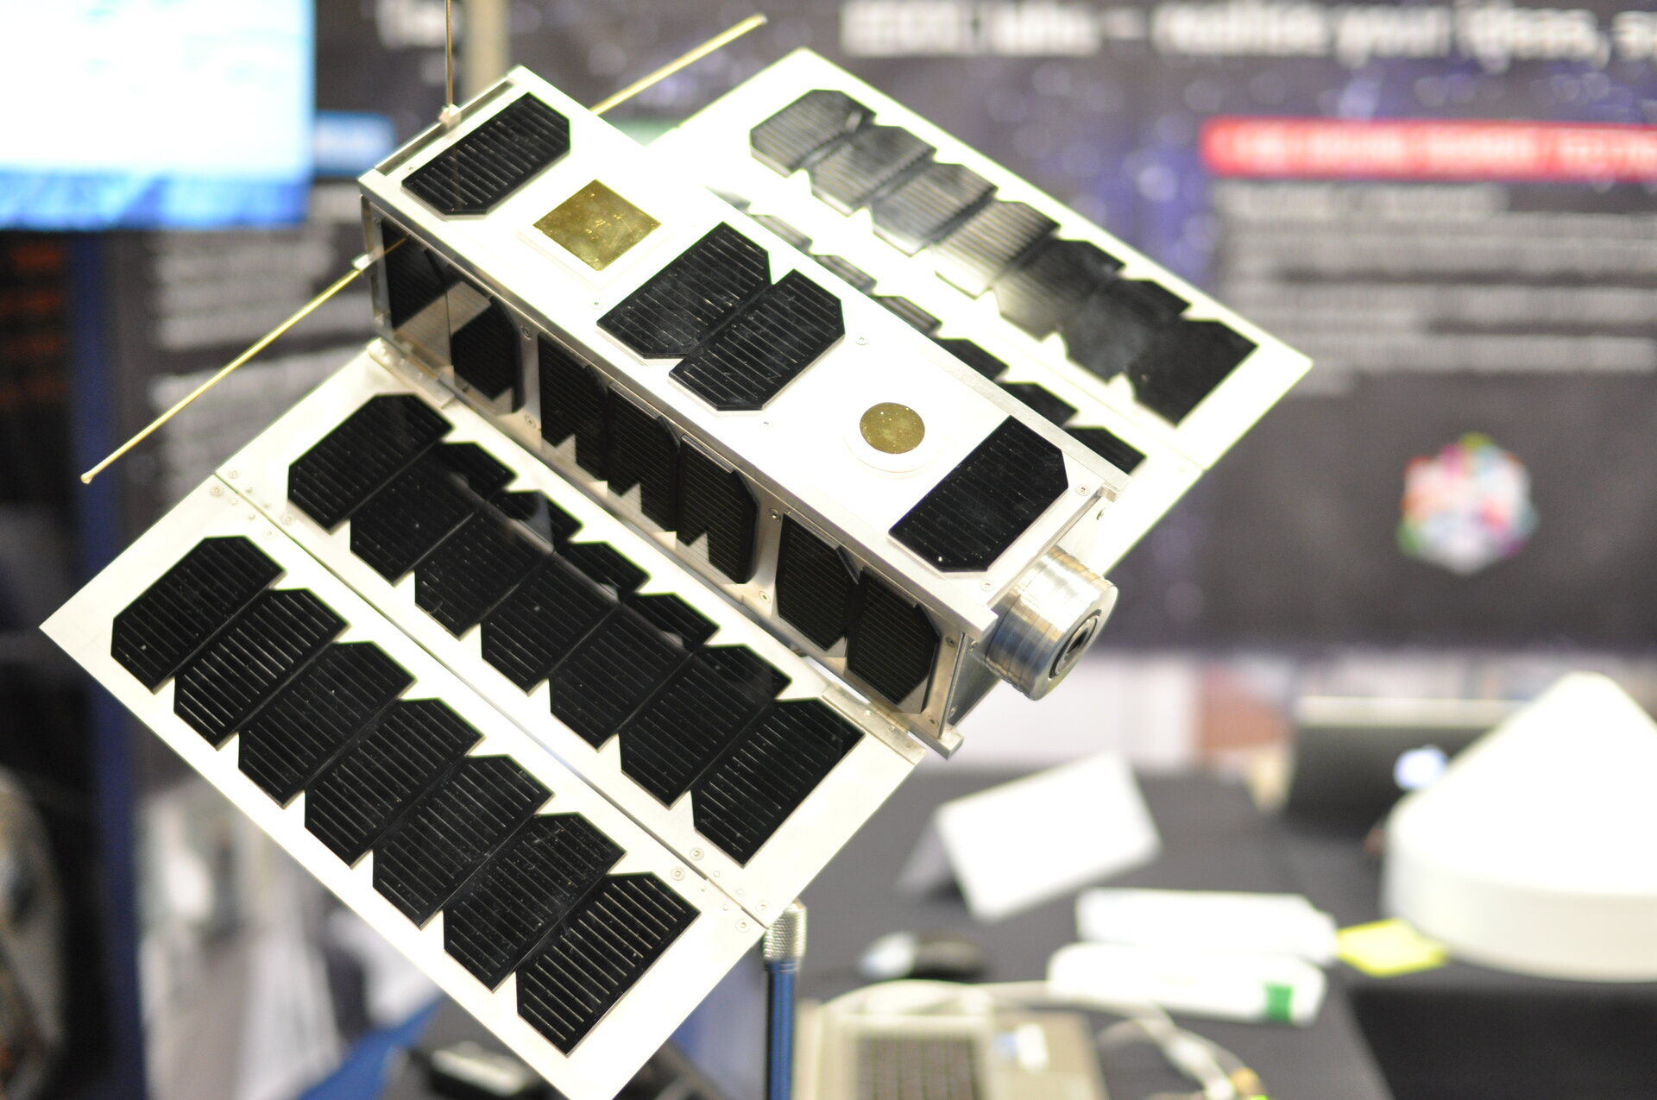
OPS-SAT Space Lab
A nanosatellite (10x10x30 cm and a mass of approximately 5.4 kg.) launched in December 2019
Purpose
An ESA space lab service to help accelerate innovation by testing and validating new techniques in mission control (e.g. communication protocol)
Offer a range of resources
Cameras
Attitude Determination Control System (ADCS)
GPS
Implementation of AI solutions
Source: https://www.esa.int/Enabling_Support/Operations/OPS-SAT

Slide 11
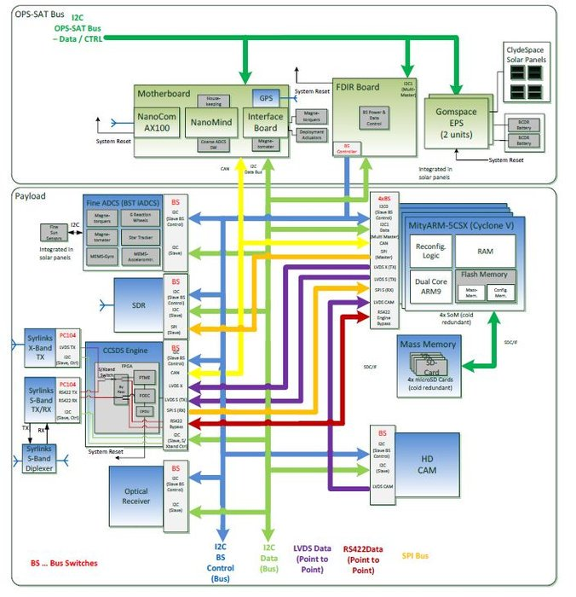
OPS-SAT Space Lab
Source: https://www.eoportal.org/satellite-missions/ops-sat

Slide 12

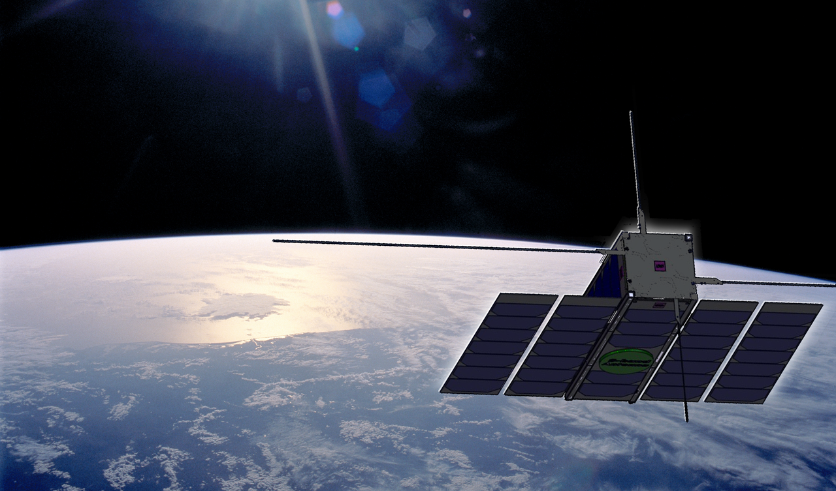



Experimenter’s access to OPS-SAT starring: The Good, An Innocent Experimenter

Slide 13
Developping an OPS-SAT experiment
Experiments on OPS-SAT run on the SEPP
Via the Nanosat Mission Operations Framework (NMF), an experiment can use of a range of services:
Camera, GPS, ADCS, …
Ground ↔ space communication
For starters, you just want to take some pretty pictures using the satellite:
Wait for the ADCS to be available (other experiments may be using it)
Point the satellite along your target direction
Take a picture with the camera

Slide 14
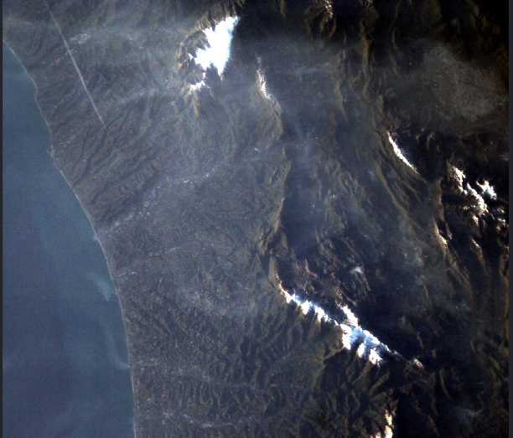
Developping an OPS-SAT experiment
What the Good expects

Slide 15

Developping an OPS-SAT experiment
What the Good actually gets

Slide 16
Developping an OPS-SAT experiment
What happened?

Slide 17


A malicious experiment? starring: The Bad

Slide 18
Attacker’s objectives
Take control of OPS-SAT’s sensors & actuators, for:
Disinformation: tamper with camera images, falsify sensor readings
Destruction: damage the platform and disrupt the mission
Stay undetected
Our malicious code should not be detectable before upload on the satellite

Slide 19

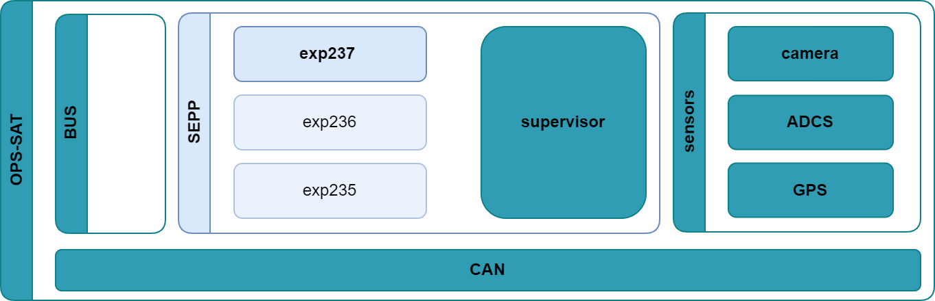
Taking control of the sensors

Slide 20
Problem #1: Stay undetected
Our experiment app relies on the supervisor to access OPS-SAT services
But our app goes through a review process before running on the real satellite
How to evade this? → Find a way to dynamically execute shell commands
Good starting point: experiments can communicate with ground apps directly
Possible vectors:
Abuse existing services: e.g. command execution feature (CommandExecutor)
Leverage a vulnerability to exploit it: existing (NMF)

Slide 21
Stay undetected: Deserialization vulnerability
We submitted an innocuous-looking app
Derived from a sample NMF app: hello-world-simple
It contains no overtly malicious code
But there’s a slight twist:
new Parameter("Dummy parameter", 1 , /*…*/)
This exposes a vulnerability in NMF: « unsafe Java deserialization » (a call to readObject with attacker-controlled data)

Slide 22
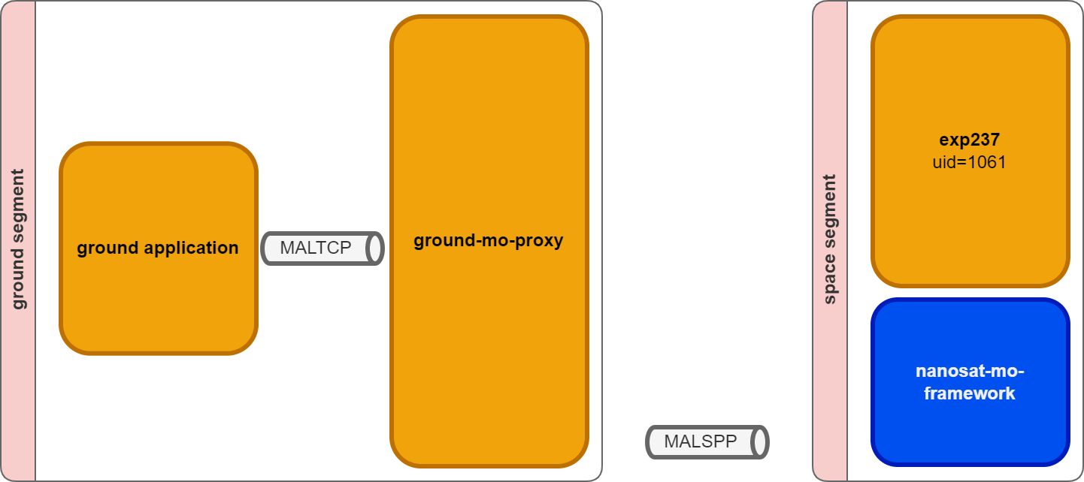
Stay undetected: Deserialization vulnerability
Ground App communicates with Space App

Slide 23
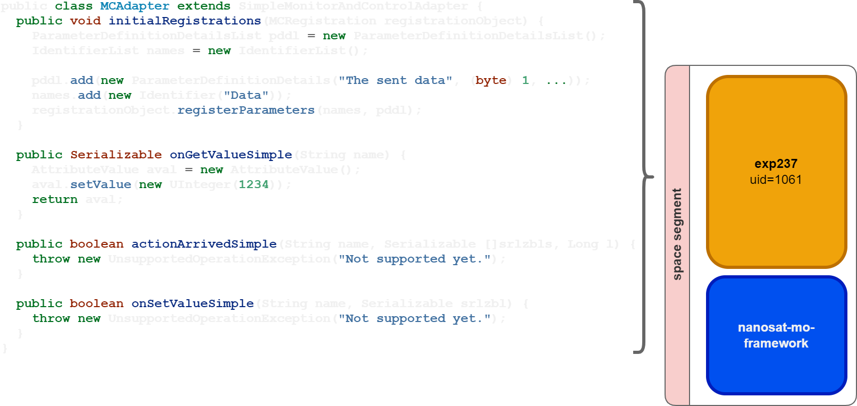
Stay undetected: Deserialization vulnerability
Leveraging the samples code base
NMF class
Blob parameter

Slide 24
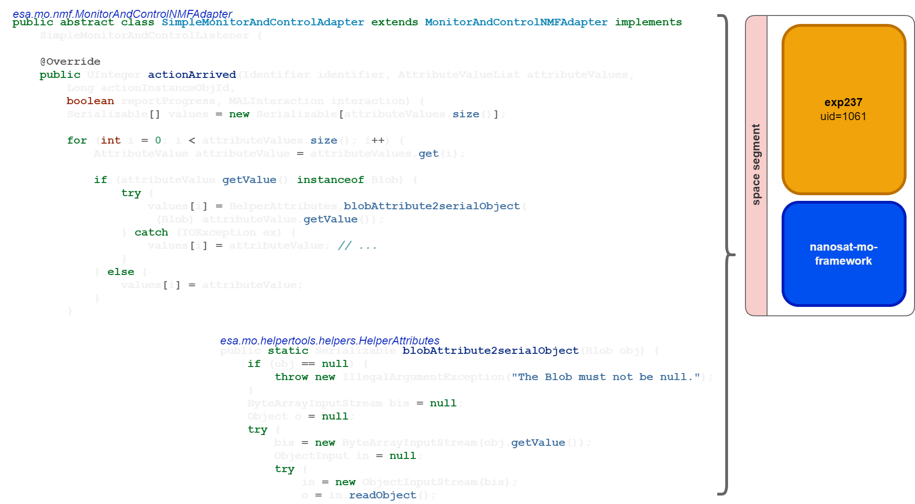
Stay undetected: Deserialization vulnerability
Java deserizalization vulnerability in NMF
Receive the blob
Unserialize!

Slide 25
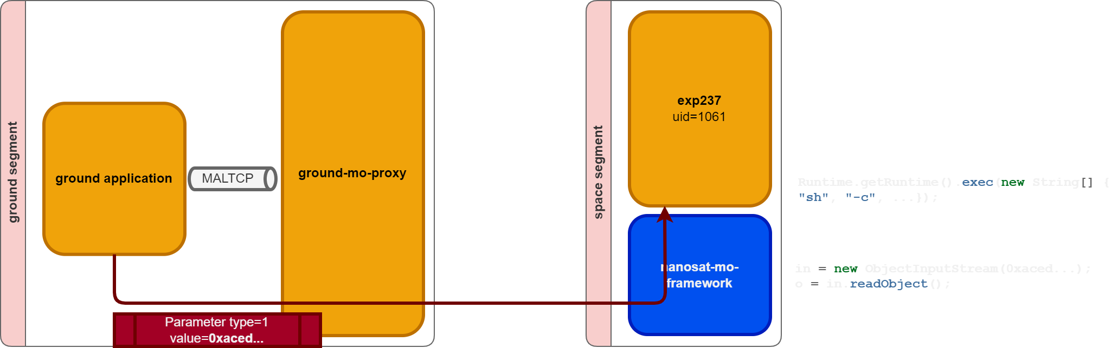
Stay undetected: Deserialization vulnerability
Execute arbitrary commands

Slide 26
Stay undetected: Deserialization vulnerability
SUCCESS!
We leveraged this vulnerability to design a covert channel, in cooperation with ESA
The exploit is sent from a ground app we developed: a parameter is sent to our space app
The malicious parameter payload is routed to space
Once received by our app, it triggers arbitrary code execution under the identity of our app
Yet this code doesn’t appear in the binary files submitted for our experiment

Slide 27
Unrestricted payloads upload
payload
Notes:
*

Slide 28
Problem #2: Taking control of the SEPP
Our app runs as an unprivileged Linux user
It has no direct access to sensors and actuators, but though the supervisor
How to take control of them?
Good starting point: being root yields full privileges over the whole system
Possible vectors:
Exploit a 1-day vulnerability either user-space or kernel
Find critical daemons running as root

Slide 29
Taking control: Privilege escalation from user to root
The SEPP’s supervisor controls access to the sensors for NMF apps
It runs as root
To take control of the sensors, we take control of their gatekeeper: the supervisor
To do so, we need to escalate our privileges from our user to root
There’s an intriguing service running on the SEPP: space-shell-root
We grabbed the binary & reverse engineered it
It’s a client that decodes then executes as root whatever command it receives…
Anyone can talk on the CAN bus, including unprivileged apps
Thus… any app can send commands for the space-shell-root to run as root ☺
(this is OPS-SAT-specific, not NMF-related)

Slide 30
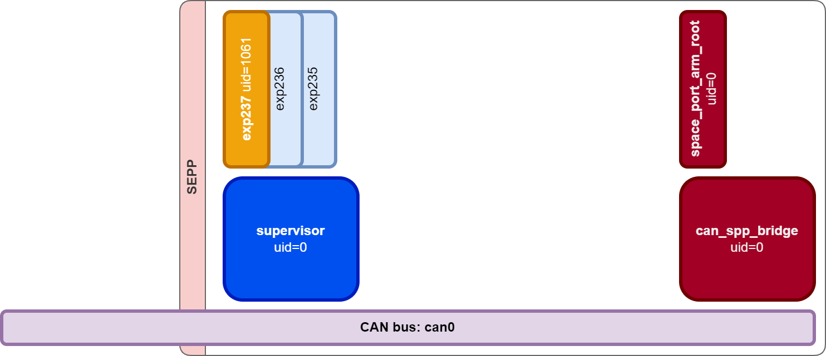
Taking control: Privilege escalation from user to root
CAN bus vulnerability

Slide 31
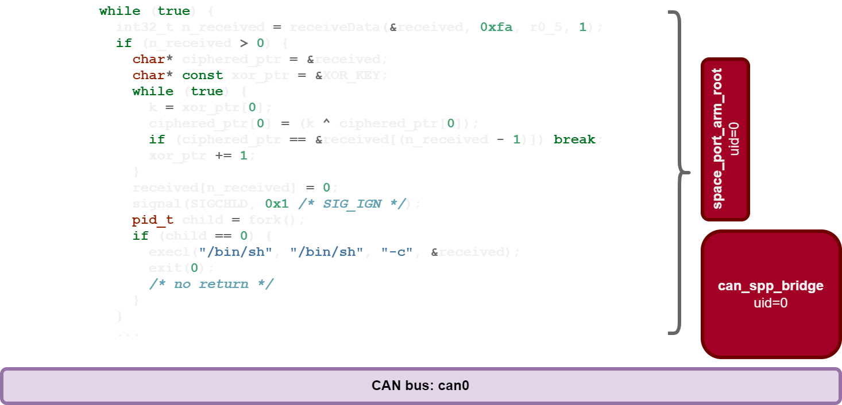
Taking control: Privilege escalation from user to root
Nice looking feature!
Received data
XORed with key
Executed as root!

Slide 32
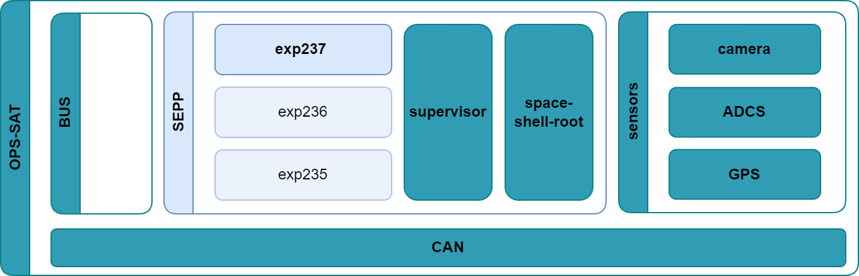
Taking control: Privilege escalation from user to root
Arbitrary code execution as root
payload
shell commands

Slide 33
Problem #3: Persistence
Our app escalated as root
How to ensure persistent effects on sensors and actuators ?
Good starting point: apps use the NMF framework
Possible vectors:
Inject into a library or an executable file

Slide 34
Persistence: Injection of a jar library
Supervisor provides experiments with features they need: images, GPS
It adapts standardized interfaces to low-level hardware
Perfect spot to control the information received by experiments
The library that is used by the supervisor
The jar library which is writable by root user (so by us ☺)
A jar is simply a zip file, with compiled Java bytecode inside
We craft our bytecode based on the original one, and simply replace some files inside the jar
The supervisor now runs the jar containing our malicious bytecode

Slide 35

Taking control: Inject into supervisor
payload
Java bytecode
shell commands

Slide 36
Summary: Full Attack Flow

Slide 37
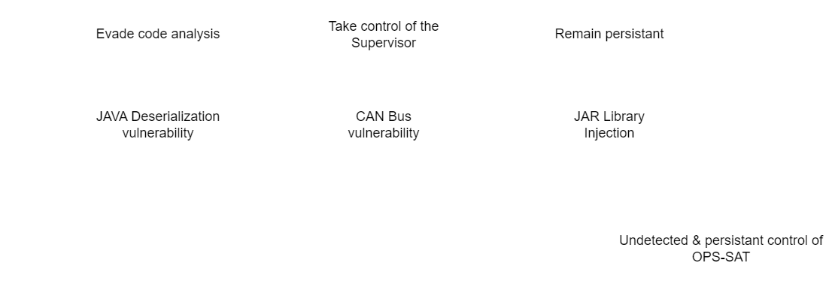
Full attack flow

Slide 38

Post Exploitation starring: The Ugly

Slide 39

Tampering with camera & ADCS
Root privileges allow us to take control on the supervisor:
Alter/delete all images captured by the camera
Override satellite attitude requested by other apps
This also provides persistence for our malicious code since the supervisor starts early and is almost always running

Slide 40
Other potential effects
Non-demonstrated possible effects:
Shutting down services used by other experiments
Draining the batteries by maintaining an unfavourable attitude
Tampering with GPS coordinates
Spying on other experiments data
…

Slide 41
No satellites were harmed in the making of this presentation
Satellites are key elements in numerous critical systems:
Telecommunication
Earth surveillance
Positioning (Galileo, GPS…)
Satellite compromise can lead to:
Service disruption
Unreliable/tampered data transmission
Confidential data leaks
Especially true if the compromise remains undetected!

Slide 42
Key takeaways or Why it isn’t all that bad… but it could well become so

Slide 43
Why it isn’t all that bad… but it could well become so
ESA supervised our tests and retained control throughout the demo
The SEPP can only control most of OPS-SAT…
… as long as the BUS* allows it
ESA’s design ensures they can always safely reset the SEPP and restore it to a known-good state through a simple TC (On-board operations are conducted in RAM only)
We also had access to the SEPP image
ESA is in the process of fixing the vulnerabilities we uncovered
* Core OPS-SAT component that can’t be overridden by the SEPP

Slide 44
Risk Mitigation

Slide 45
Mitigation risk - Prevention
Design with security in mind:
Build threat model (e.g. MITRE ATT&CK)
Harden systems (e.g. CIS benchmark and RedHat STIG)
Isolate tasks (e.g. SELinux)
Grant least amount of privileges
Code review
Red-team designs & implementations

Slide 46
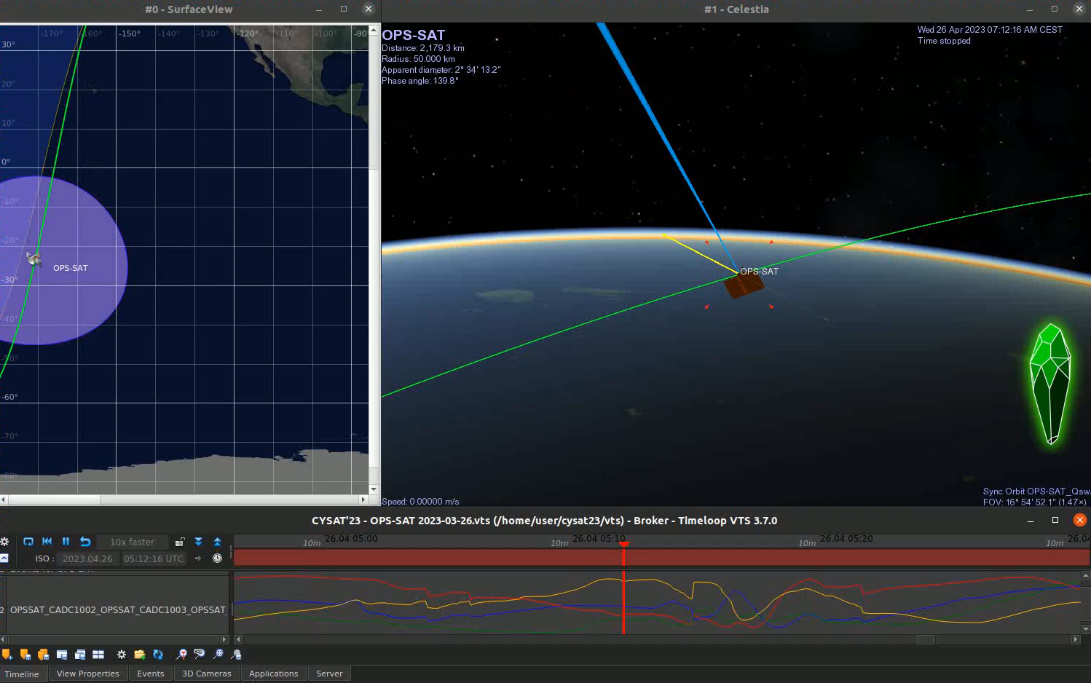

Slide 47

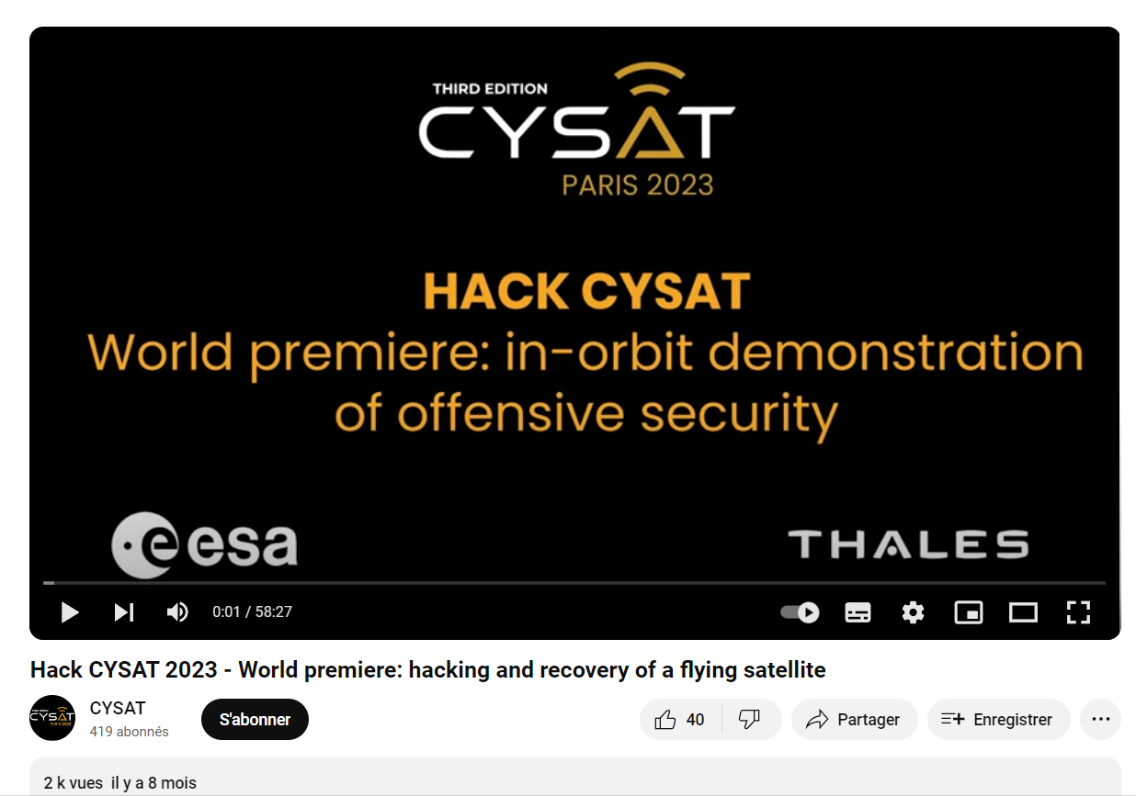
Thank you Contact: gabriel.zaid@thalesgroup.com

