Slide 1



Ranking Loss: Maximizing the Success Rate in Deep Learning Side-Channel Analysis
Gabriel ZAID, Lilian BOSSUET, François Dassance, Amaury HABRARD, Alexandre VENELLI
Univ Lyon, UJM-Saint-Etienne, CNRS Laboratoire Hubert Curien UMR 5516 F-42023, Saint-Etienne, France
Thales ITSEF, Toulouse, France
Journée thématique des GDR SoC² et Sécurité Informatique – Virtual Event

Slide 2
What is a Side-Channel Attack?

Slide 3





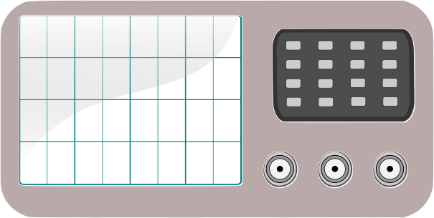
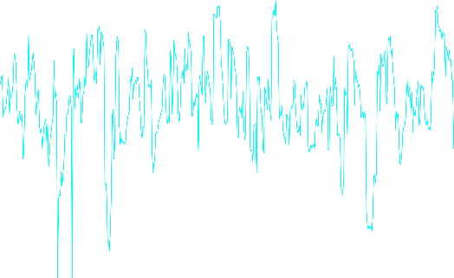
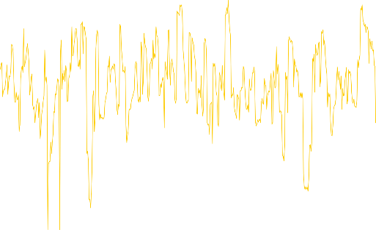


Plaintext = 0x17130198f8adb9ab
Secret Key = 0x25404f9d6bcc3c68
Plaintext = 0xda1294ddc28b466b
Secret Key = 0x89e8f11831b71a05

Slide 4




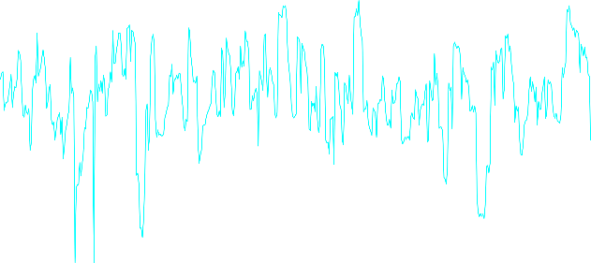



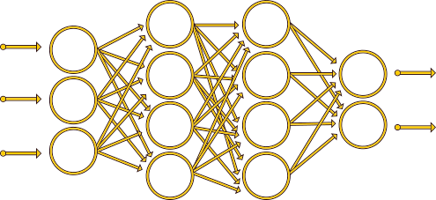
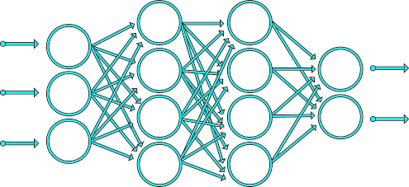
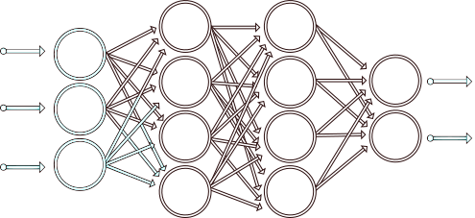
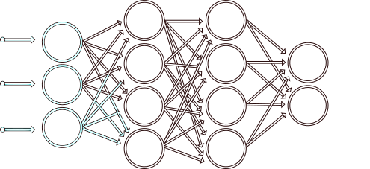
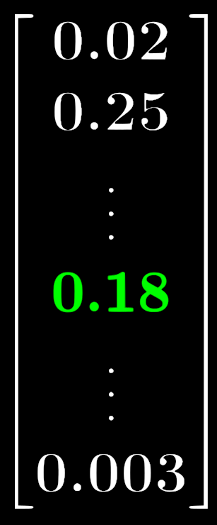




Profiling phase
Plaintext = 0x5e44a0b8cd0e4c5f
Secret Key =
Plaintext = 0x13c635b1ab74bab0
Secret Key = ?
Plaintext = 0x17130198f8adb9ab
Secret Key = 0x25404f9d6bcc3c68
Plaintext = 0x5e44a0b8cd0e4c5f
Secret Key = ?
Plaintext = 0xda1294ddc28b466b
Secret Key = 0x89e8f11831b71a05
Attack phase
Model Trained !

Slide 5
What is the classical learning metric used in DL-SCA?

Slide 6

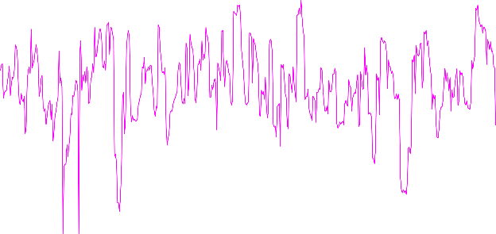
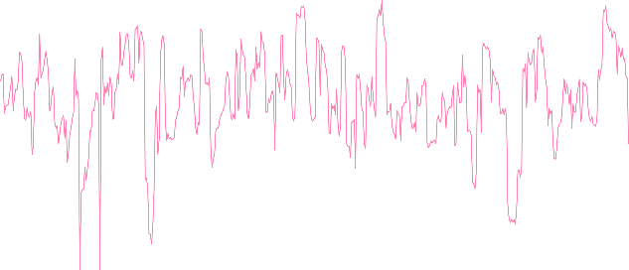

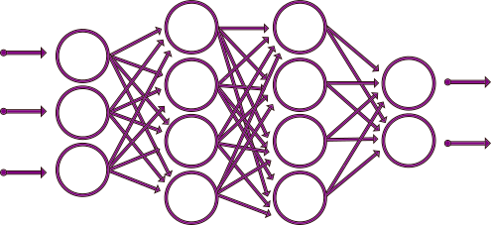
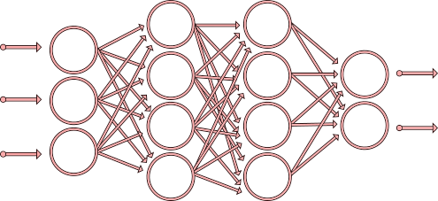



Plaintext = 0xff321a45327864c3
Secret Key = 0x89e8f11831b71a05
Plaintext = 0xac42d64ea1102567
Secret Key = 0x89e8f11831b71a05
Plaintext = 0x17130198f8adb9ab
Secret Key = 0x89e8f11831b71a05
Plaintext = 0xda1294ddc28b466b
Secret Key = 0x89e8f11831b71a05
Profiling phase
Cross-Entropy
Model Trained !

Slide 7







Cross-Entropy interpretation [MDP20]
Minimizing the cross-entropy is asymptotically equivalent to maximizing the perceived information [RSVC+11] :
Cross-Entropy Loss
Optimal Solution
Optimization Error
Estimation Error
Approximation Error
$$\hat{θ}≠θ$$
$$N_{p}<∞$$
$$F_{θ}→PI( , Z)$$
The optimization algorithm (eg. Stochastic Gradient Descent) converges towards the optimal solution
$$N_{p}→∞$$
$$F_{θ}→MI( , Z)$$

Slide 8
Ranking Loss: Maximizing the Success Rate

Slide 9
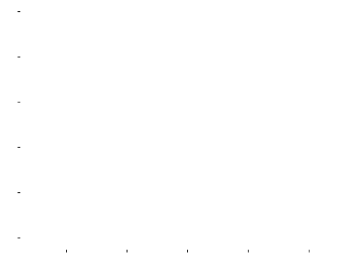




Goal
Find a model $F$ that maximizes the Success Rate for a minimum number of $N_{a}$ traces:
Estimation [QLL10]

Slide 10







Ranking Loss
We want to penalize the learning process when $c_{k^{∗}} c_{k}$ is not respected:
Partial Ranking Loss
Given a profiling set , a classifier with parameter and a number of attack traces $N_{a}$, we define the Ranking Loss function as:

Slide 11
Cross-Entropy vs. Ranking Loss

Slide 12


Estimation of the Optimal Distinguisher
Given a conditional probability distribution $Pr⁡[Z|T, θ]$, maximizing the success rate is equivalent to finding an estimation of the Optimal Distinguisher:
Ranking Loss
Mutual Information Estimation

Slide 13





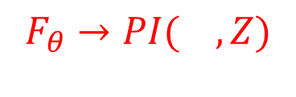





Error Analysis
Ranking Loss
Cross-Entropy Loss
Optimal Solution
Optimization Error
Estimation Error
Approximation Error
$$\hat{θ}≠θ$$
$$N_{p}<∞$$
$$F_{θ}→MI( , Z)$$
$$\hat{θ}≠θ$$
$$N_{p}<∞$$
$$F_{θ}→PI( , Z)$$
The optimization algorithm (eg. Stochastic Gradient Descent) converges towards the optimal solution
$$N_{p}→∞$$
$$F_{θ}→MI( , Z)$$
The Ranking Loss prevents the Approximation Error
13

Slide 14
Experimental Results

Slide 15




Datasets
ChipWhisperer (AES-128)
8-bit AVR microcontroller
Sensitive variable:
$$Z=Sbox\left[P_{0} ⊕ k^{∗}\right]$$
Unprotected implementation
ASCAD-v1 (AES-128) [BPS+20]
8-bit AVR microcontroller
Sensitive variable:
$$Z=Sbox[P_{3} ⊕ k^{∗}]$$
- Countermeasure: Random delay + 1st order masking

Slide 16

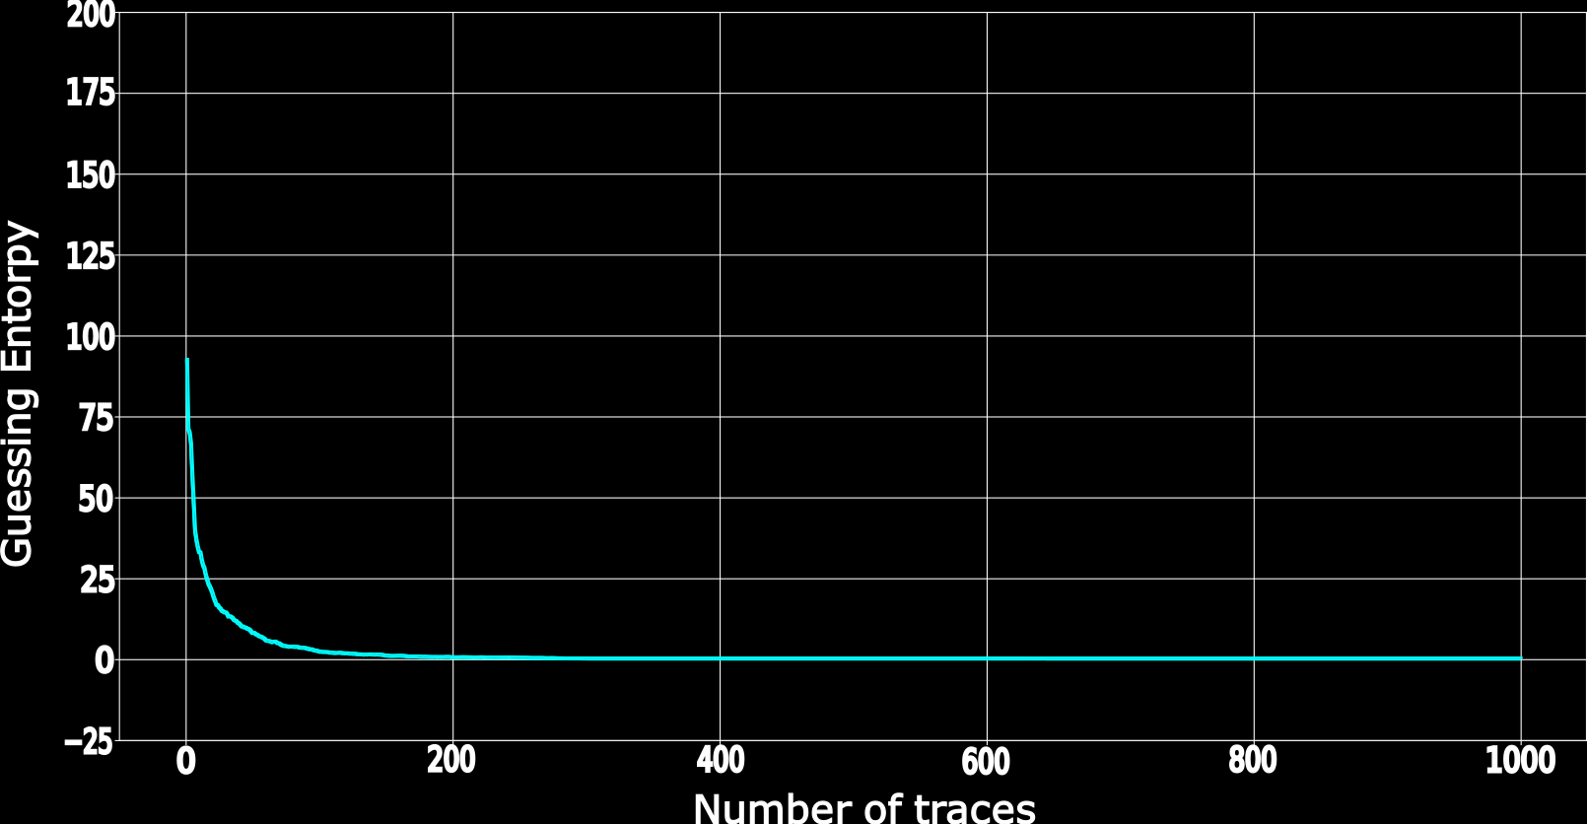

We compute ${Nt}_{GE}$ over 100 tests and denote the final result as ${\overline{Nt}}_{GE}$
$${\overline{Nt}}_{GE}$$

Slide 17
Chipwhisperer: A Partial Exploitation of the Leakages

Slide 18


Profiling phase
Plaintext = 0xda1294ddc28b466b
Secret Key = 0x89e8f11831b71a05
Plaintext = 0x17130198f8adb9ab
Secret Key = 0x25404f9d6bcc3c68
Ranking Loss
Cross Entropy
Model Trained !

Slide 19



Partial Leakage Exploitation
Cross-Entropy
SNR on Chipwhisperer dataset
Approximation Error
Ranking Loss

Slide 20
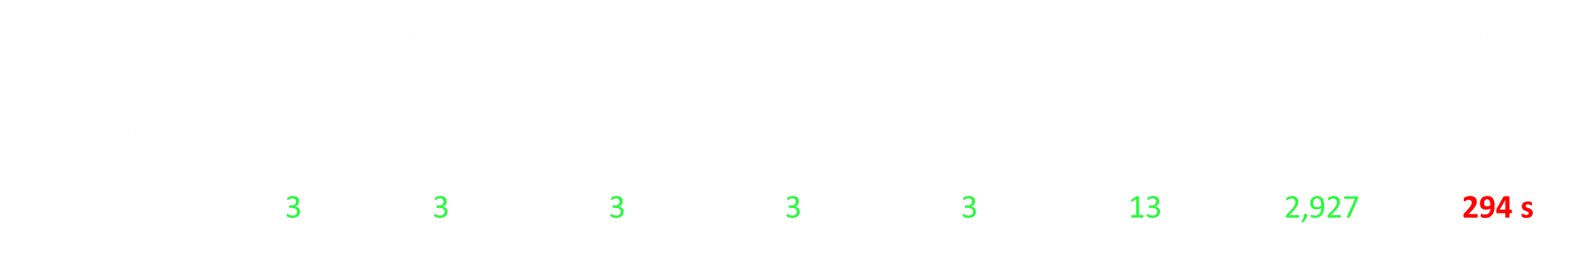
Cross-Entropy
Ranking Loss
$$σ$$ $$\overline{N}t_{GE}$$ | 0 | $$10^{−6}$$ | $$10^{−5}$$ | $$10^{−4}$$ | $$10^{−3}$$ | $$10^{−2}$$ | $$10^{−1}$$ | Training Time
Cross-Entropy | 4 | 4 | 6 | 6 | 7 | 21 | 3,958 | 81 s
Ranking Loss | 3 | 3 | 3 | 3 | 3 | 13 | 2,927 | 294 s

Slide 21
ASCAD: A Total Exploitation of the Leakages

Slide 22
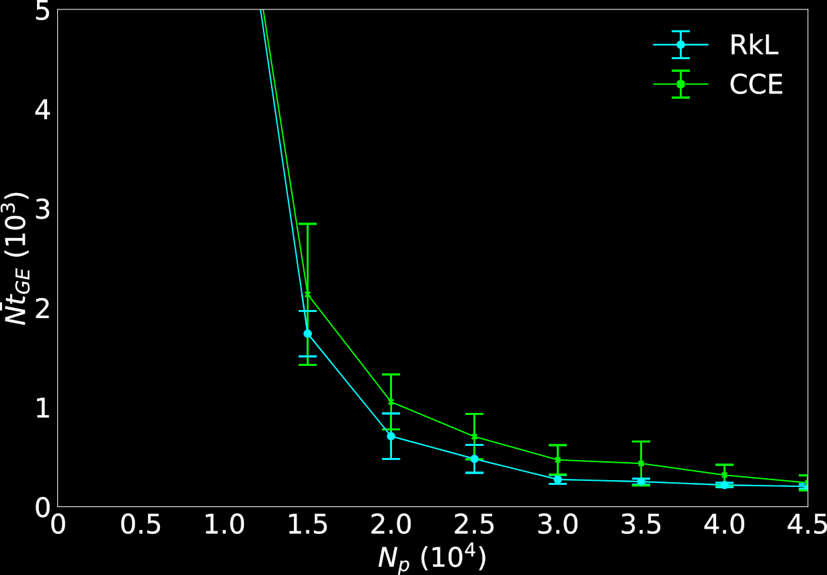
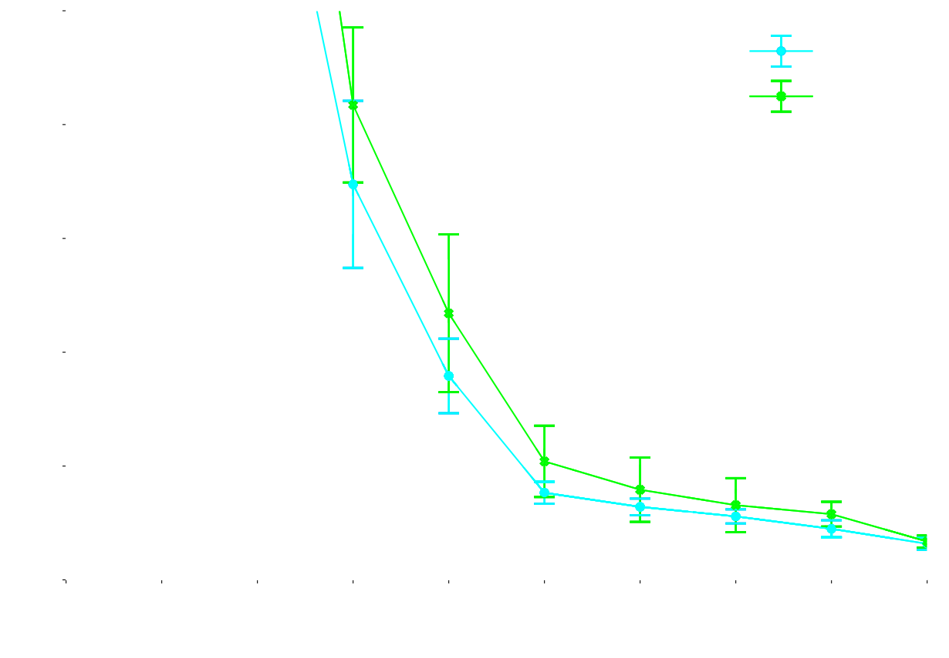
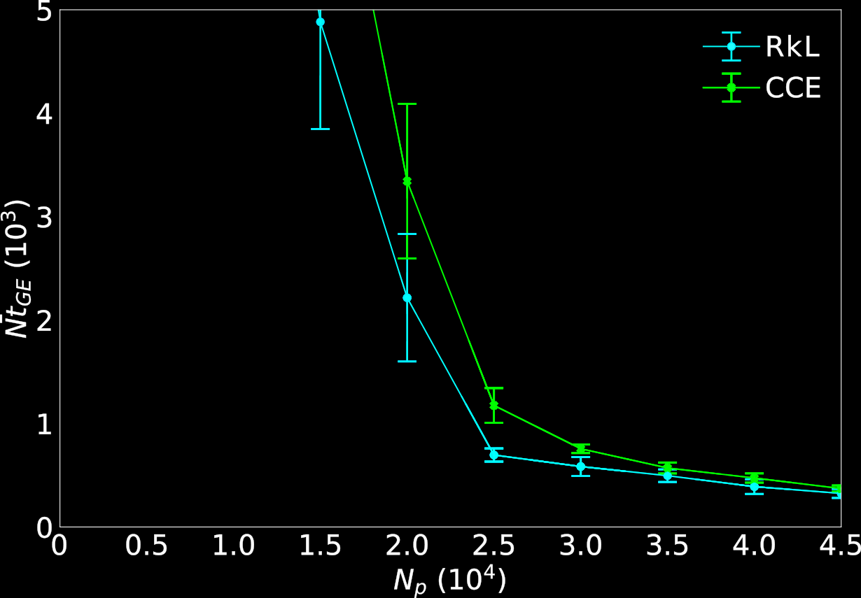
A Total Exploitation of the Leakages:
No Approximation Error
Remaining errors: Estimation Error and Optimization Error
ASCAD
(no desynchronization)
ASCAD
(desynchronization 50)
ASCAD
(desynchronization 100)
The Ranking Loss reduces the Estimation Error

Slide 23


MERCI !
Take-Away Messages
The Ranking loss tends to maximize the success rate for a given $N_{a}$ attack traces and converges towards the optimal model introduced in [BGH+17].
Through this new proposition, we are concerned with the relative order of the relevance of the key hypothesis and their absolute value.
The Approximation Error is prevented when the Ranking Loss is considered.
Further investigations should be made on other “Learning To Rank” approaches.
“Ranking Loss: Maximizing the Success Rate in Deep Learning Side-Channel Analysis” will be presented at TCHES 21 !
Contact: gabriel.zaid@univ-st-etienne.fr
GitHub: https://github.com/gabzai/Ranking-Loss-SCA

Slide 24
Bibliography (1):
[BGH+17] Nicolas Bruneau, Sylvain Guilley, Annelie Heuser, Damien Marion, and Olivier Rioul. Optimal side-channel attacks for multivariate leakages and multiple models. Journal of Cryptographic Engineering, 7:331–341, 2017.
[BP20] Elie Bursztein, Jean-Michel Picod. A Hacker’s guide to reducing side-channel attack surfaces using deep-learning. Defcon 28 & Black Hat USA 2020.
[BPS+20] Ryad Benadjila, Emmanuel Prouff, Rémi Strullu, Eleonora Cagli and Cecile Dumas. Deep learning for side-channel analysis and introduction to ASCAD database. J Cryptogr Eng 10, 163–188 (2020). https://doi.org/10.1007/s13389-019-00220-8.
[CDP17] Eleonora Cagli, Cécile Dumas, and Emmanuel Prouff. Convolutional neural networks with data augmentation against jitter-based countermeasures - profiling attacks without pre-processing. In Wieland Fischer and Naofumi Homma, editors, Cryptographic Hardware and Embedded Systems - CHES 2017 - 19th International Conference, Taipei, Taiwan, September 25-28, 2017, Proceedings,volume 10529 of Lecture Notes in Computer Science, pages 45–68. Springer,2017.
[CK09] Jean-Sébastien Coron and Ilya Kizhvatov. An efficient method for random delay generation in embedded software. In Christophe Clavier and Kris Gaj, editors, Cryptographic Hardware and Embedded Systems - CHES 2009, pages 156–170, Berlin, Heidelberg, 2009. Springer Berlin Heidelberg.
[GGH20] Christophe Genevey-Metat, Benoît Gérard and Annelie Heuser. On What to Learn: Train or Adapt a Deeply Learned Profile? Cryptology ePrint Archive, Report 2020/952, 2020. https://eprint.iacr.org/2020/952.

Slide 25
Bibliography (2):
[HGG19] Hettwer B., Gehrer S., Güneysu T. (2020) Deep Neural Network Attribution Methods for Leakage Analysis and Symmetric Key Recovery. In: Paterson K., Stebila D. (eds) Selected Areas in Cryptography – SAC 2019. SAC 2019. Lecture Notes in Computer Science, vol 11959. Springer, Cham. https://doi.org/10.1007/978-3-030-38471-5_26
[KPH+19] Jaehun Kim, Stjepan Picek, Annelie Heuser, Shivam Bhasin and Alan Hanjalic. Make some noise. unleashing the power of convolutional neural networks for profiled side-channel analysis. IACR Transactions on Cryptographic Hardware and Embedded Systems, 2019(3):148–179, 2019.
[LH20] JongHyeok Lee and Dong-Guk Han. DLDDO: Deep Learning to Detect Dummy Operations. Cryptology ePrint Archive, Report 2020/939, 2020. https://eprint.iacr.org/2020/939.
[MDP19] Loïc Masure, Cécile Dumas, and Emmanuel Prouff. Gradient visualization for general characterization in profiling attacks. In Ilia Polian and Marc Stöttinger, editors, Constructive Side-Channel Analysis and Secure Design, pages 145–167, Cham, 2019. Springer International Publishing.
[MDP20] Loïc Masure, Cécile Dumas, and Emmanuel Prouff. A comprehensive study of deep learning for side-channel analysis. IACR Transactions on Cryptographic Hardware and Embedded Systems, 2020(1):348–375, Nov. 2019.
[PEC19] Guilherme Perin, Baris Ege, and Lukasz Chmielewski. Neural network model assessment for side-channel analysis. Cryptology ePrint Archive, Report 2019/722, 2019. https://eprint.iacr.org/2019/722.
[QLL10] Tao Qin, Tie-Yan Liu, and Hang Li. A general approximation framework for direct optimization of information retrieval measures. Inf. Retr., 13(4):375–397, 2010.

Slide 26
Bibliography (3):
[RSVC+11] Mathieu Renauld, François-Xavier Standaert, Nicolas Veyrat-Charvillon, Dina Kamel, and Denis Flandre. A formal study of power variability issues and side-channel attacks for nanoscale devices. In Kenneth G. Paterson, editor, Advances in Cryptology – EUROCRYPT 2011, pages 109–128, Berlin, Heidelberg, 2011. Springer Berlin Heidelberg.
[RWM19] Bastian Richter, Alexander Wild and Amir Moradi. Automated Probe Repositioning for On-Die EM Measurements. 2019 IEEE/ACM International Conference on Computer-Aided Design (ICCAD), Westminster, CO, USA, 2019, pp. 1-6, doi: 10.1109/ICCAD45719.2019.8942157.
[WAGP20] Wouters, L., Arribas, V., Gierlichs, B., & Preneel, B. (2020). Revisiting a Methodology for Efficient CNN Architectures in Profiling Attacks. IACR Transactions on Cryptographic Hardware and Embedded Systems, 2020(3), 147-168. https://doi.org/10.13154/tches.v2020.i3.147-168
[WP20] Lichao Wu and Stjepan Picek. Remove Some Noise: On Pre-processing of Side-channel Measurements with Autoencoders. IACR Transactions on Cryptographic Hardware and Embedded Systems, 2020(4), Aug. 2020.
[ZBHV20] Gabriel Zaid, Lilian Bossuet, Amaury Habrard, and Alexandre Venelli. Methodology for efficient cnn architectures in profiling attacks. IACR Transactions on Cryptographic Hardware and Embedded Systems, 2020(1):1–36, Nov. 2019.

Slide 27

Why is DL interesting for performing SCA?
Pros:
Reduces the preprocessing
Efficient against classical countermeasures (e.g. desynchronization [CDP17], dummy operations [LH20], …)
Wide range of applications (noise reduction [WP20], multiple inputs [GGH20], probe repositioning [RWM19], leakage detector tool [BP20], …)
Cons:
DL vs SCA metrics
Black box tool (explainability) [MDP19, HGG19, PEC19, ZBHV20]
Generation of suitable models for SCA [KPH+19, ZBHV20, WAGP20]
Good understanding of DL-SCA is crucial to evaluate its limitation

Slide 28
Learning to Rank in DLSCA

Slide 29











Query = 0xac42d64ea1102567
Learning To Rank
Pairwise Approach
Model Trained !
Score
Score
Score
Score
Score
Score

Slide 30
Learning To Rank
Documents
Side-Channel
Input
(Query, Set of documents)
Physical traces
Objective
Predict relative distance between inputs
Predict relative distance between output classes
Performance Metric
Discounted cumulative gain, expected Reciprocal Rank
Success Rate
Learning Metric
Pointwise, Pairwise, Listwise losses
Ranking Loss

Slide 31
Plaintext = 0xac42d64ea1102567
Secret Key = 0x89e8f11831b71a05
Plaintext = 0x17130198f8adb9ab
Secret Key = 0x89e8f11831b71a05
Plaintext = 0xda1294ddc28b466b
Secret Key = 0x89e8f11831b71a05
Side-Channel
Ranking Loss
Model Trained !

