Slide 1
Side-Channel Attacks Cyber In Occitanie

Slide 2



Who am I?
2018
Master in computer science
2021
Thesis in Deep Learning for SCA
From 2021-…
Security evaluator

Slide 3
Agenda
Context
Side-channel attacks
Statistical distinguishers
Demonstration

Slide 4
Context

Slide 5



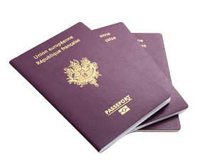

Context
Available on the
market
Develops
Company
Critical devices
Examples

Slide 6

Context
Available on the
market
Develops
Follows regulations
Company
Examples
Today

Slide 7


Context
Common Criteria for Information Technology Security Evaluation (or CC*)
International standard (ISO/IEC 15408) for computer security certification
Framework which helps developer for defining
The Target of Evaluation (TOE)
The security assets to protect (e.g. secret keys)
The secure functions related to the TOE (e.g. secure communication, authentication process)
The level of security assurance (EAL, Evaluation Assurance Level)
Different security levels
EAL 1: This is the most basic level, focusing on functional testing to ensure the product performs as specified.
EAL 2: This level involves more in-depth testing, including structural analysis of the product's components.
EAL 3: It adds a methodical approach to testing and checking the product's security features.
EAL 4: This level requires a more rigorous design process, along with thorough testing and review of the product's security.
EAL 5: It introduces semi-formal methods for design and testing, increasing the level of assurance.
EAL 6: This level builds upon EAL5 with more formal verification techniques.
EAL 7: It is the highest level of assurance, requiring formal verification of the product's design and security features.
Functional testing and
structural verifications
+ security testing
(software attacks)
+ physical attacks
+ formal verifications
Who is responsible for making the evaluation process?
*https://www.commoncriteriaportal.org/index.cfm

Slide 8



Evaluation process
Security assets
Threats
Security function
Hypothesis
Evaluation Security Level
Security target
Certifies
ANSSI
Evaluation
Analysis
Documentary analysis
Cryptographic analysis
Audit code
Company
Thales ITSEF
Weaknesses: physical/logical attacks
Criticity level for each weakness
Identification
Test plan
Exploitation of one or most weaknesses
Verdict
Exploitation

Slide 9
Physical attacks

Slide 10
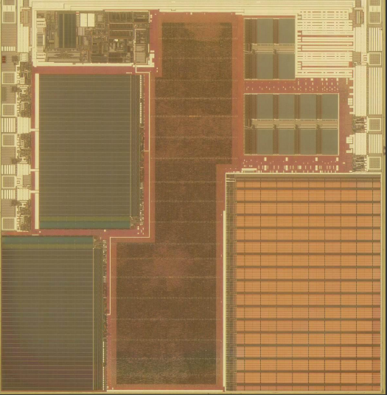










Physical attacks
Reverse ingineering /
FIB probing routing
Invasive attacks
Evaluates
Temporarily / Permanently perturbations
(fault attacks)
Thales ITSEF
Semi-Invasive attacks
Today
Side-channel attacks
Non-Invasive attacks

Slide 11
Side-channel Attacks

Slide 12
Side-channel attacks
Surveillance and Exploitation of an INVOLUNTARY leak from the system
Related to the communication protocol
Related to the implementation
Related to the underlying hardware and physics
Common channels (not exhaustive)
Errors returned [SW]
Computation time (duration, cache access time, etc.) [SW]
Instantaneous current consumption (transistor switching) [HW]
1 -> 1 or 0 -> 0 consumes less than 1 -> 0 or 0 -> 1
Electromagnetic radiation [HW]
Photon emissions, temperature, noise, etc. [HW]
Objective
Allows attacks on cryptographic algorithms (RSA, ECC, AES, DES, HASH...) to retrieve secret information (key, message)
Allows attacks on AI embedded systems to retrieve NN architecture, weight value.
Also helps to understand how the code works (reverse engineering)

Slide 13
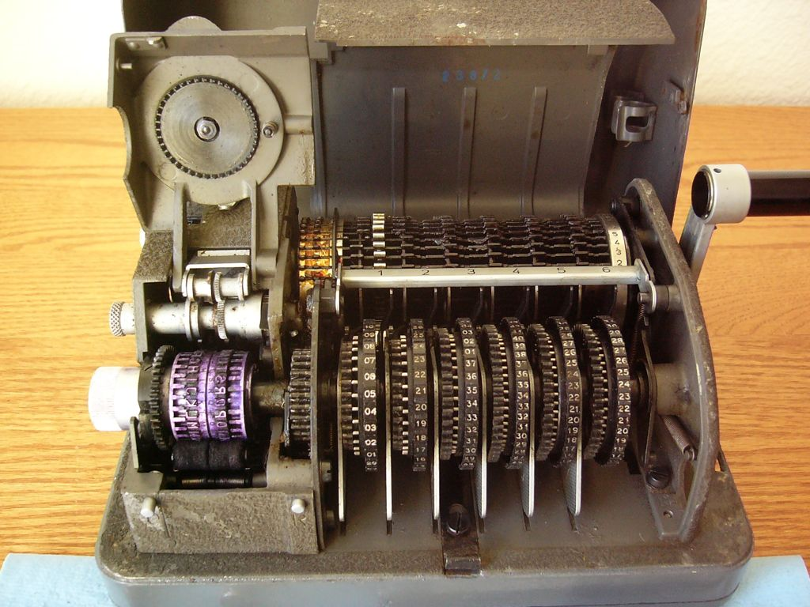
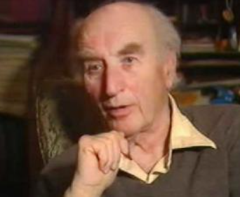
Side-channel attacks
Historical example: Hagelin cipher machine
Context
In 1956, Egyptian embassy used Hagelin cipher machine to protect communications.
Weakness
The Hagelin machine used 7 wheels (or rotors), which were part of its cryptographic mechanism.
These wheels needed proper positioning to ensure the encryption and decryption were accurate.
The Hagelin machine required periodic resetting or reinitialization of their settings, including the positions of the wheels.
Strategy (MI5)
Peter Wright (MI5, Scientific expert and counterintelligence officer) proposes installing a microphone in the encryption room.
Acoustic channel
Acoustic cryptanalysis is a known technique where sounds produced by mechanical operations can reveal information about the machine's state.
The noise emitted during the initialization allowed MI5 to determine the position of the wheels during encryption process.
Result
MI5 was be able to decrypt the secure communication of the Egyptian embassy.

Slide 14


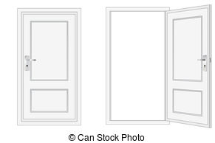
Side-channel attacks
Short exercise: 3 switches, 3 light bulbs in another room
Only one visit is possible
Which switch turns on each light bulb?
1
2
A
B
C
3

Slide 15


Side-channel attacks
Short exercise: 3 switches, 3 light bulbs in another room
Only one visit is possible
Which switch turns on each light bulb?
ON 5min then OFF
1
2
ON
A
B
C
3
OFF

Slide 16
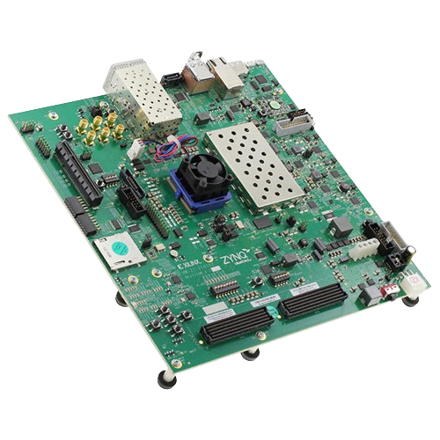

Side-channel attacks
Scenario of this talk
Target of Evaluation: Embedded system
Security function: Password verification
Security asset: Password
Attack: side-channel attack
Password verification process

Slide 17















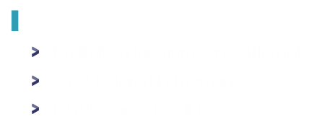
Side-channel attacks
Hypotheses
No limit on the number of attempts
${PWD}^{∗}$ is stored in memory
Is brute-force possible?
Password verification process
Can we use side-channel attacks?
$$N=16$$
$$pwd\left[0\right]$$
$$pwd\left[1\right]$$
$$pwd\left[2\right]$$
$$pwd\left[3\right]$$
$$…$$
$$pwd\left[13\right]$$
$$pwd\left[14\right]$$
$$pwd\left[15\right]$$
$$=$$
$$=$$
$$≠$$
$${PWD}^{∗}\left[0\right]$$
$${PWD}^{∗}\left[1\right]$$
$${PWD}^{∗}\left[2\right]$$

Slide 18
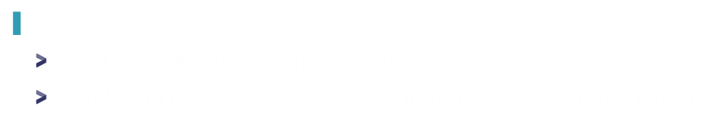

Side-channel attacks
Password verification process
“Divide-and-conquer” strategy
$pwd$ is validated byte per byte
Timing difference between the number of correctly verified bytes
In practice
Assuming $PWD^{∗}\left[i\right]≠pwd[i]$ operation takes $≈10 ms$
Number of requests = $2^{8}×16=2^{12}$ instead of ${\left(2^{8}\right)}^{16}$ (brute-force)
Countermeasure?

Slide 19

Side-channel attacks
Countermeasure?
Developing an algorithm which is not time-dependent
Password verification process

Slide 20








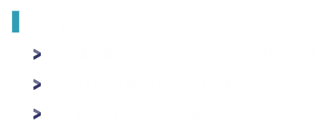

Side-channel attacks
Hypothesis
No limit on the number of attempts
$PWD$ is stored in memory
Is brute-force possible?
Password verification process
Can we use side-channel attacks?
$$N=16$$
$$pwd\left[0\right]$$
$$pwd\left[1\right]$$
$$pwd\left[2\right]$$
$$pwd\left[3\right]$$
$$…$$
$$pwd\left[13\right]$$
$$pwd\left[14\right]$$
$$pwd\left[15\right]$$
$$⊕$$
$$⊕$$
$$⊕$$
$$⊕$$
$$⊕$$
$$⊕$$
$$⊕$$
$$⊕$$
$${PWD}^{∗}\left[0\right]$$
$${PWD}^{∗}\left[1\right]$$
$${PWD}^{∗}\left[2\right]$$
$${PWD}^{∗}\left[3\right]$$
$$…$$
$${PWD}^{∗}\left[13\right]$$
$${PWD}^{∗}\left[14\right]$$
$${PWD}^{∗}\left[15\right]$$

Slide 21
Side-channel attacks
Scenario of this talk
Target of Evaluation: Embedded system
Security function: Password verification
Security asset: Password
Attack: side-channel attack

Slide 22
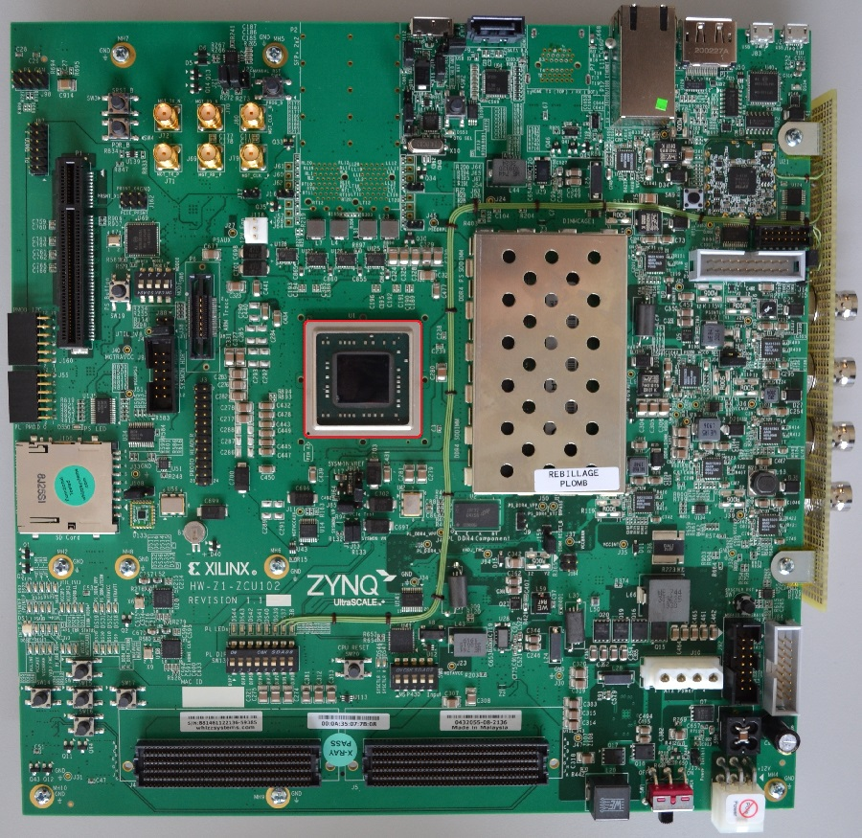
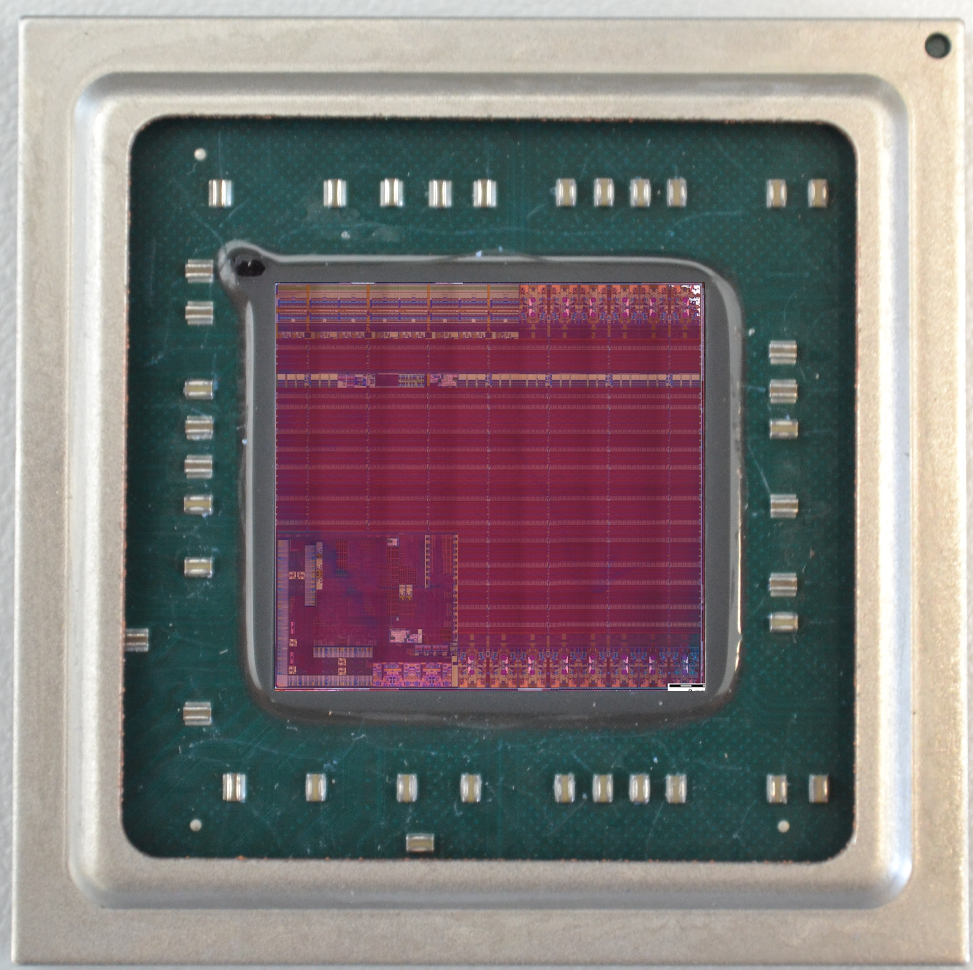
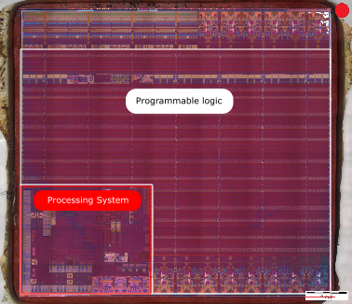
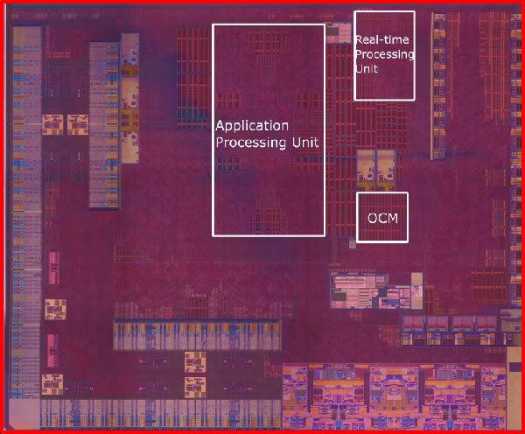
Side-channel attacks
Capture physical emanation
Source: Electromagnetic signal
Equipment: EM probe, oscilloscope, PC
Step 1
Physical identification
The CPUs are here ☺

Slide 23
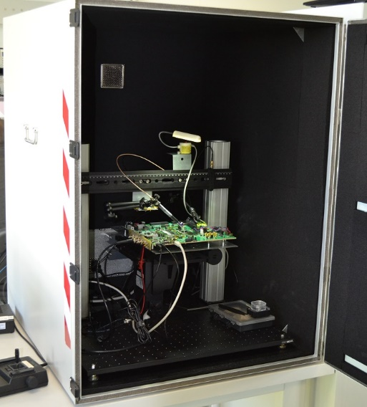
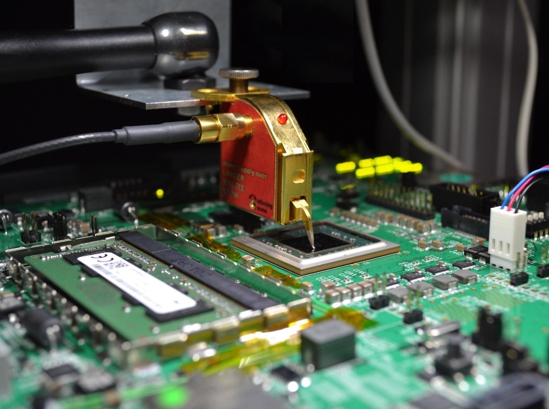
Side-channel attacks
Capture physical emanation
Source: Electromagnetic signal
Equipment: EM probe, oscilloscope, PC
Step 2
Setup preparation

Slide 24






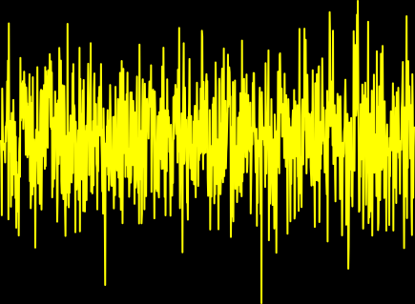


Side-channel attacks
Capture physical emanation
Source: Electromagnetic signal
Equipment: EM probe, oscilloscope, PC
Step 3
Signal acquisition

Slide 25
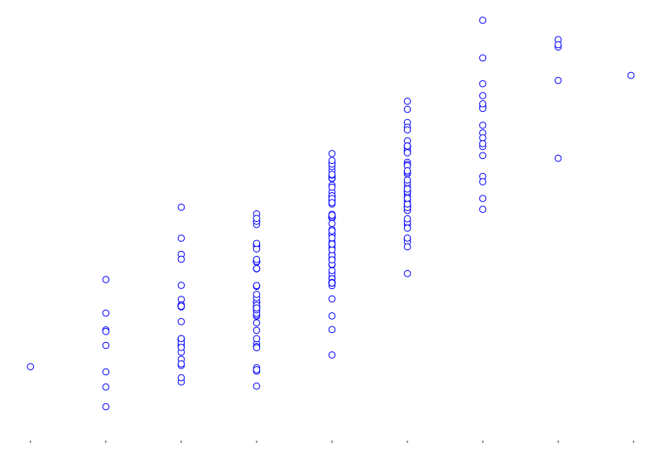
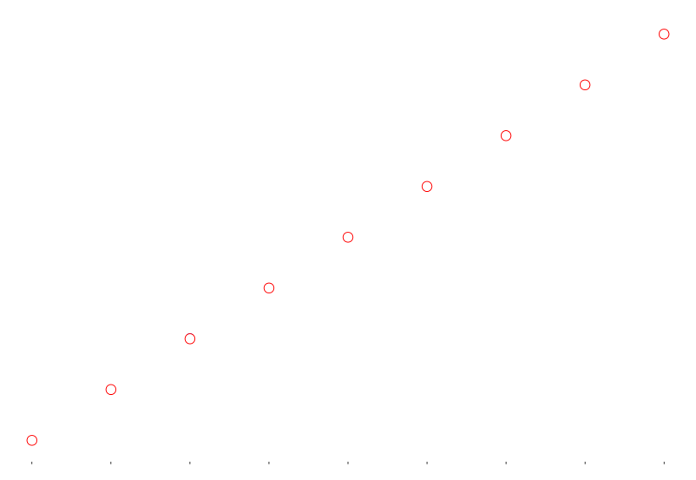






Side-channel attacks
Leakage model $ψ$
A leakage model is a function $ψ:𝔽_{2}^{n}→ℝ$ which characterizes a dependency between a pair $(pwd, {PWD}^{∗})$ and the electromagnetic signal $L$
$$L[i]=HW\left(pwd⊕{PWD}^{∗}\right)$$
$$L[i]=HW\left(pwd⊕{PWD}^{∗}\right)+Z[i]$$
$$Amplitude$$
$$HW\left(pwd⊕{PWD}^{∗}\right)$$
Attacker’s goal
Retrieving the dependency between $pwd$ and $PWD$ in a minimum amount of physical traces.
How can we identify such dependencies?

Slide 26


















Side-channel attacks
Step 4: Signal analysis
A signal characterizes the process conducted by the password verification
$$i=0$$
$$i=10$$
$$i=1$$
$$res←0$$
$$i=2$$
$$i=3$$
$$i=4$$
$$i=5$$
$$i=6$$
$$i=7$$
$$i=8$$
$$i=9$$
$i=1$5
$$i=11$$
$$i=12$$
$$i=13$$
$$i=14$$
$$res==0?$$
Next step?
Which part of the signal is interesting for our study?
Should we consider all the time samples?
Do we need to restrict ourselves to a sub-portion of the signal?

Slide 27
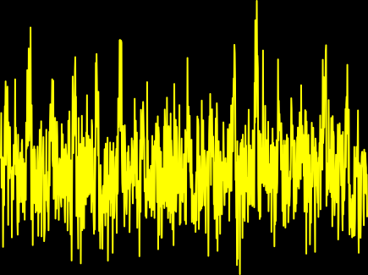




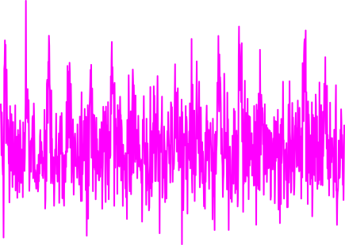
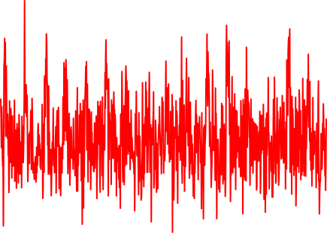
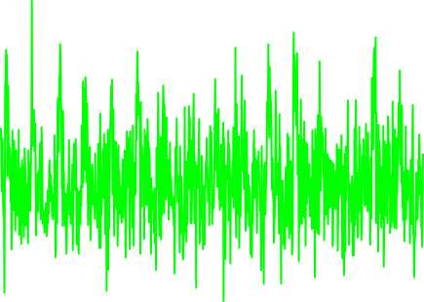









Side-channel attacks
Issues
Lots of points in a physical signal are not dependent on the sensitive data.
How can you identify them?
Step 5: Points of interest detection
$$SNR[i]= \frac{𝕍_{pwd}[𝔼\left[L[i] | HW(pwd⊕PWD^{∗})\right]}{𝔼_{pwd}[𝕍\left[L[i] | HW(pwd⊕PWD^{∗})\right]}=\frac{𝕍_{pwd}\left[HW(pwd⊕PWD^{∗})\right]}{𝕍\left[Z[i]\right]}$$
$$L=HW\left(pwd⊕PWD^{∗}\right)+Z$$
$$L=HW\left(pwd⊕PWD^{∗}\right)+Z$$
$SNR$ → Allows the variability identification of $pwd$ on the signal
Other metrics can be used [BDHP21]
$$L=HW\left(pwd⊕PWD^{∗}\right)+Z$$
$$\sim 𝒩_{D}(0, Σ_{D})$$
$$SNR$$
$$L=HW\left(pwd⊕PWD^{∗}\right)+Z$$
$$Time samples$$
$$L=HW\left(pwd⊕PWD^{∗}\right)+Z$$
[BDHP21] It Started with Templates: The Future of Profiling in Side-Channel Analysis. Batina, L., et al. (2021). In: Avoine, G., Hernandez-Castro, J. (eds) Security of Ubiquitous Computing Systems.

Slide 28




Side-channel attacks
Issues
Lots of points in a physical signal are not dependent on the sensitive data.
How can you identify them?
Step 5: Points of interest detection
No depency with $pwd$
Dependencies with $pwd$
$$SNR$$
$$SNR$$
$$Time samples$$
$$Time samples$$
Next step?
How can we exploit these points of interest (POIs)?

Slide 29
Statistical distinguishers

Slide 30















Statistical distinguishers
Optimal attack: Maximum likelihood [HRG14]
Goal: retrieving information on $PWD^{∗}$
Let denotes $Y\left[i\right]=pwd\left[i\right]⊕PWD^{∗}\left[i\right]$
$$L=HW\left(Y[0]\right)+Z$$
$$pwd$$
$$pwd$$
$$pwd$$
$$Pr\left[Y\left[0\right] | L\right]$$
$$Pr\left[PWD^{∗}\left[0\right] | L,pwd\left[0\right]\right]$$
$$PWD^{∗}$$
$$\left[\begin{matrix}0.10 & 0.08 & … & 0.16\end{matrix}\right]$$
$256$ classes
$$\left[\begin{matrix}0.25 & 0.38 & … & 0.18\end{matrix}\right]$$
$$\left[\begin{matrix}0.05 & 0.28 & … & 0.08\end{matrix}\right]$$
$$PWD^{∗}\left[0\right]=1$$
$$\sum{log\left(.\right)}$$
$$\left[\begin{matrix}−6.68 & −4.77 & … & −6.07\end{matrix}\right]$$
[HRG14] Good Is Not Good Enough – Deriving Optimal Distinguishers from Communication Theory. Heuser, A., et al. CHES 2014.

Slide 31













Statistical distinguishers
Optimal attack: Maximum likelihood [HRG14]
Goal: retrieving information on $PWD^{∗}$
Let denotes $Y\left[i\right]=pwd\left[i\right]⊕PWD^{∗}\left[i\right]$
$$L=HW\left(Y[1]\right)+Z$$
How can we estimate $Pr\left[Y | L\right]$?
$$pwd$$
$$Pr\left[Y\left[1\right] | L\right]$$
$$Pr\left[PWD^{∗}\left[1\right] | L,pwd\left[1\right]\right]$$
$$PWD^{∗}$$
$$\left[\begin{matrix}0.20 & 0.18 & … & 0.46\end{matrix}\right]$$
$$\left[\begin{matrix}0.05 & 0.08 & … & 0.38\end{matrix}\right]$$
$$\left[\begin{matrix}0.09 & 0.28 & … & 0.18\end{matrix}\right]$$
$$PWD^{∗}\left[1\right]=255$$
$$\sum{log\left(.\right)}$$
$$\left[\begin{matrix}−7.01 & −5.51 & … & −3.46\end{matrix}\right]$$
Success Rate: Probability to succeed an attack within $N_{a}$ attack traces
[HRG14] Good Is Not Good Enough – Deriving Optimal Distinguishers from Communication Theory. Heuser, A., et al. CHES 2014.

Slide 32
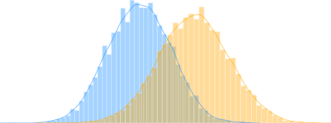
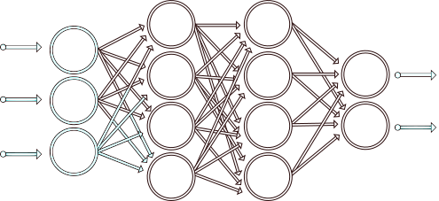

Statistical distinguishers
Estimation of $Pr[Y|L]$
Problem: $Pr[Y|L]$ is unknown and device-dependent
Existing solutions
Generative model
Discriminative model

Slide 33

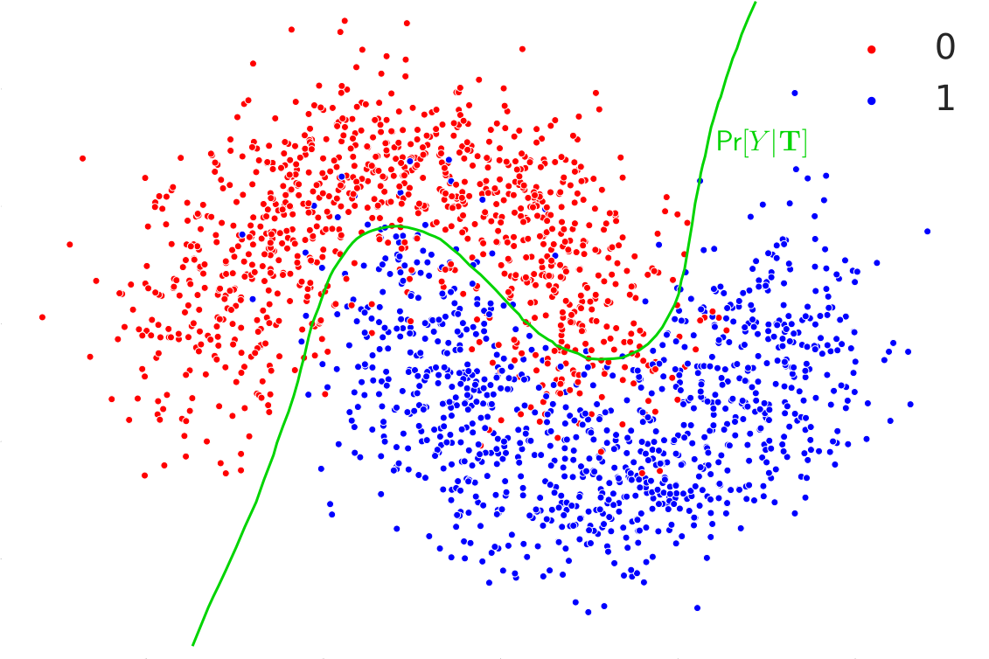
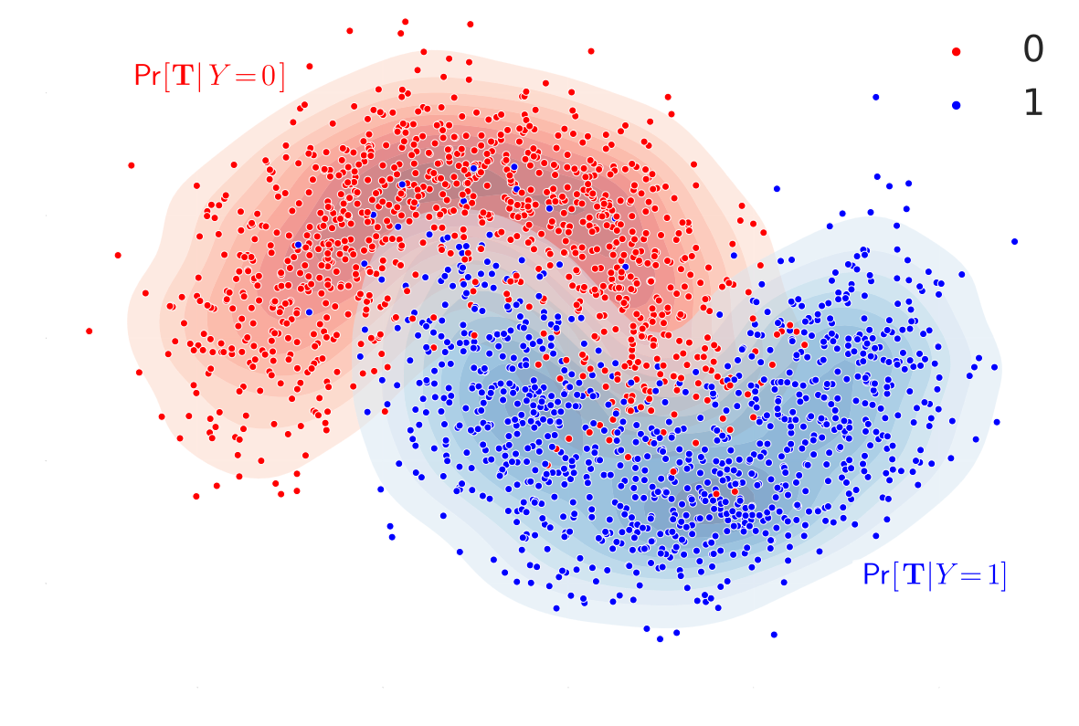
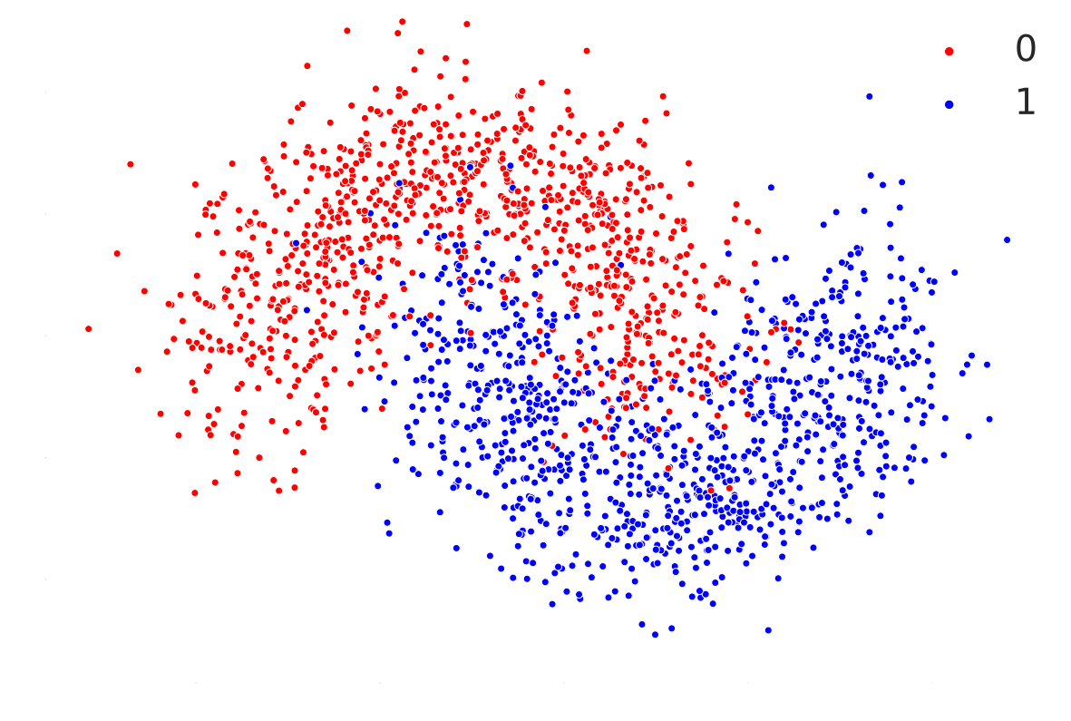

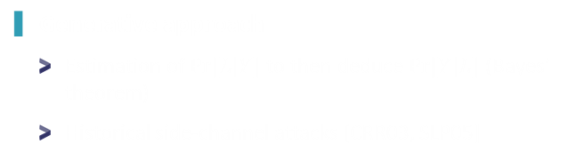


Statistical distinguishers
Estimation of $Pr[Y|L]$
Problem: $Pr[Y|L]$ is unknown and device-dependent
Generative approach
Estimation of $Pr⁡[L|Y]$ to then deduce $Pr⁡[Y|L]$ (Bayes’ theorem)
Historical side-channel attacks [CRR03, SLP05]
$$Dimension 2$$
Discriminative approach
Estimation of $\operatorname{Pr}\left[Y | L\right]$ via the approximation of a decision boundary
Approach using AI [MPP16, CDP17, MDP20]
$$Dimension 1$$
[CRR03] Template attacks. Chari, S. et al. CHES 2003.
[SLP05] A stochastic model for differential side channel cryptanalysis. Schindler, W. et al. CHES 2005.
[MPP16] Breaking cryptographic implementations using deep learning techniques. Maghrebi, H. et al. SPACE 2016.
[CDP17] Convolutional neural networks with data augmentation against jitter-based countermeasures - profiling attacks without pre-processing. Cagli, E. et al. CHES 2017.
[MDP20] A comprehensive study of deep learning for side-channel analysis. Masure, L. et al. TCHES 2020.

Slide 34
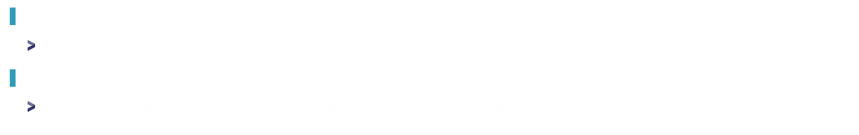
Statistical distinguishers
Estimation of $Pr[Y|L]$
Problem: $Pr[Y|L]$ is unknown and device-dependent
Generative approach
Given a trace $L$ to which it must associate a sensitive variable $Y$, the generative methods approximate the conditional probability $\operatorname{Pr}\left[L | Y\right]$
Template attack [CRR03]
Hypothesis
Stochastic attack [SLP05]
[CRR03] Template attacks. Chari, S. et al. CHES 2003.
[SLP05] A stochastic model for differential side channel cryptanalysis. Schindler, W. et al. CHES 2005.

Slide 35
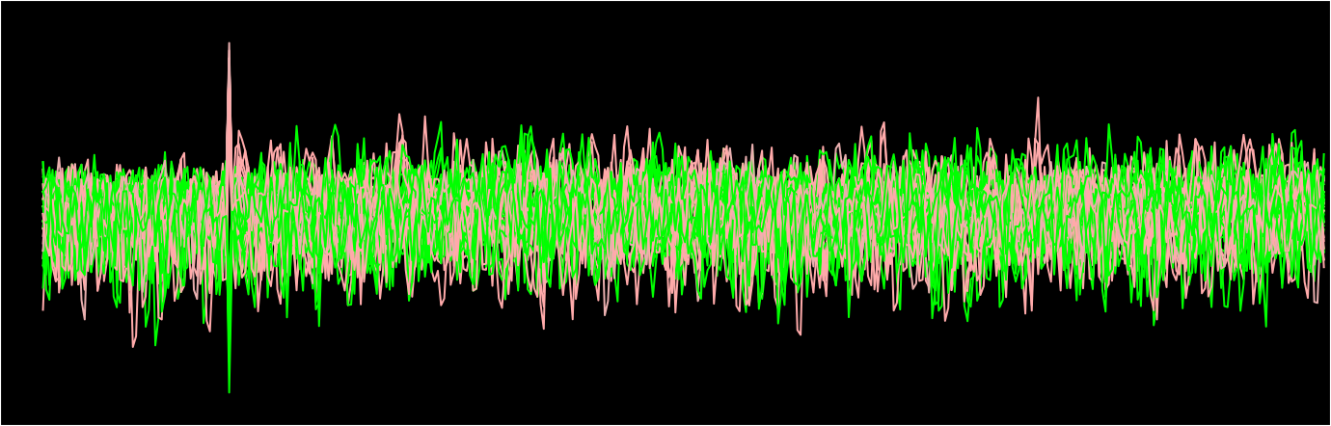
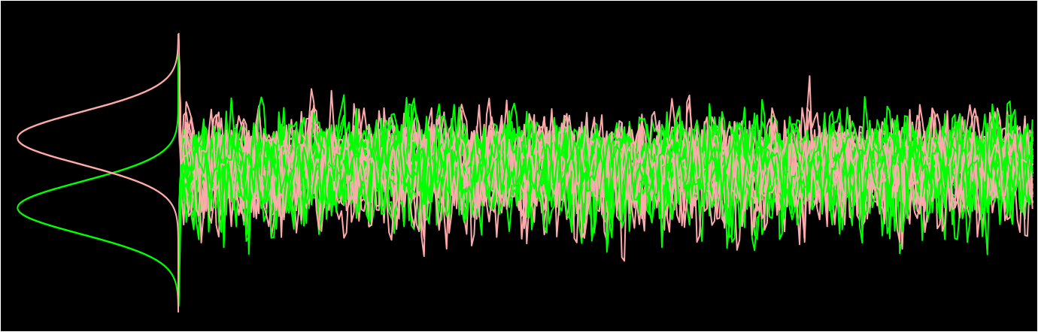
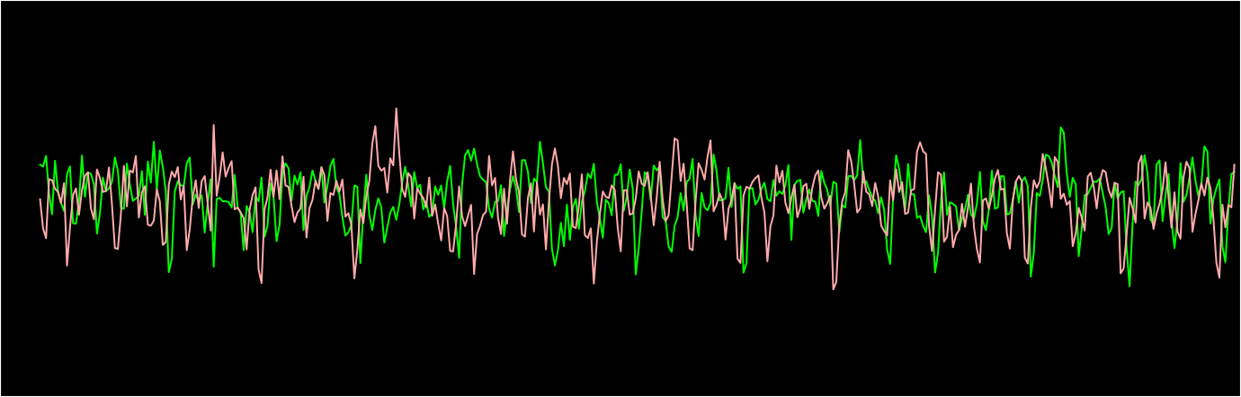







Statistical distinguishers
Estimation of $Pr[Y|L]$
Problem: $Pr[Y|L]$ is unknown and device-dependent
Generative approach
Given a trace $L$ to which it must associate a sensitive variable $Y$, the generative methods approximate the conditional probability $\operatorname{Pr}\left[L | Y\right]$
Toy example
Goal: Approximating $\operatorname{Pr}\left[L | Y\right]$
Hypothesis: $Y∈\{0,1\}$
$$\operatorname{Pr}\left[L | Y=1\right]$$
$$Y=0$$
$Y=$ 1
$$Amplitude$$
$$\operatorname{Pr}\left[L | Y=0\right]$$
$$Time sample$$

Slide 36
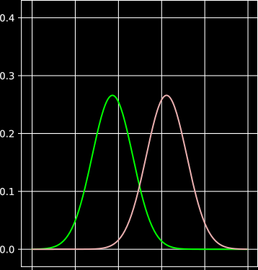
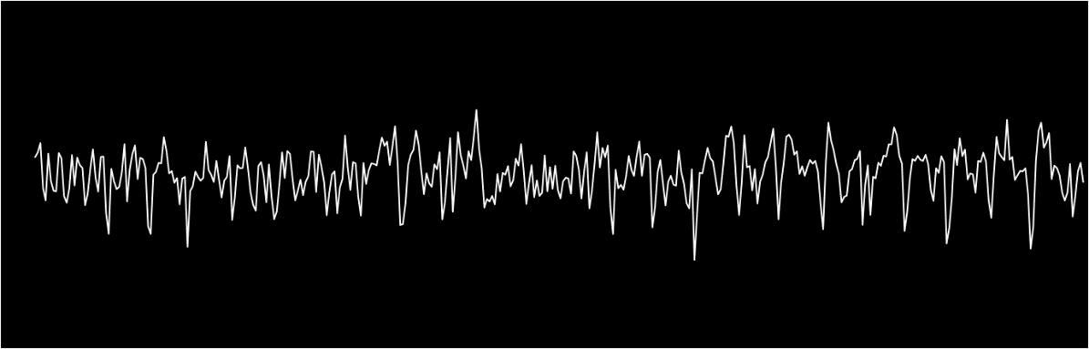
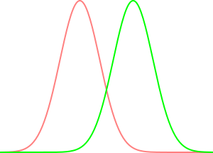









Statistical distinguishers
Estimation of $Pr[Y|L]$
Problem: $Pr[Y|L]$ is unknown and device-dependent
Generative approach
Given a trace $L$ to which it must associate a sensitive variable $Y$, the generative methods approximate the conditional probability $\operatorname{Pr}\left[L | Y\right]$
$$\operatorname{Pr}\left[L | Y=0\right]$$
$\operatorname{Pr}\left[L | Y=1\right]$
$$Y=0$$
$Y=$ 1
$$Probability density$$
$$Amplitude$$
$$Amplitude$$
$$Time sample$$
$$Time sample$$
$$Amplitude$$

Slide 37





Statistical distinguishers
Estimation of $Pr[Y|L]$
Problem: $Pr[Y|L]$ is unknown and device-dependent
Generative approach
Given a trace $L$ to which it must associate a sensitive variable $Y$, the generative methods approximate the conditional probability $\operatorname{Pr}\left[L | Y\right]$
$$\operatorname{Pr}\left[L | Y=0\right]$$
Steps
Acquire a set of $N$ traces such that $Y$ is unknown
For each trace $l_{i}$, we calculate $Pr⁡[l_{i}|Y=0]$ and $Pr⁡[l_{i}|Y=1]$
We compute the Maximum likelihood:
$$\hat{Y}= \underset{k∈\left\{0,1\right\}}{argmax}\left(\sum_{i=0}^{N−1}{log(Pr\left[l_{i} | Y=k\right]{)}}\right)$$
$\operatorname{Pr}\left[L | Y=1\right]$
$$Probability density$$
$$Amplitude$$

Slide 38

Statistical distinguishers
Estimation of $Pr[Y|L]$
Problem: $Pr[Y|L]$ is unknown and device-dependent
Generative approach
Given a trace $L$ to which it must associate a sensitive variable $Y$, the generative methods approximate the conditional probability $\operatorname{Pr}\left[L | Y\right]$
Benefits
Limitations
Information on the exploitated POIs
Strong hypothesis on the leakage model (Gaussian hypothesis)
Confident in the modeling of $\operatorname{Pr}\left[L | Y\right]$
The success of attack performances depends on the POIs selection
Multiple POIs can be exploited simultaneously
How can we automate the process?

Slide 39




Statistical distinguishers
Estimation of $Pr[Y|L]$
Problem: $Pr[Y|L]$ is unknown and device-dependent
Generative
Discriminative
Bayes’ theorem
$$\operatorname{Pr}\left[Y | L\right]=\operatorname{Pr}\left[L | Y\right]×\frac{\operatorname{Pr}\left[Y\right]}{\operatorname{Pr}\left[L\right]}$$
$$Pr⁡[L|Y]$$
$$\operatorname{Pr}\left[Y | L\right]=ε⋅\operatorname{Pr}\left[L | Y\right]$$
Maximum likelihood
$$\hat{Y}= \underset{k∈\left\{0,1\right\}}{argmax}\left(\sum_{i=0}^{N−1}{log(Pr\left[l_{i} | Y=k\right])}\right)$$
Constant
Uniformly distributed

Slide 40
Statistical distinguishers
Estimation of $Pr[Y|L]$
Problem: $Pr[Y|L]$ is unknown and device-dependent
Existing solutions
Generative model
Discriminative model

Slide 41


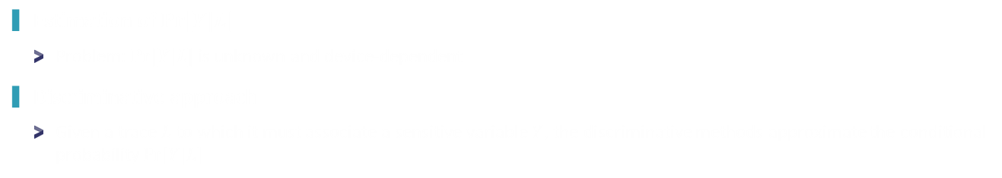



Statistical distinguishers
Estimation of $Pr[Y|L]$
Problem: $Pr[Y|L]$ is unknown and device-dependent
Discriminative approach
Given a trace $L$ to which it must associate a sensitive variable $Y$, the discriminative methods approximate the conditional probability $\operatorname{Pr}\left[Y | L\right]$
$$\operatorname{Pr}\left[Y=0 | L\right]$$
$$\operatorname{Pr}\left[Y=1 | L\right]$$
$$L=HW\left(pwd⊕{PWD}^{∗}\right)+Z$$
Training process
Use of loss function to minimize with gradient descent (e.g. Negative Log-Likelihood)
Not detailed in this talk (see [MDP20])
[MDP20] A comprehensive study of deep learning for side-channel analysis. Masure, L. et al. TCHES 2020.

Slide 42






Statistical distinguishers
Estimation of $Pr[Y|L]$
Problem: $Pr[Y|L]$ is unknown and device-dependent
Discriminative approach
Given a trace $L$ to which it must associate a sensitive variable $Y$, the discriminative methods approximate the conditional probability $\operatorname{Pr}\left[Y | L\right]$
Toy example
Goal: Approximating $\operatorname{Pr}\left[Y | L\right]$
Hypothesis: $Y∈\{0,1\}$
$$Y=0$$
$Y=$ 1
$$Amplitude$$
$$θ⋅L$$
$$Time sample$$

Slide 43
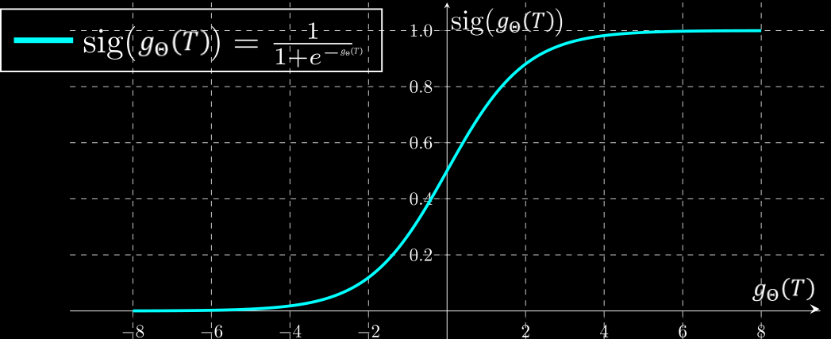
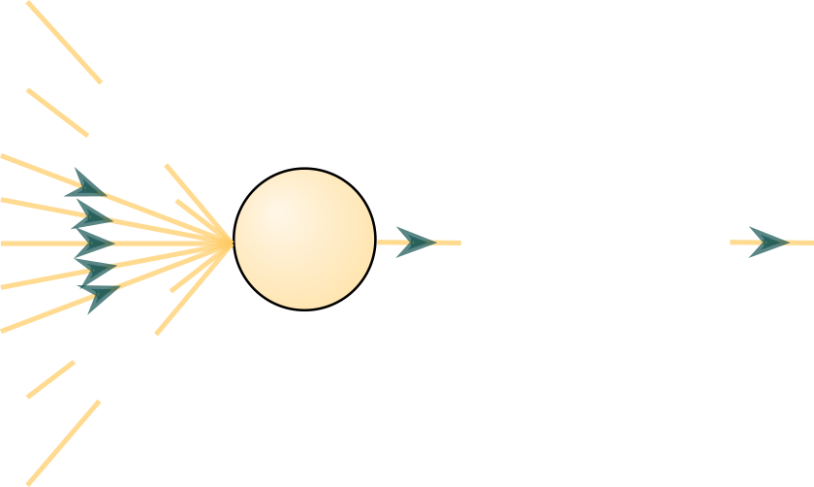
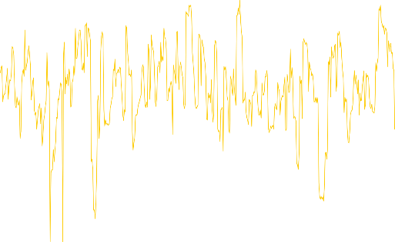





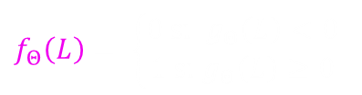








Statistical distinguishers
$$L[j]$$
$$Y=0$$
$Y=$ 1
$$0$$
$$Amplitude$$
$$θ⋅L$$
$$Time sample$$
$$g_{Θ}\left(L\right)=b+ \sum_{i=0}^{D}{Θ_{i}⋅L\left[i\right]}$$
$f_{Θ}\left(L\right)= \left\{\begin{aligned}0 si g_{Θ}\left(L\right)<0 \\ 1 si g_{Θ}\left(L\right)≥0\end{aligned}\right.$
such that
$$g_{Θ}\left(L\right)=b+Θ_{j}⋅L\left[j\right]$$
$$Θ_{0}$$
$$Θ_{1}$$
$$∑$$
$$g_{Θ}\left(L\right)$$
$$Θ_{D−1}$$
$$Θ_{D}$$

Slide 44



Statistical distinguishers
Estimation of $Pr[Y|L]$
Problem: $Pr[Y|L]$ is unknown and device-dependent
Discriminative approach
Given a trace $L$ to which it must associate a sensitive variable $Y$, the discriminative methods approximate the conditional probability $\operatorname{Pr}\left[Y | L\right]$
$$Y=0$$
$Y=1$
$$Y=0$$
$Y=$ 1
$$Amplitude$$
$$Amplitude$$
$$Time sample$$
$$Time sample$$
$$Amplitude$$

Slide 45
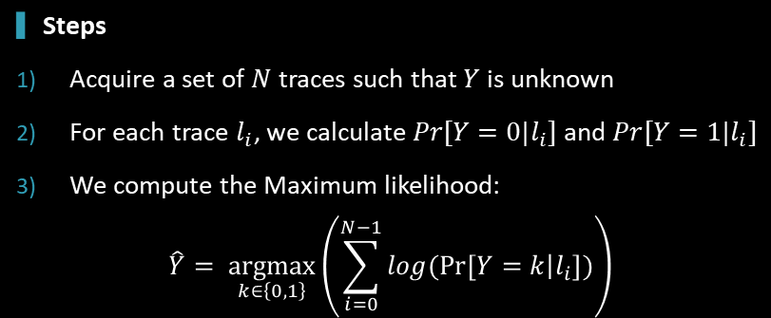
Statistical distinguishers
Estimation of $Pr[Y|L]$
Problem: $Pr[Y|L]$ is unknown and device-dependent
Discriminative approach
Given a trace $L$ to which it must associate a sensitive variable $Y$, the discriminative methods approximate the conditional probability $\operatorname{Pr}\left[Y | L\right]$
$$Y=0$$
$Y=1$
Steps
Acquire a set of $N$ traces such that $Y$ is unknown
For each trace $l_{i}$, we calculate $Pr⁡[Y=0|l_{i}]$ and $Pr⁡[Y=1|l_{i}]$
We compute the Maximum likelihood:
$$\hat{Y}= \underset{k∈\left\{0,1\right\}}{argmax}\left(\sum_{i=0}^{N−1}{log(Pr\left[Y=k | l_{i}\right]{)}}\right)$$
$$Amplitude$$

Slide 46
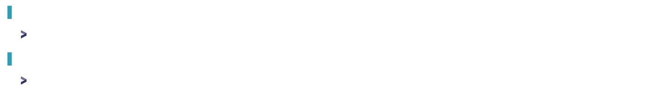
Statistical distinguishers
Estimation of $Pr[Y|L]$
Problem: $Pr[Y|L]$ is unknown and device-dependent
Discriminative approach
Given a trace $L$ to which it must associate a sensitive variable $Y$, the generative methods approximate the conditional probability $\operatorname{Pr}\left[L | Y\right]$
Benefits
Limitations
No hypothesis on the leakage model
Neural networks can be seen as black-box tools
All the tasks (e.g. POIs selection) are automatized
Construction of adequate statistical model
Multiple POIs can be exploited simultaneously

Slide 47

Statistical distinguishers
Generative
Discriminative
$$Y=0$$
$$Y=0$$
$Y=$ 1
$Y=$ 1
$$Amplitude$$
$$Amplitude$$
$$Time sample$$
$$Time sample$$
Strong hypothesis on the leakage model (Gaussian hypothesis)
Performance
The success of attack performances depends on the POIs selection
All the tasks (e.g. POIs selection) are automatized
Interpretability & Explainability
Neural networks can be seen as black-box tools
Confident in the modeling of $\operatorname{Pr}\left[L | Y\right]$
Construction of adequate statistical model

Slide 48
Countermeasures

Slide 49






















Countermeasures
Desynchronization
$$N=16$$
$$5$$
$$8$$
$$10$$
$$0$$
$$…$$
$$1$$
$$7$$
$$3$$
$$pwd\left[5\right]$$
$$pwd\left[8\right]$$
$$pwd\left[10\right]$$
$$pwd\left[0\right]$$
$$…$$
$$pwd\left[1\right]$$
$$pwd\left[7\right]$$
$$pwd\left[3\right]$$
$$⊕$$
$$⊕$$
$$⊕$$
$$⊕$$
$$⊕$$
$$⊕$$
$$⊕$$
$$⊕$$
$${PWD}^{∗}\left[5\right]$$
$${PWD}^{∗}\left[8\right]$$
$${PWD}^{∗}\left[10\right]$$
$${PWD}^{∗}\left[0\right]$$
$$…$$
$${PWD}^{∗}\left[1\right]$$
$${PWD}^{∗}\left[7\right]$$
$${PWD}^{∗}\left[3\right]$$

Slide 50



Countermeasures
Desynchronization
Query 1
Query 2
Query 3
$$HW\left(pwd[2]⊕PWD^{∗}[2]\right)+Z$$
$$HW\left(pwd[14]⊕PWD^{∗}[14]\right)+Z$$
$$HW\left(pwd[5]⊕PWD^{∗}[5]\right)+Z$$

Slide 51

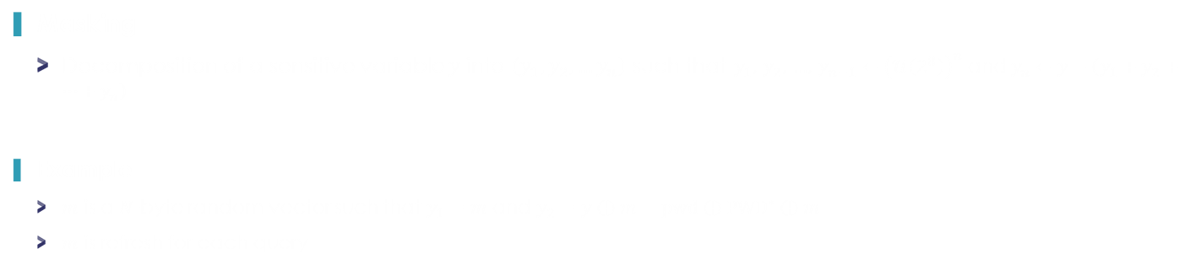


Countermeasures
Masking
Decomposition of a sensitive variable $y$ into $\left(y_{1},y_{2},…y_{n}\right)$ such that $y_{1}$, $y_{2}$, $…$, $y_{n−1}←{\left(𝒰\left(2^{8}\right)\right)}^{n}$ and $y_{n}←y−\left(y_{1}+y_{2}+…+y_{n}\right)$
Example
$m$ is a $N$-byte random vector such that $y_{1}=m$ and $y_{2}=y⊕m=pwd⊕PWD^{∗}⊕m$
$m$ is refresh for each query
2 side-channel attacks are required
Estimation of $Pr[y_{1}|L]$
Estimation of $Pr[y_{2}|L,y_{1}]$

Slide 52
Personal recommendations
Machine-Learning
Side-channel attacks
Online courses
Andrew NG’s course (Coursera): Machine Learning by Stanford University | Coursera, Deep Learning by deeplearning.ai | Coursera
Books
Shai Shalev-Shwartz and Shai Ben-David. Understanding Machine Learning: From Theory to Algorithms.
Christopher M. Bishop and Hugh Bishop. Deep Learning: Foundations and Concepts.
Open source Librairies:
Tensorflow, PyTorch
International conferences
NeurIPS, ICML, ECML-PKDD, CVPR, …
Online courses
Amir Moradi’s course: https://www.youtube.com/@AmirMoradi_impsec/playlists
Books
Embedded Cryptography 1 | Wiley
Embedded Cryptography 2 | Wiley
Embedded Cryptography 3 | Wiley
Public datasets:
ASCAD, AES_HD, AES_RD, DPA contest, …
Open source Librairies:
For side-channel attacks: SCALib – the Side-Channel Analysis Library: https://scalib.readthedocs.io/
For deep learning: AISyLab’s framework - GitHub - AISY_Framework: Deep Learning-based Framework for Side-Channel Analysis
International conferences
CHES, Cascade, Crypto, Eurocrypt, Asiacrypt, …

Slide 53
Demonstration

Slide 54
Physical Attacks against Neural Networks Benefits from an adversary’s viewpoint

Slide 55





Evasion attack
It’s a 7 !
Adversarial examples, KESAKO ?
It’s a 3 !
Could be difficult to consider in practice
White-box scenario: knowledge of the IA architecture, weights, activation functions, etc…
Black-box scenario: partial knowledge on the AI system (e.g., logits)
Practical issue: How can we generate adversarial examples without any knowledge on the device?
Notes:
Introduire les notions « logits »…

Slide 56



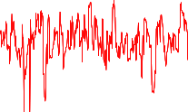

Evasion attack
Practical issue: How can we generate adversarial examples without any knowledge on the device?
Our idea :
1) Extraction of the logits through the use of side-channel attacks
2) Use the state-of-the art adversarial attacks (e.g. ZOO*)
It’s a 3 !
It’s a 7 !
$$ZOO( + )$$
* ‘‘ZOO: Zeroth Order Optimization Based Black-box Attacks to Deep Neural Networks without Training Substitute Models’’, Chen et al., AISec '17

Slide 57
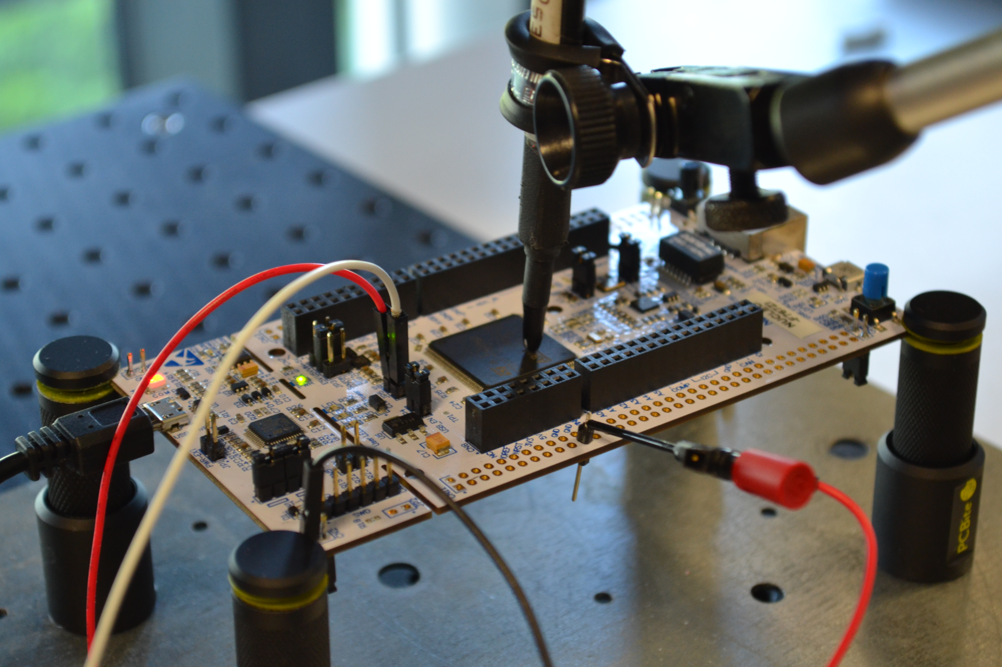
Evasion attack
Device: ARM Cortex-M7 MCU on a STM32F767 board (216 MHz)
Embedded AI: a 8-bit quantized denseNET (weights, activations, inputs) with NNOM* tool
Classification problem: 10 classes (MNIST)
Channel: Electromagnetic signal (EMV-Technik RF-U 2,5 probe)
* GitHub - majianjia/nnom: A higher-level Neural Network library for microcontrollers.

Slide 58


Evasion attack
It’s a 0
It’s a 1
It’s a 2
It’s a 3
It’s a 4
Neural network
Softmax
It’s a 5
It’s a 6
It’s a 7
It’s a 8
It’s a 9
Logits
Probability

Slide 59
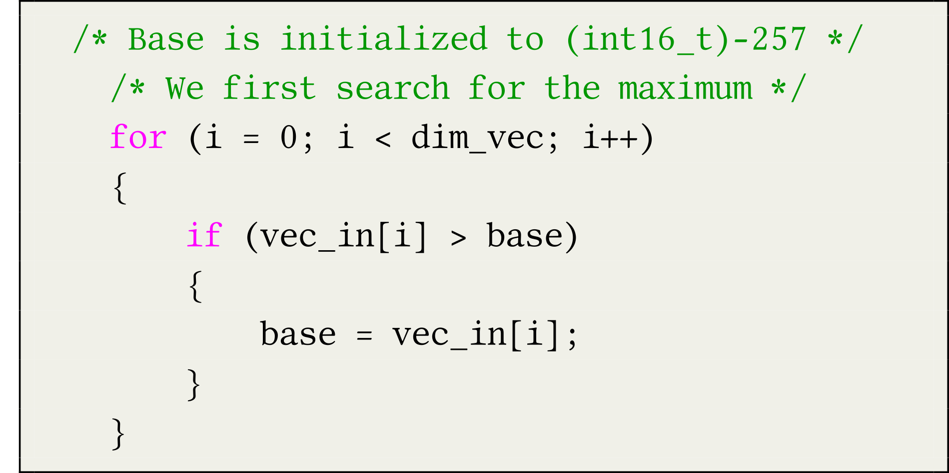














Evasion attack
Targeted function: Softmax function
C code related to the softmax function
vec_in
$$l_{0}$$
$$l_{1}$$
$$l_{2}$$
$$l_{3}$$
$$l_{4}$$
$$l_{5}$$
$$l_{6}$$
$$l_{7}$$
$$l_{8}$$
$$l_{9}$$
$$base=0$$
$$base=l_{0}$$
$$base=l_{7}$$
$$base=l_{4}$$

Slide 60
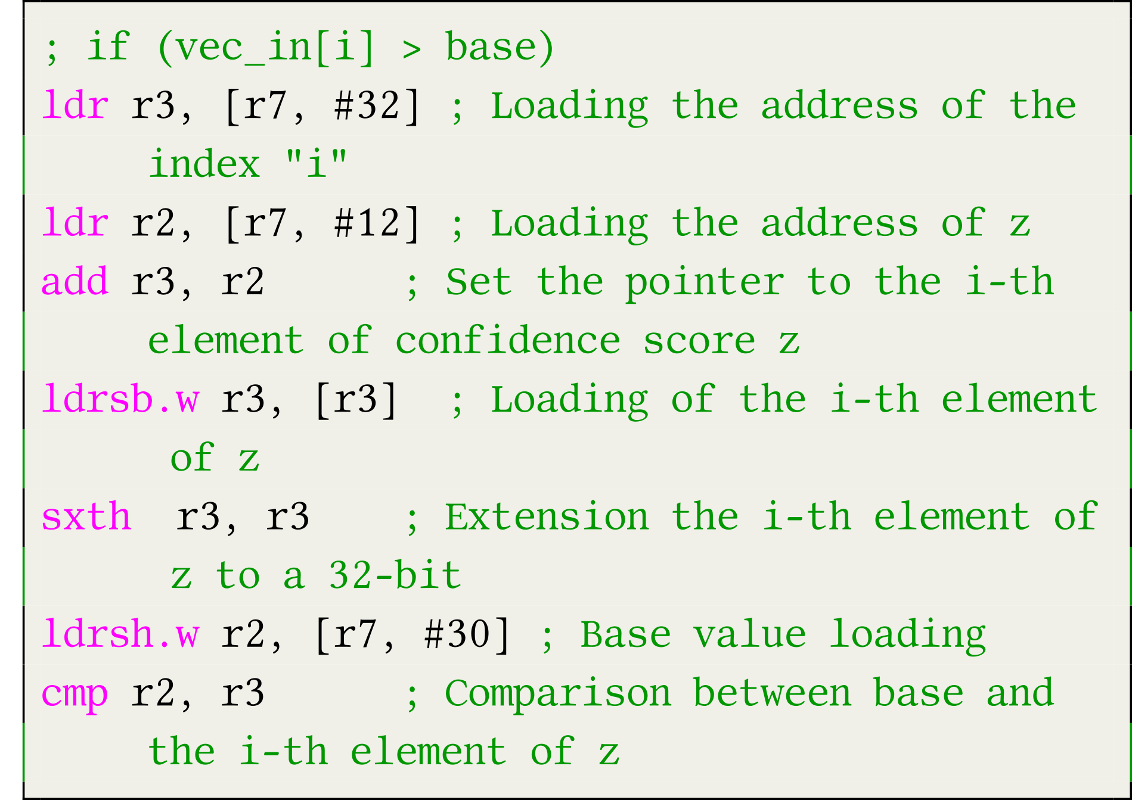
Evasion attack
Targeted function: Softmax function
Assembly code
C code related to the softmax function

Slide 61


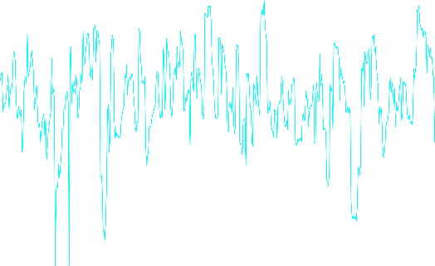
Evasion attack
Side-Channel attacks
Notes:
Corrèle le code de la fonction avec le rayonnement électromagnétique
Comme pour la crypto

Slide 62

Evasion attack
Experimental results
Profiled attack
Black-box scenario (the attacker has no knowledge on the targeted AI)
Template
Logistic regression
Deep learning
We successfully extract all the logits within 5 traces
Logits

Slide 63
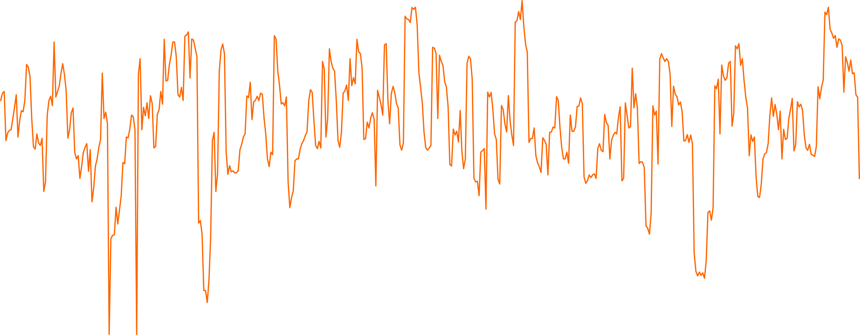



Evasion attack
Practical issue: How can we generate adversarial examples without any knowledge on the device?
Our idea :
1) Extraction of the logits through the use of side-channel attacks
2) Use the state-of-the art adversarial attacks (e.g. ZOO*)
It’s a 7 !
x3
Logits
* ‘‘ZOO: Zeroth Order Optimization Based Black-box Attacks to Deep Neural Networks without Training Substitute Models’’, Chen et al., AISec '17

Slide 64



Evasion attack
Generate an adversarial example
Application of the Zeroth Order Optimization* (ZOO) method
Recap (ZOO)
Let $X∈ℝ^{n}$ be an image and a wrong targeted class that an attacker wants to predict $y^{∗}∈𝒴$, she looks for an adversarial example $X^{∗}∈ℝ^{n}$ such that the following relation is satisfied:
$${\left\|X^{∗}−X\right\|}_{2}^{2}+c×g_{obj}\left(X^{∗},y^{∗}\right),$$
with $g_{obj}\left(X^{∗},y^{∗}\right)=\max\left(\max_{y≠y^{∗}}\left(\log\left(F\left(X^{∗}\right)\right)\right)\left[i\right]−\log\left(F\left(X^{∗}\right)\right)\left[y^{∗}\right], 0\right)$
Original image
Adversarial example
$$y^{∗}=7$$
$$y^{∗}=3$$
* ‘‘ZOO: Zeroth Order Optimization Based Black-box Attacks to Deep Neural Networks without Training Substitute Models’’, Chen et al., AISec '17

Slide 65

Evasion attack
Practical issue: How can we generate adversarial examples without any knowledge on the device?
Our idea :
1) Extraction of the logits through the use of side-channel attacks
2) Use the state-of-the art adversarial attacks (e.g. ZOO*)
It’s a 3 !
$$ZOO( + )$$
* ‘‘ZOO: Zeroth Order Optimization Based Black-box Attacks to Deep Neural Networks without Training Substitute Models’’, Chen et al., AISec '17

Slide 66

Thank you Contact: gabriel.zaid@thalesgroup.com

